Slide 1
Workforce and Training
Extended Flu and COVID-19 Vaccination Programme
DRAFT – OFFICIAL SENSITIVE – NOT FOR WIDER CIRCULATION
National Specification for Occupational Health services to be able to administer the COVID-19 vaccination to Trust Staff
03rd December 2020 v2.0

Slide 2
Occupational Health Specification
This specification has been developed to cover the Occupational Health clearance required for both existing NHS workforce and the workforce recruited to support the COVID-19 vaccination programme. This specification is underpinned by the concept that all staff recruited as vaccinators should be recruited for that purpose only and should not be deployed elsewhere in the hospital. The scope of this specification is the administration of the COVID-19 vaccination to NHS Trust staff and can be further developed for expanded COVID-19 vaccination cohorts. This specification is based on the delivery of vaccination through a National Protocol.
Health Clearance Standards
Occupational Health Services within NHS Trusts have existing guidance on standards for fitness for NHS employees and these standards should continue to be applied for existing staff who choose to be vaccinators. New staff appointed specifically for the COVID-19 vaccination programme should as a minimum be subject to the same checks as those appointed to work in the national Mass Vaccination scheme but NHS Trusts can choose to apply their existing health clearance standards.
Vaccination Status
Clinical staff in NHS Trusts will already have health clearance, be immunised and no additional clearance is required for COVID-19 vaccinators.
Non-clinical staff and returning staff should as a minimum have non-confidential health questionnaire (ref 1) (if already employed in the NHS this will have been done) administered by recruitment and a referral to Occupational health is only required if there is a positive response. Clinically Extremely Vulnerable, Clinically Vulnerable staff and pregnant woman are likely to be better suited to non-patient facing roles due to the volume of direct patient contact. In addition staff should receive training on how to manage a needlestick, including reporting processes and use of vaccine hub protocol to manage needlesticks with immediate access to first Hep B given at the time of the needlestick, preferably followed by a rapid course (0,1 & 2 months). It is acknowledged that some NHS Trusts may have the capacity and can use their discretion to apply a higher level of clearance standards.

Slide 3
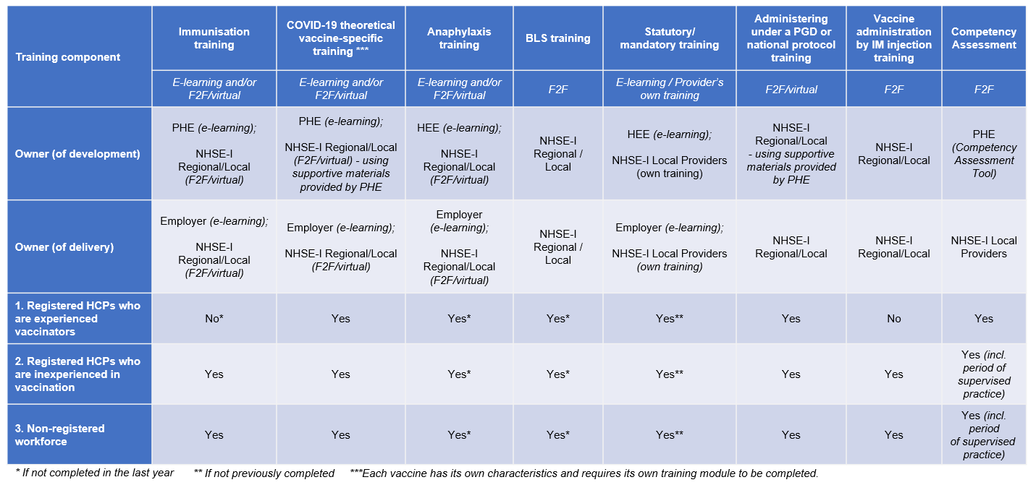
Occupational Health Specification
National training requirements have been developed to support the COVID-19 vaccination as well as recommendations for the minimum training required for each new workforce role. There is a requirement to have a local induction in place and ensure all workforce have had competencies assessed. Providers should keep their own training records for governance purposes. The training requirements are outlined below;

Slide 4
Occupational Health Specification
Prioritisation for vaccine
In principle, we do not recommend prioritisation and the vaccine should be offered to all staff in a healthcare environment.
Local decision making should be used to operationalise the delivery of the vaccine.
There are many reasons for this:
Evidence from serological testing has not demonstrated a significant difference between different occupational groups
All workers, regardless of their background, should be included in the same overarching approach to workforce risk management as evidenced in the publication of documentation produced by the working party led by Public Health England, Health and Safety Executive, and Faculty of Occupational Medicine (ref 2)
When there is sufficient supply of vaccine the demand for COVID vaccine for NHS staff should not overwhelm the vaccination programme. There is a recognised risk that prioritisation may increase wastage through limiting the demand.
Whilst the vaccine supply is limited staff that have been identified through a risk assessment by employers as ‘higher risk’ should be contacted proactively and offered the vaccine.

Slide 5
Occupational Health Specification
Data capture
The collection and capture of vaccination records for Occupational Health is a key consideration.
It is recommended NHS Trusts have their own local system for appointment bookings, which might form part of an existing Occupational Health system or stand alone.
There should be consideration given to promptly link the data from the booking system to NIVs.
NIVs will be ready inline with vaccination availability and will deliver reporting back to GP systems within 24 hours. It is a local decision for Occupational Health to transfer this data to their occupational health record.
Consideration should be given to ensure there is an appropriate recall system in place.

Slide 6
Occupational Health Specification
References
https://www.nhsemployers.org/-/media/Employers/Publications/employment-check-standards/Work-health-assessments.pdf?la=en&hash=32AF65BC6973CA194A03B7FBA47FBDC98FBA25EB
https://www.gov.uk/government/publications/covid-19-mitigation-of-risks-in-occupational-settings-with-a-focus-on-ethnic-minority-groups
This specification has been developed through the following specialist reference group:
Dr Shriti Pattani
Dr Ali Hashtroudi
Dr Anne de Bono
Dr Richard Preece
Janette Barnes

