Slide 1


World Menopause Day comms toolkit

Slide 2


What is the campaign?
World Menopause Day takes place every year on Tuesday 18 October and aims to raise awareness of the menopause and the support options available for improving health and wellbeing.
The theme for 2022 is cognition and mood.
With more than three quarters of menopausal women having symptoms, and hundreds of thousands of people leaving their jobs as a result, at NHS England we are working hard to improve the experiences of individuals experiencing the menopause in the workplace.
But we want everyone to start talking about the menopause.
So whether its tweeting your support, sharing your own experiences with one or one hundred people, showcasing examples of best practice or signposting to helpful materials and resources, get involved with the conversation on 18 October and help break down the taboo.

Slide 3
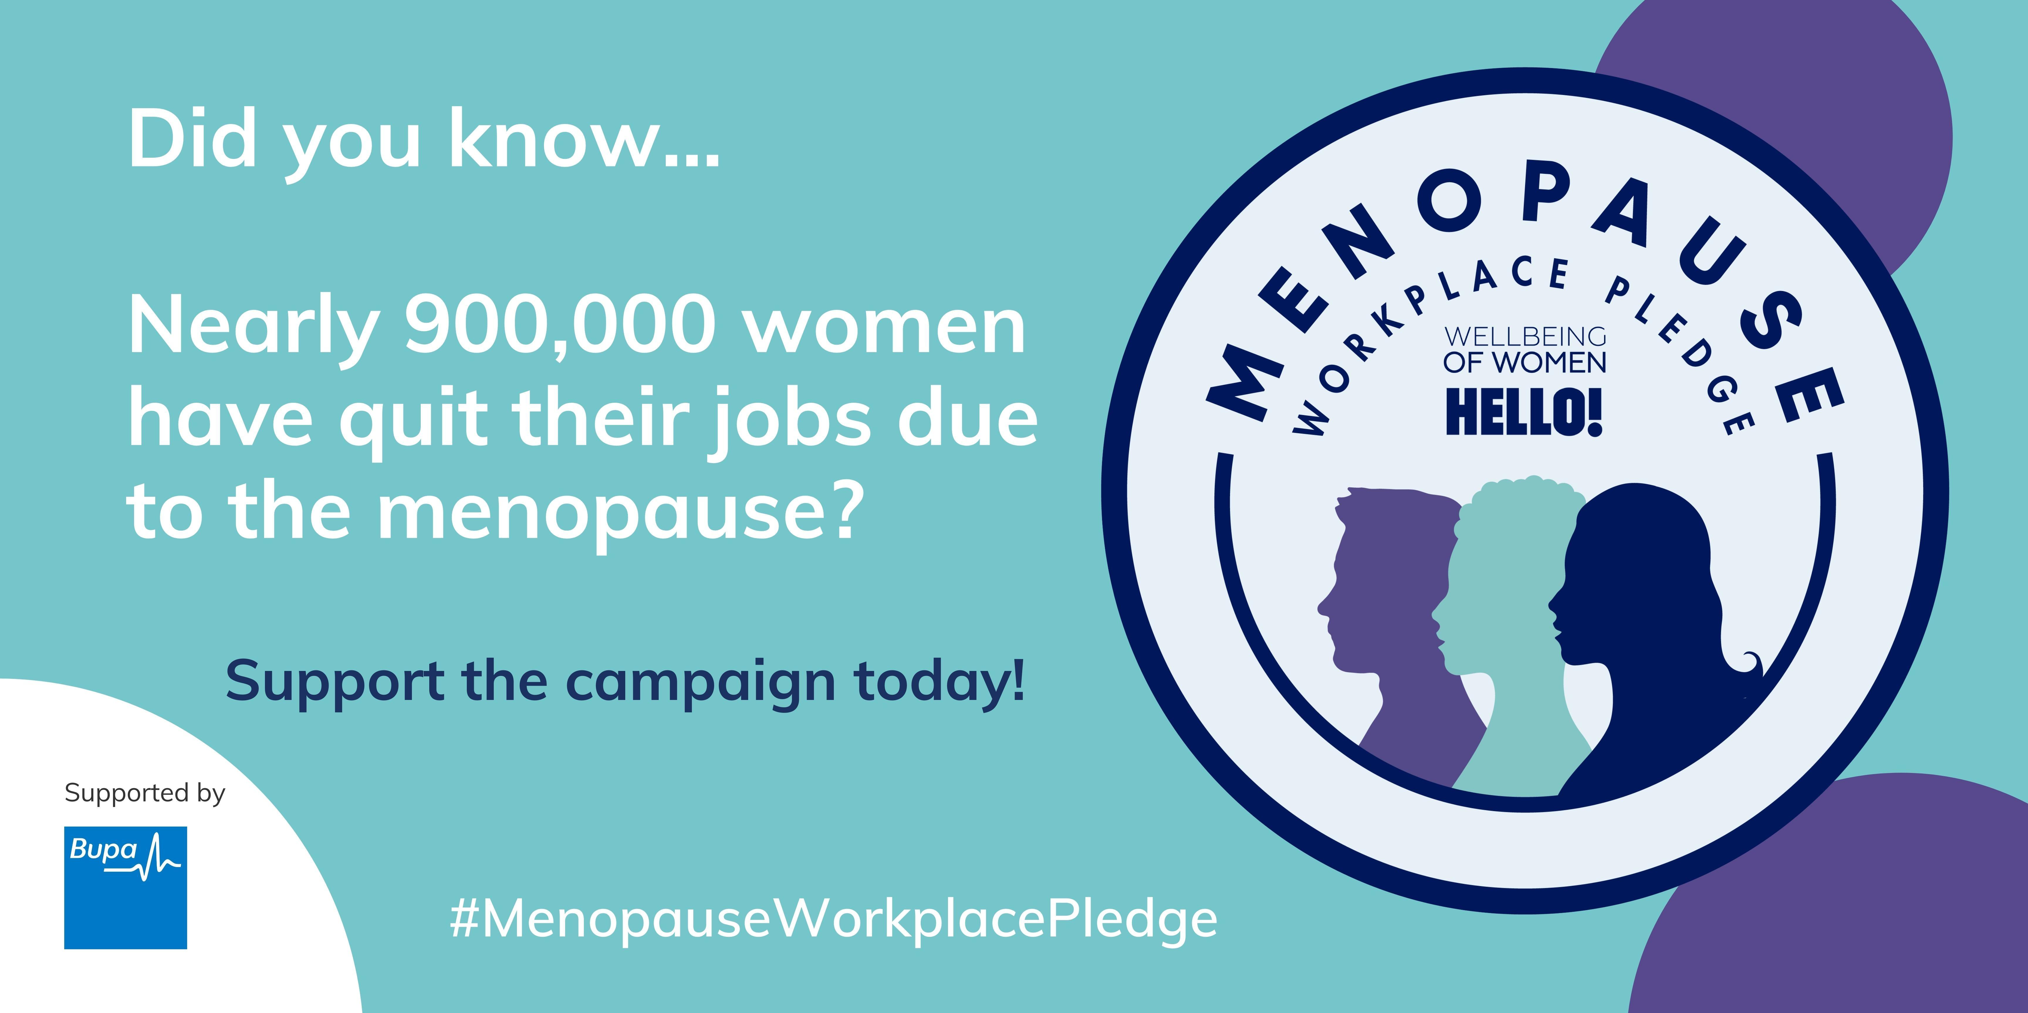
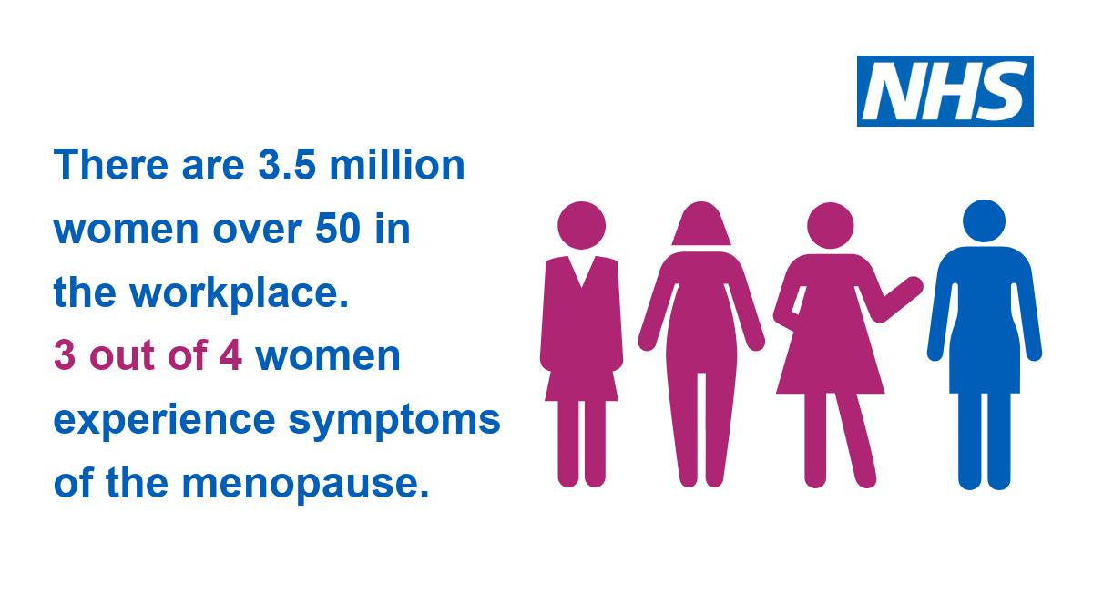
Audience and insights
Audience(s)
NHS England staff
The public (especially those experiencing the menopause or supporting someone going through the menopause)
Key stats or insights
A 2019 survey conducted by BUPA and CIPD found that three in five menopausal women were negatively affected at work and that almost 900,000 women in the UK left their jobs because of menopausal symptoms.
According to research for the Government Equalities Office, menopausal women are the fastest growing demographic in the workplace: the biggest increases in employment rates over the last 30 years have been for women aged 60-64 (from 18% to 41%) and for women aged 55-59 (from 49% to 69%).
Data from NHS Digital shows women make up 74% of the 1.3 million people in the NHS workforce and in nursing, 89% of employees are female (48.9% of whom are aged 45 and over).

Slide 4
Key messages
Key messages
The menopause is a natural part of ageing that will affect all women at some point in their lives, so it is crucial that individuals feel supported both personally and in the workplace.
Symptoms of the menopause are varied and can often be mistaken for other conditions, but most commonly include hot flushes, difficulty sleeping, poor concentration, anxiety and headaches.
A GP, nurse or pharmacist can give you advice and help with your menopause symptoms and can discuss possible treatment options available to you.
With menopausal women the fastest growing demographic in the workplace, employers can take simple steps to help them feel more supported, such as offering flexible working patterns, providing alternative uniforms or lowering office temperatures.
Call to action
Being aware of the symptoms of the menopause can be life-changing for women experiencing the transition, and can help their colleagues, friends and relatives better understand what they are going through. More information about the transition is available on the NHS website and tips on self-care and managing symptoms can be found here.

Slide 5

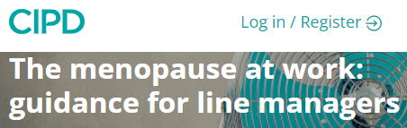
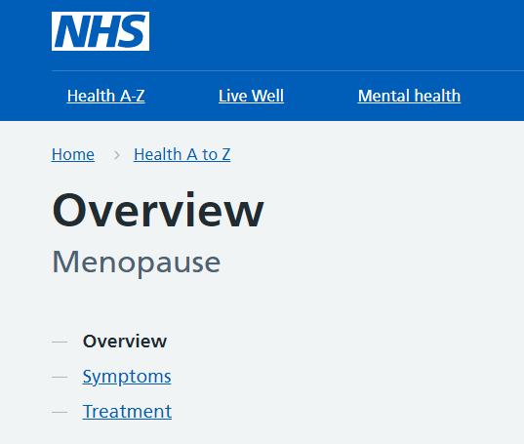

Top three ways to help
Mark World Menopause Day in bulletins, staff emails, on intranets and on your social media channels – reshare our national content or create your own. The official hashtag is #WorldMenopauseDay2022
Highlight examples of best practice in your regions and share ideas of how other systems can support their staff
Signpost to internal and external resources and materials that can help colleagues experiencing the menopause and those supporting them

Slide 6
Resources to use
Specific information on the NHS England website about supporting colleagues affected by the menopause.
For internal staff, information on supporting people in early and late career is available here, which also includes a self-care factsheet developed by the NHS and the Self Care Forum, and guidance on recording menopause-related sickness (available on the ESR).
The Unmind & Headspace apps, which NHS staff can access for free, have dedicated menopause areas.
The Training sessions are offered to NHS staff on how to have safe and effective wellbeing conversations.
More information to address menopause and the workplace is available on the NHS Employers website including case studies which highlight improvements that can be made to the workplace environment, sharing good practice that is taking place in many organisations.
The Chartered Institute of Personnel and Development (CIPD) has developed resources to download to help you break the stigma within your team/organisation, such as Let’s Talk Menopause: Facts and a podcast called The ultimate taboo.
CIPD also provide support for line managers and HR professionals.

Slide 7

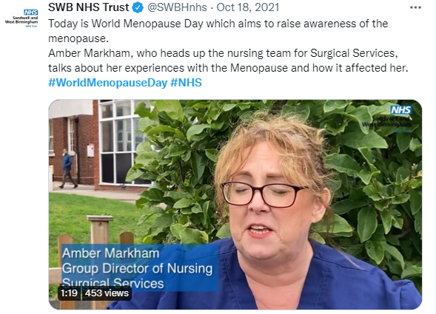
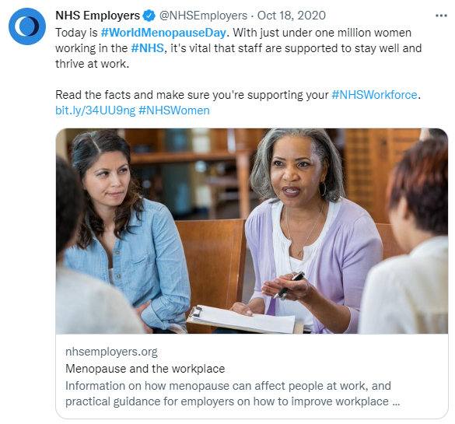
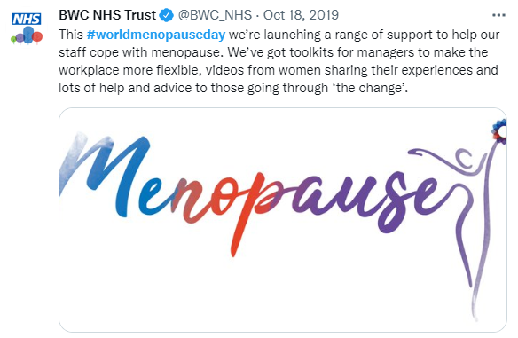
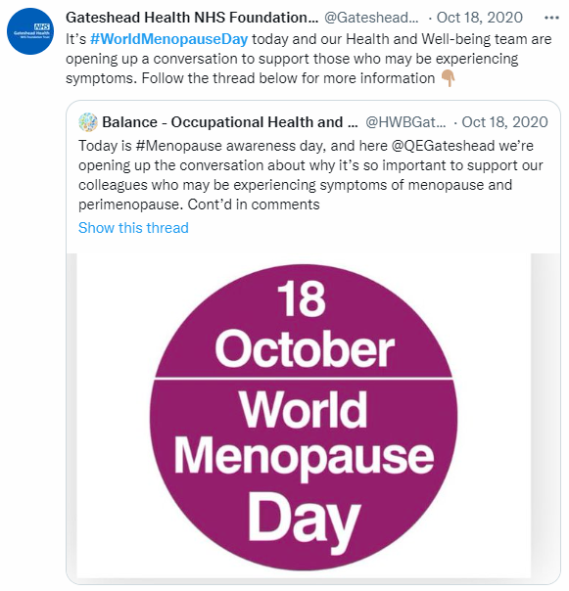
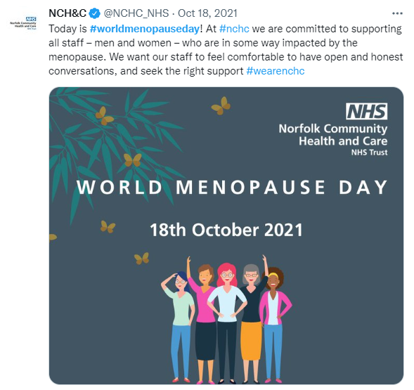
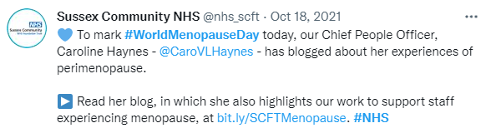
Example social media posts
Example posts for Twitter

Slide 8

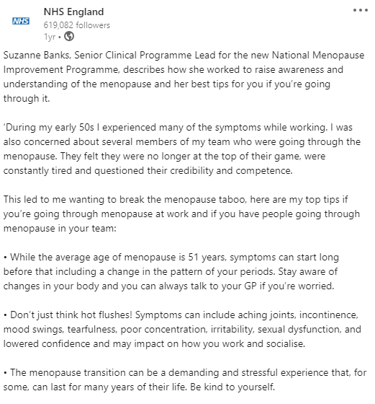
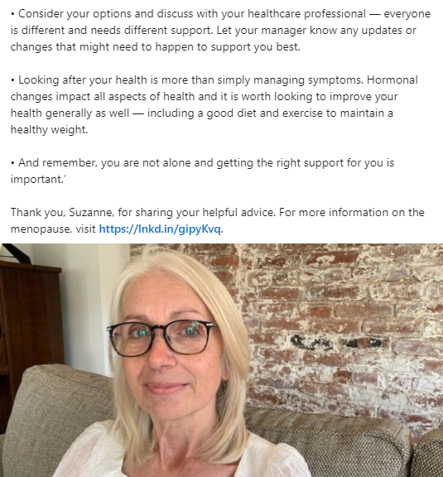
Example post for LinkedIn

Slide 9

Example long copy
Today is World Menopause Day, and people across the globe are coming together to raise awareness of this natural transition that millions experience - but which remains shrouded in taboo.
The menopause usually occurs between the ages of 45 and 55 and symptoms can last up to ten years, including everything from fatigue and hot flushes to anxiety, insomnia and problems with concentration and memory.
For around a quarter of women, these symptoms can be severe, and have a huge impact on their day-to-day life. And it's not just an individual's problem either. The menopause can impact an organisation as a whole, with many women quitting their jobs, reducing their hours or passing up promotions because of their symptoms and the lack of support in their workplace.
In fact, research shows that 59% of women in the UK say the menopause has negatively impact them at work, and almost one million people have quit their jobs altogether.
For more information about the symptoms of the menopause and about available treatment options including hormone replacement therapy (HRT), head to the NHS website, and check out this self-care factsheet for tips on how you can look after yourself while going through the transition.

Slide 10
Example short copy
Today is World Menopause Day, and this year’s theme is cognition and mood. Three quarters of women going through the menopause will experience symptoms, which can include insomnia, anxiety and problems with concentration and memory.
These symptoms can negatively impact people at work and hundreds of thousands of women have left their jobs as a result, so it is more important than ever that we continue the conversation around menopause and ensure everyone feels comfortable, confident and supported in both their personal and professional lives.
To learn more about the menopause, visit https://www.nhs.uk/conditions/menopause/

Slide 11
Find out more!
World Menopause Day was created by the International Menopause Society (IMS). Head to their website for more details and useful resources: https://www.imsociety.org/
Information about the menopause is available on the NHS website, including signs and symptoms, tips on looking after yourself, and advice on when to seek further treatment or advice:
https://www.nhs.uk/conditions/menopause/
And for thoughts or feedback on this comms toolkit please contact strategic.comms@nhs.net

