Slide 1





‘The Wounded Healer’: Harnessing the Power of Storytelling to Reject the Stigma attached to Mental Health Conditions in Healthcare Professionals and Students
2025 NHS Health at Work Network Annual Conference
Warwickshire, UK
Professor Ahmed Hankir MBChB MRCPsych
Yvonne YuRichko Professor of Academic Psychiatry, Carrick Institute for Graduate Studies, USA
Honorary Visiting Professor, School of Medicine, Cardiff University, UK
Assistant Professor of Psychiatry, Western University, Canada

Slide 2
Outline
Provide background information about the mental health of healthcare professionals and students.
Define stigma, trace its origins and describe its far-reaching ramifications.
Share and signpost my recovery journey.
Present and ‘perform!’ The Wounded Healer - an Expert by Personal and Professional Experience (EPPE) led anti-stigma intervention.

Slide 3
1. The Mental Health of Healthcare Professionals and Students.

Slide 4



Slide 5

The Mental Health of Healthcare Professionals
Mental health problems are common in healthcare professionals and students (Harvey B et al. 2021.)
The pandemic placed a huge strain on the mental health of healthcare workers (Lamb et al. 2023.)
400 doctors die by suicide every year in the US alone (AFSP).

Slide 6
‘A survey of over 2100 physicians who met the diagnostic criteria for a mental disorder revealed that 50% were reluctant to seek professional help because of fear of stigmatization…’ (Gold et al 2016.)

Slide 7
2. Mental Health Stigma: Origins, Sources and Far-Reaching Ramifications…

Slide 8

Stigma and Social Exclusion

Slide 9
Historically, a stigma was a scar from a burn or cut to the skin of Greek criminals or traitors…
The mutilation was a sign of disgrace…
Stigma still alive and well today…

Slide 10

“With breast cancer, people ran towards me with open arms and hugged me. With depression, people ran away…”
Trisha Goddard
British Television Personality

Slide 11

Stigma is a formidable barrier to mental healthcare services (WHO 2022).

Slide 12
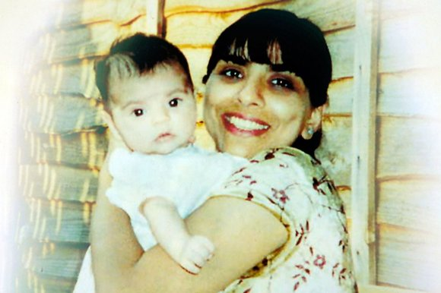
Dr Daksha Emson BSc (Hons), MBChB, MSc, MRCPsych
(1966 – 2000) (North East London Strategic Health Authority Report 2003.)

Slide 13
Stigma is killing people!!!

Slide 14
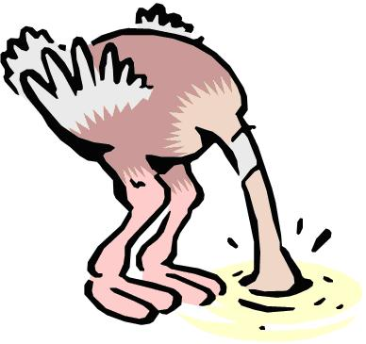
Stigma is like mental illness – those who ‘suffer’ from it are often in denial…

Slide 15
3. Deconstructing and Challenging Mental Health Related Stigma…

Slide 16



Components of Stigma
Problems of knowledge (ignorance) (Thornicroft et al, 2022.)
Problems of attitude (prejudice) (Thornicroft et al, 2022.)
Problems of behaviors (discrimination) (Thornicroft et al, 2022).

Slide 17



Challenging Stigma
Protest (Thornicroft et al, 2022.)
Education (Thornicroft et al, 2022.)
Contact (Thornicroft et al, 2022.)

Slide 18

The Power of Contact…
‘Social contact is the most effective way of reducing mental health related stigma in adults…’ (Corrigan et al, 2012).

Slide 19
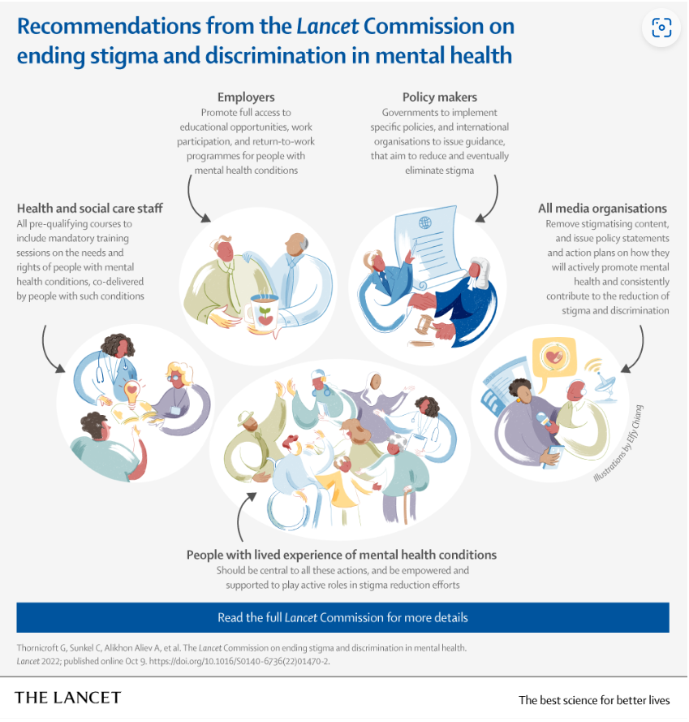
‘Nothing about us without us…’

Slide 20
Coming Out Proud and Self-Stigma
Many people with mental illness often choose between concealment and ‘disclosure’ (Rusch et al, 2014).
COP is a programme that offers support with making this difficult decision (Rusch et al, 2014).
An RCT on COP and revealed that it had immediate positive effects on disclosure and stigma stress related variables (Rusch et al 2014).

Slide 21
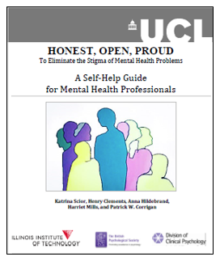

Slide 22



Slide 23



Slide 24


Slide 25

The application of art and literature to medicine…

Slide 26

‘In order to restore the human subject at the center – the suffering, afflicted fighting human subject – we must deepen a case history to a narrative or tale…’
Oliver Sacks

Slide 27
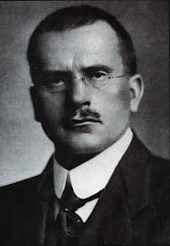
The Wounded Healer Archetype
‘It is our own hurt that gives us our measure of our power to heal…’
Carl Jung

Slide 28
2012 RCPsych Morris Markowe Award Winner
Dr Claire Polkinghorn: Doctors go Mad too…
“…As a psychiatrist, I had hoped that I was pretty good at empathising with my patients… However, the last nine months of my life has taught me more about mental illness than years of clinics, ward-rounds, home visits or reading psychiatric literature…”

Slide 29
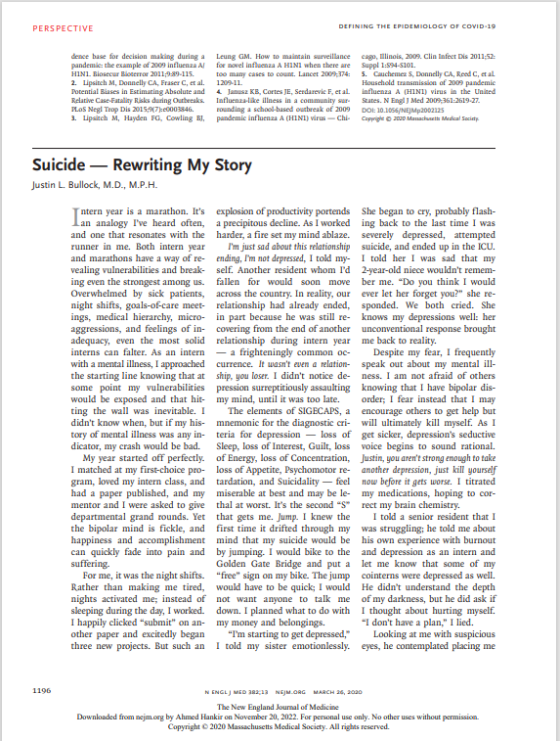
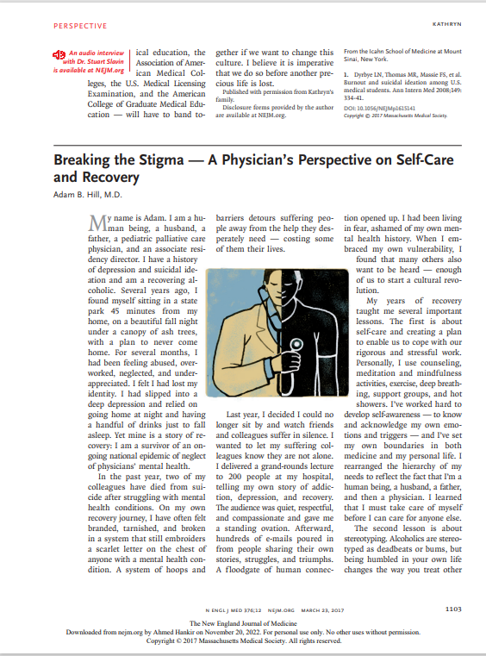

Slide 30
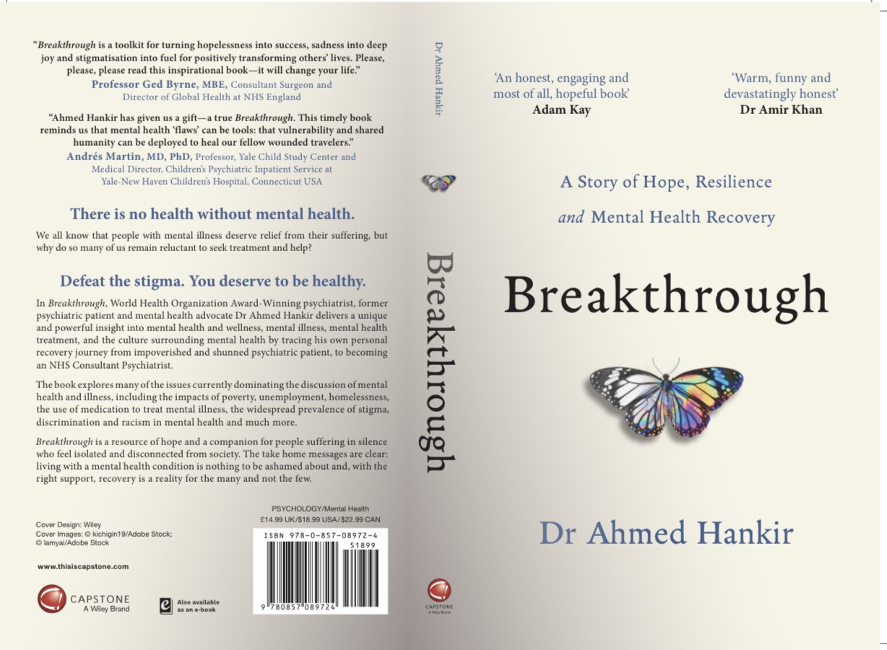

Slide 31


Slide 32

‘Everyone had a breaking point, weak or strong, cowardly or courageous, war frightened everyone witless…’
C.S Myers

Slide 33

‘Insanity is much like gravity; all it takes is a little push…’
The Joker

Slide 34


Slide 35
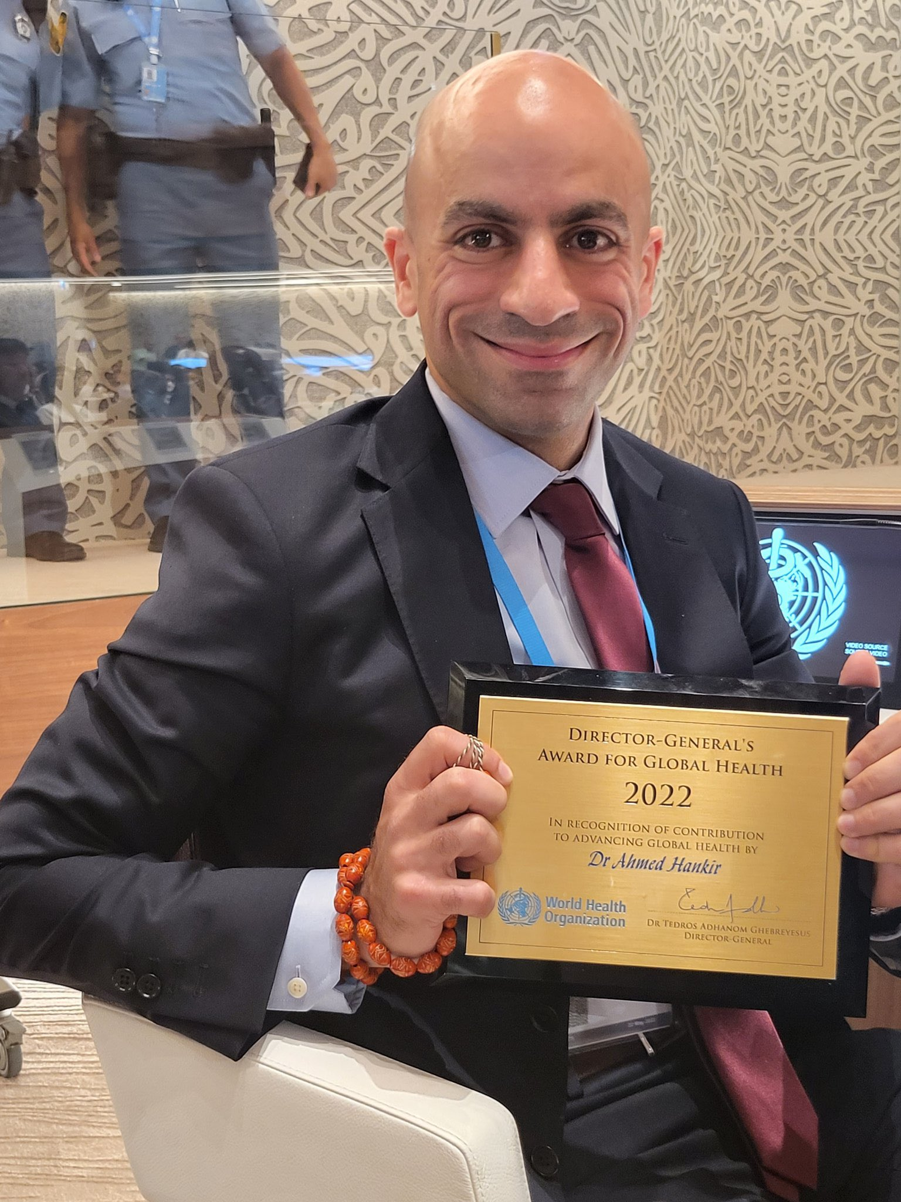
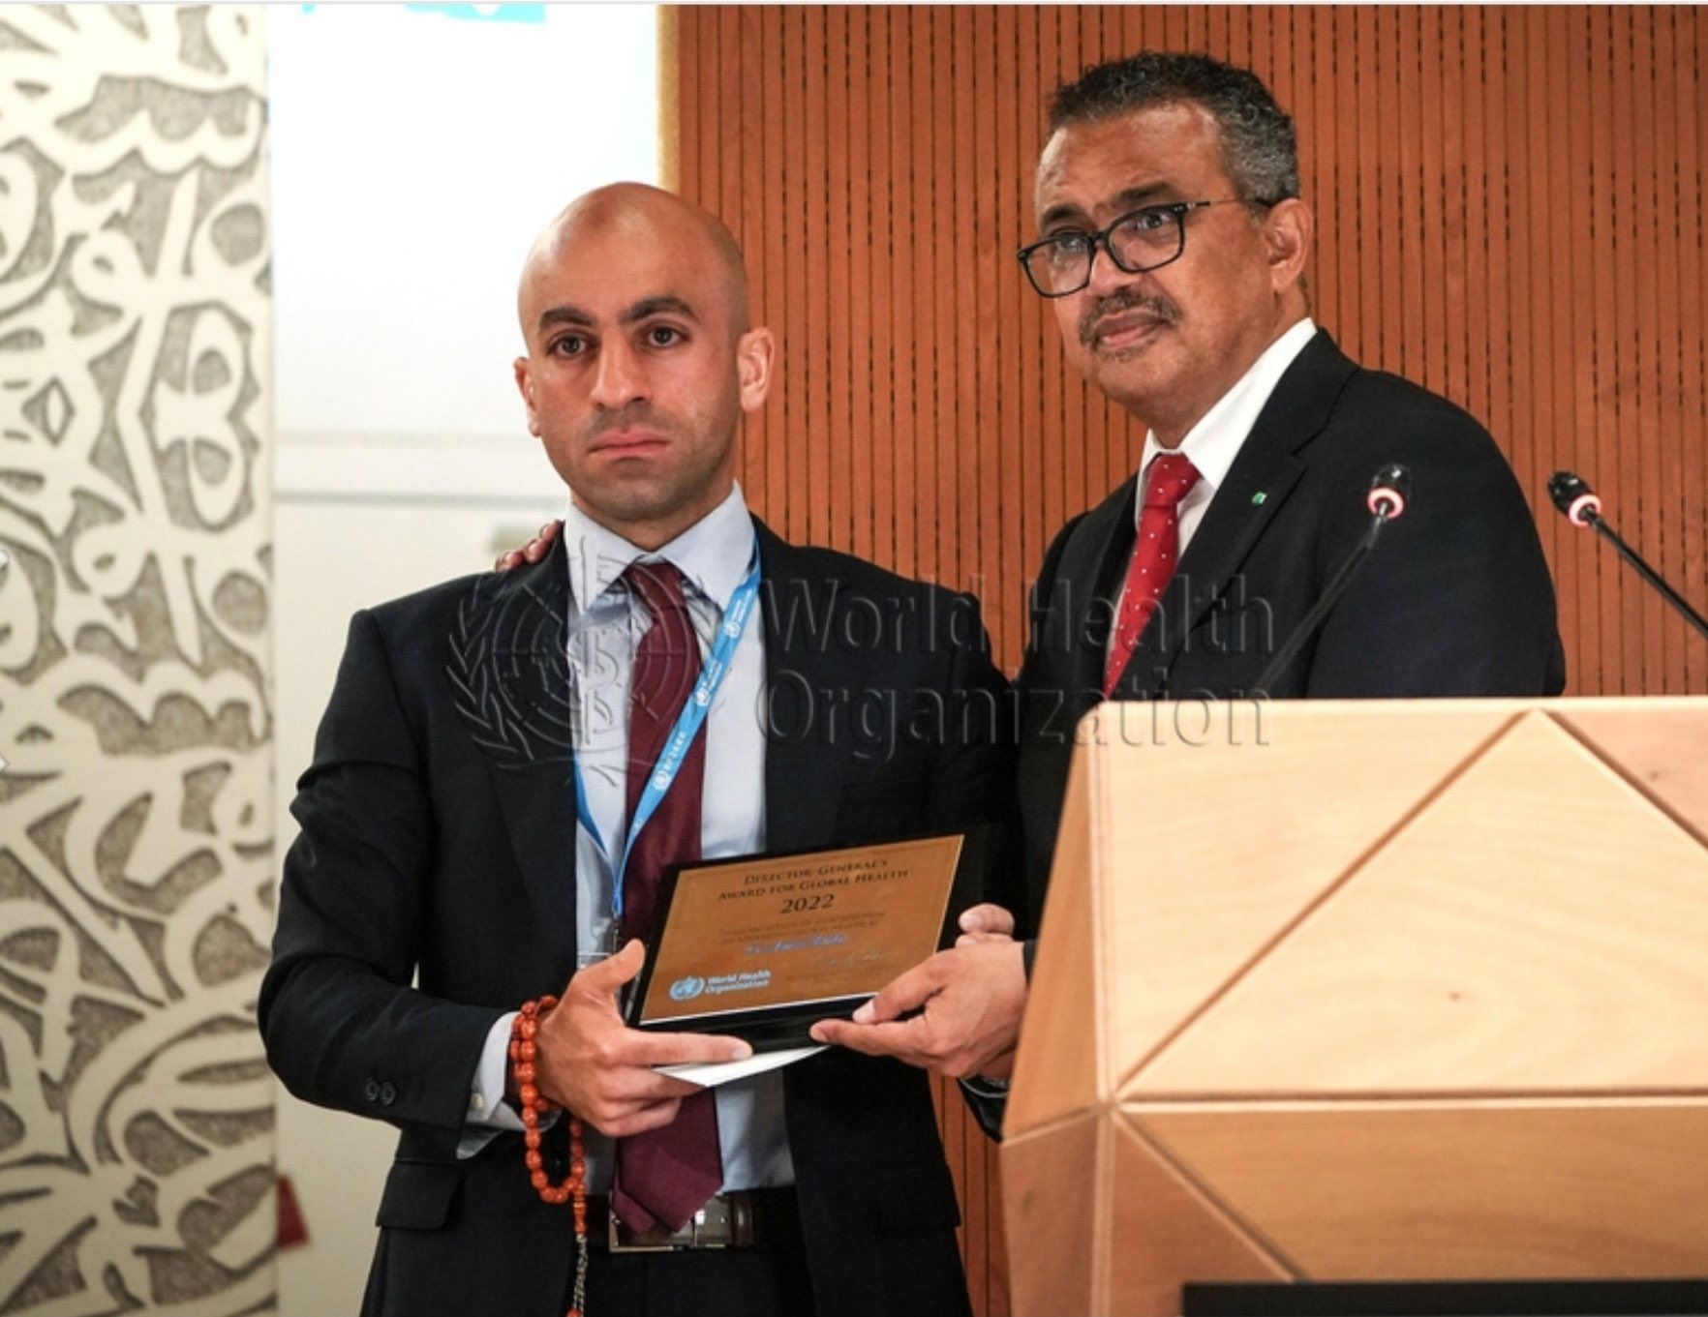

Slide 36
4. The Wounded Healer…

Slide 37
“Conventional education on mental illness alone does not reduce stigmatizing attitudes and behaviors in medical students…”
Canadian Psychiatric Association

Slide 38
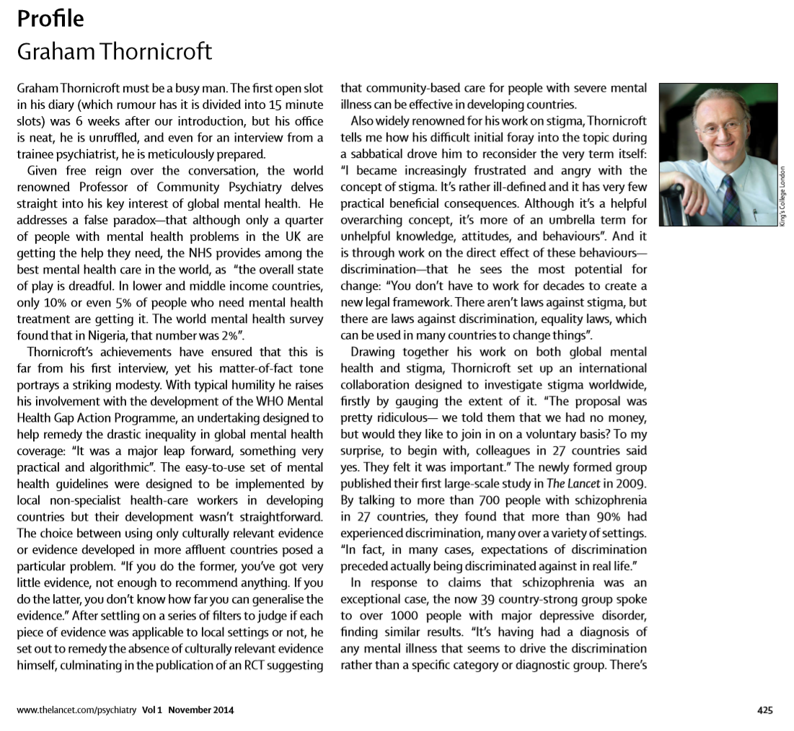


Slide 39
The Wounded Healer
“An innovative method of teaching that blends the performing arts and storytelling with psychiatry…”
Traces recovery journey of a ‘Wounded Healer’ i.e., an Expert by Personal and Professional Experience (EPPE).
Aims are to Engage, Entertain and to Educate to debunk myths, reduce stigma and encourage help seeking.

Slide 40
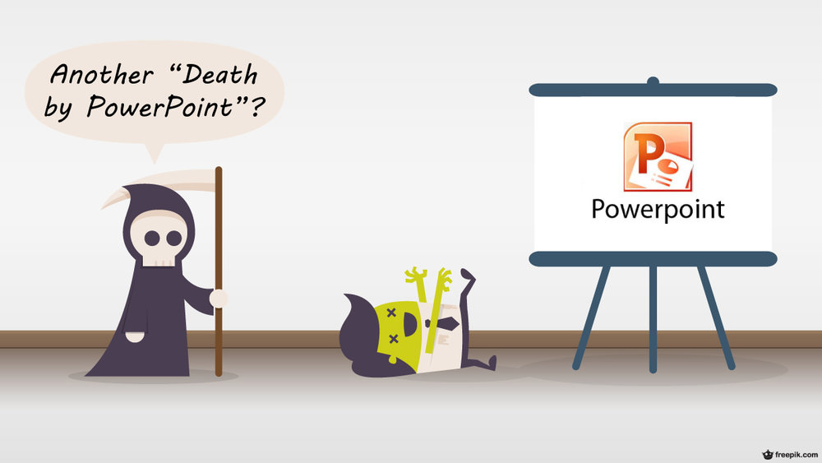

Slide 41


‘The path of the righteous man…’ Ezekial 25:17

Slide 42


Slide 43
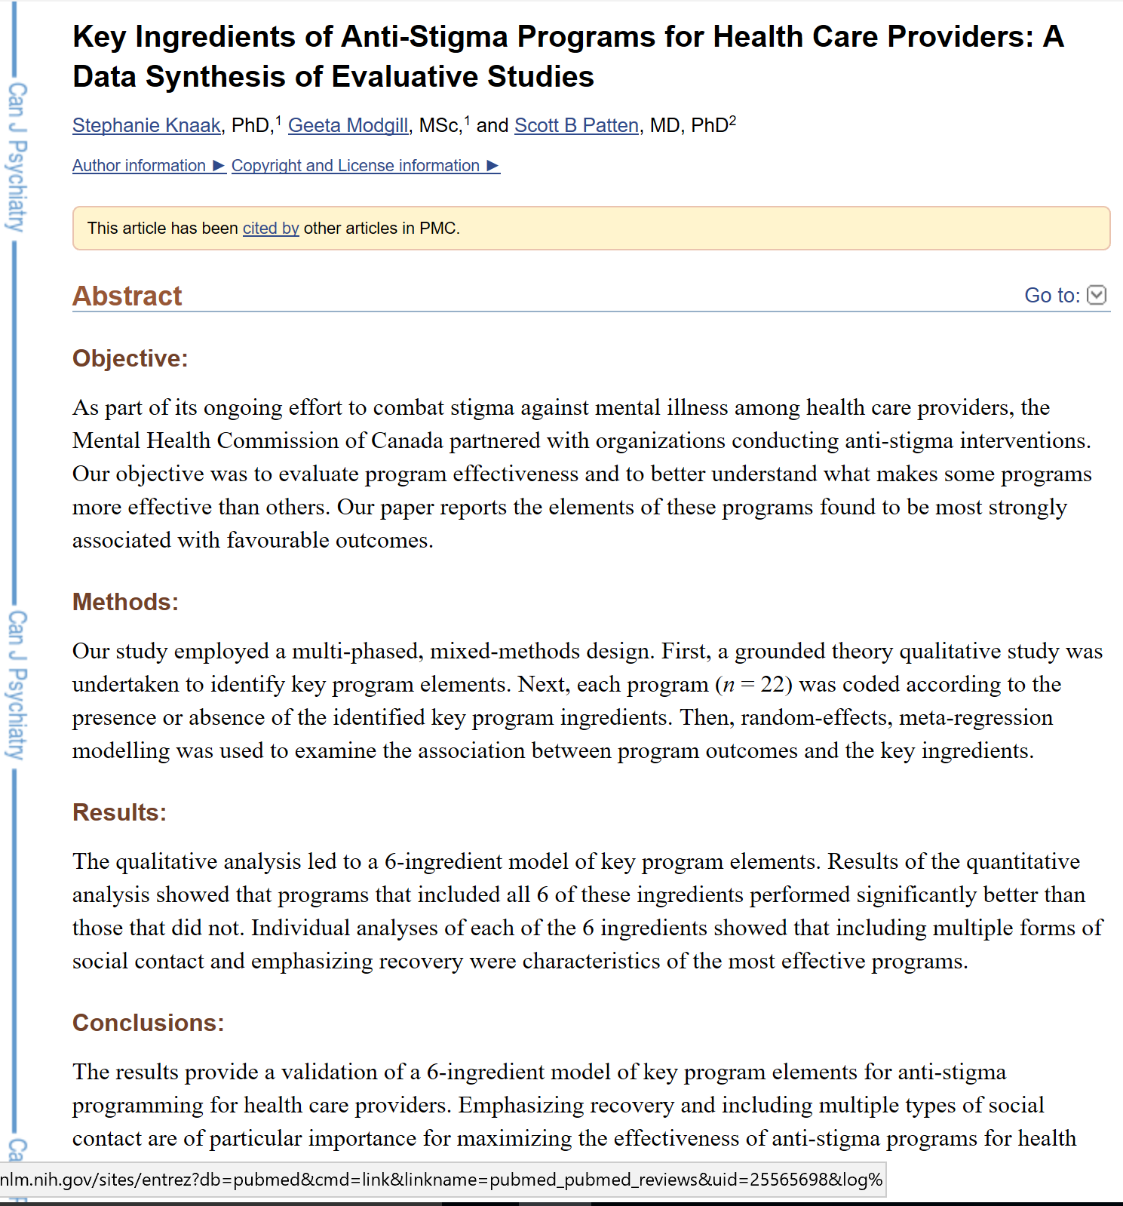
1. Emphasis on recovery.
2. Personal testimony from a trained speaker who has lived experience of mental illness.
3. That employs multiple forms of social contact.
4. That teach skills that involve what to say and what to do.
5. That employ myth busting.
6. That use an enthusiastic facilitator.

Slide 44
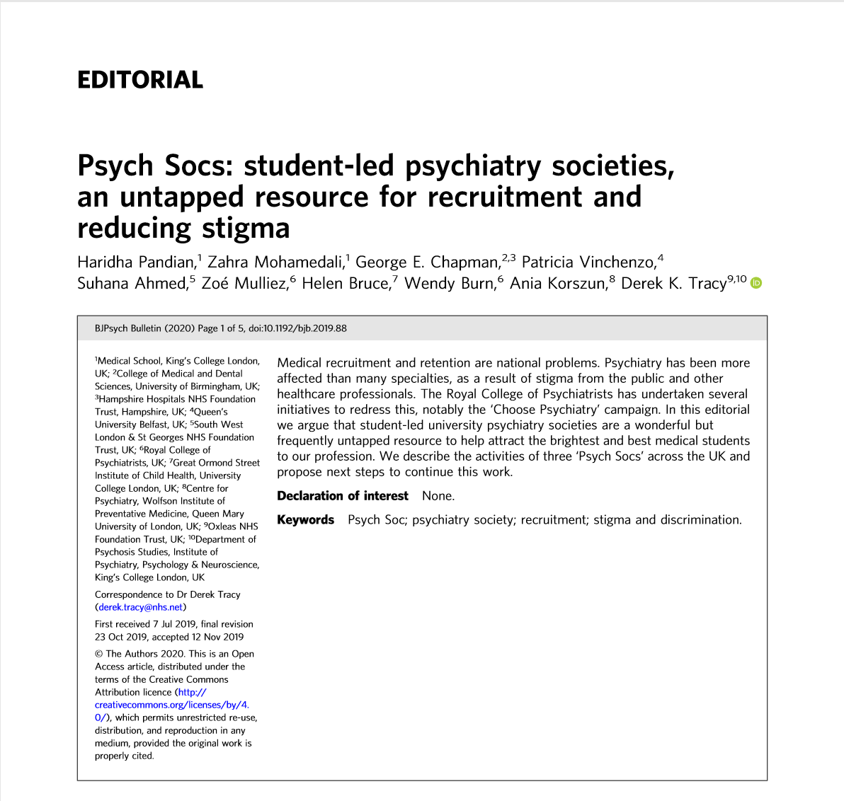

Slide 45
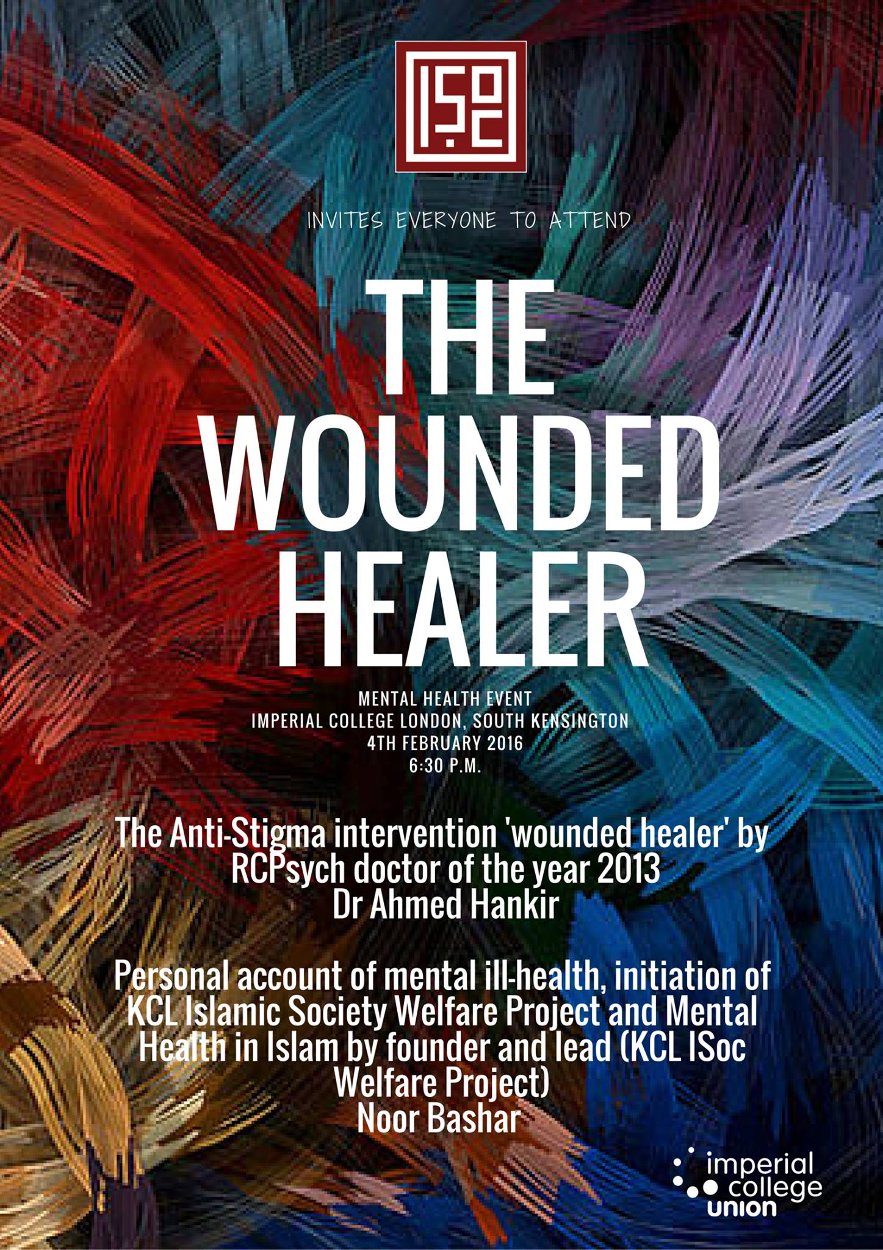

Slide 46
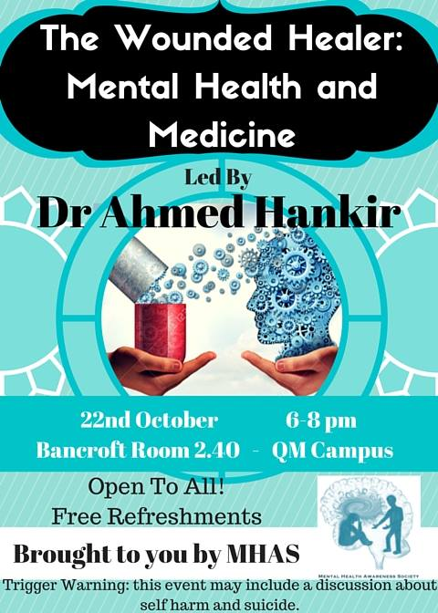
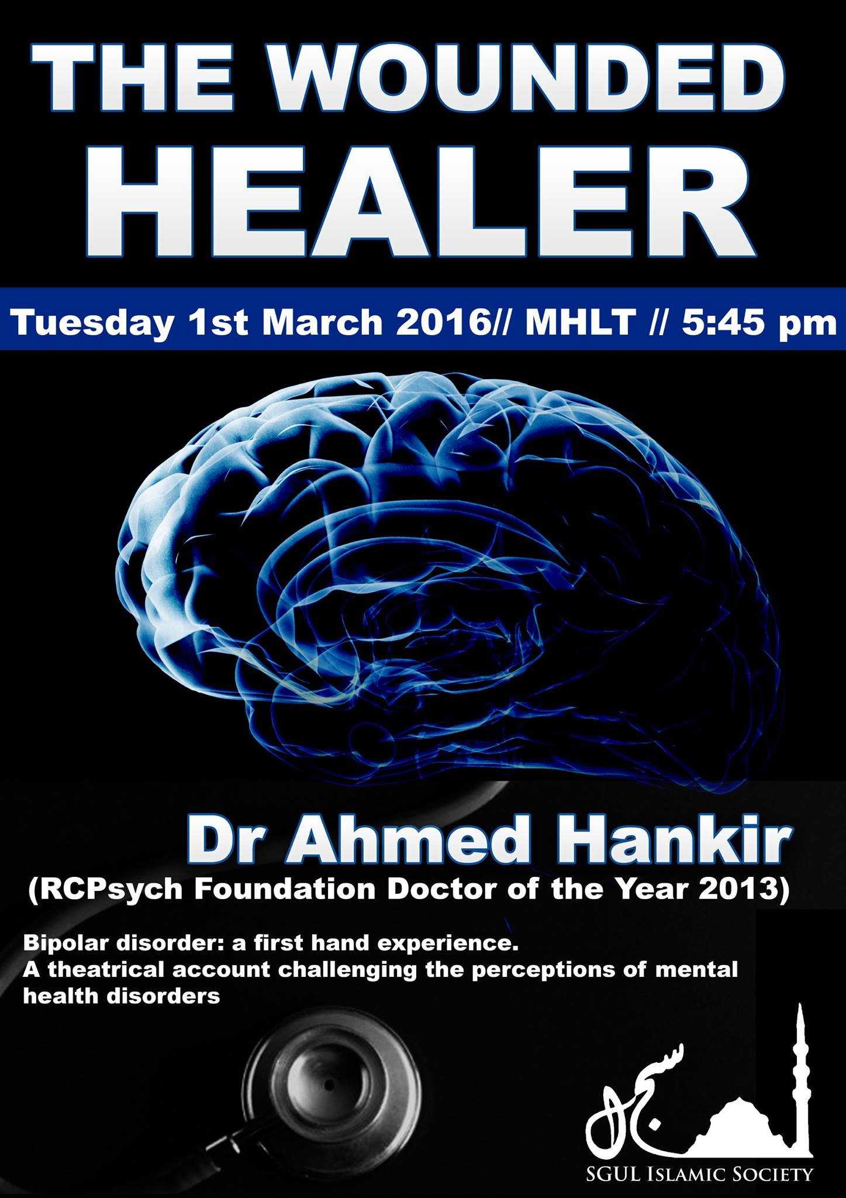

Slide 47
Global Footprint of The Wounded Healer
Delivered to over 200,000 people in person in 25 countries in 5 continents worldwide. Global footprint of The Wounded Healer: Canada, USA, Colombia, Northern Ireland, Republic of Ireland, Wales, Scotland, England, Portugal, Italy, Germany, Romania, Slovenia, Lebanon, Ukraine, New Zealand, Australia, Malaysia, Qatar and more….

Slide 48
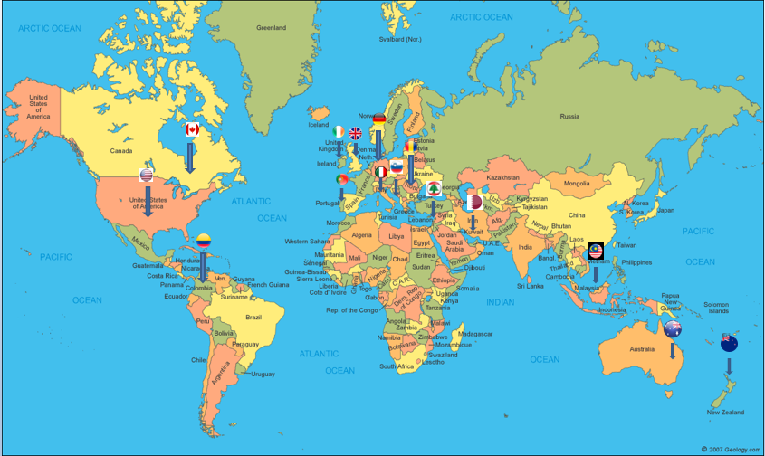

Slide 49
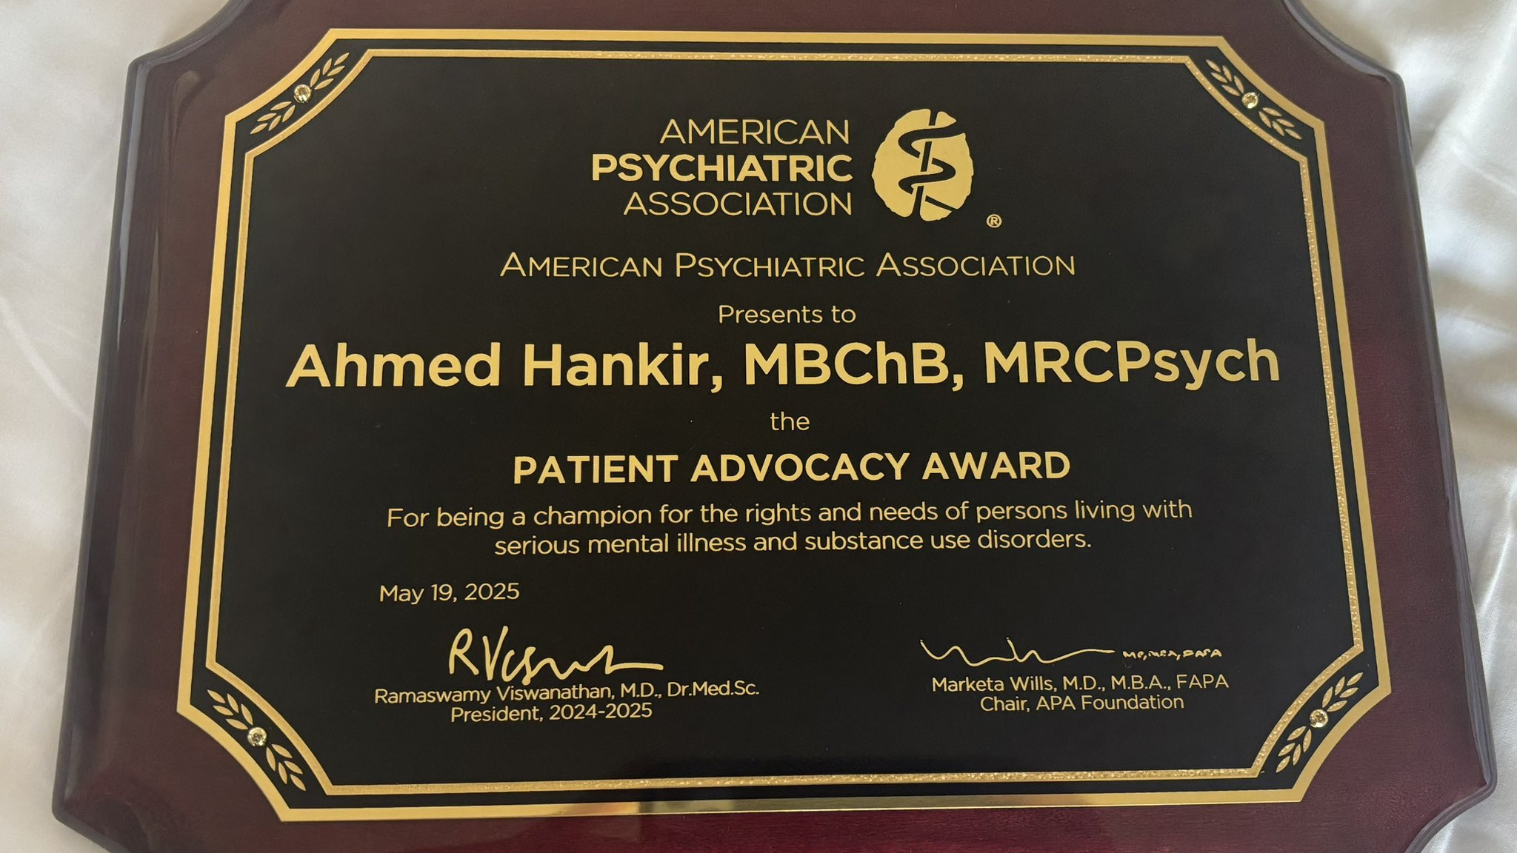

Slide 50
Countering stigma starts off with the individual by challenging our own prejudices and preconceptions…

Slide 51


Slide 52
Take Home Messages…
Living with a mental health condition is nothing to be ashamed about.
Effective treatment is available.
Seeking support is a sign of strength, not a sign of weakness.
Recovery is a reality for the many and not for the few.

Slide 53
Thank you
Questions?
ahmed.hankir@lhsc.on.ca
Twitter/X: @ahmedhankir

Slide 54
References
Harvey SB, Epstein RM, Glozier N, et al. Mental illness and suicide among physicians. Lancet. 2021;398(10303):920-930. doi:10.1016/S0140-6736(21)01596-8
Lamb D, Stevelink SAM, Scott HR, Greenberg N, Wessely S. COVID-19 and the mental health of health-care workers. Lancet Psychiatry. 2023;10(4):245. doi:10.1016/S2215-0366(23)00062-7
Home | AFSP
Amsalem, D., Markowitz, J. C., Jankowski, S. E., Yang, L. H., Valeri, L., Lieff, S. A., Neria, Y., & Dixon, L. B. (2021). Sustained Effect of a Brief Video in Reducing Public Stigma Toward Individuals With Psychosis: A Randomized Controlled Trial of Young Adults. The American journal of psychiatry, 178(7), 635–642. https://doi.org/10.1176/appi.ajp.2020.20091293
Corrigan PW, Morris SB, Michaels PJ, Rafacz JD, Rüsch N. Challenging the public stigma of mental illness: a meta-analysis of outcome studies. Psychiatr Serv. 2012 Oct;63(10):963-73. doi: 10.1176/appi.ps.201100529.
Gold, K. J., Andrew, L. B., Goldman, E. B., & Schwenk, T. L. (2016). "I would never want to have a mental health diagnosis on my record": A survey of female physicians on mental health diagnosis, treatment, and reporting. General hospital psychiatry, 43, 51–57.
Harvey, S. B., Epstein, R. M., Glozier, N., Petrie, K., Strudwick, J., Gayed, A., Dean, K., & Henderson, M. (2021). Mental illness and suicide among physicians. Lancet (London, England), 398(10303), 920–930. https://doi.org/10.1016/S0140-6736(21)01596-8
Knaak, S., Modgill, G., & Patten, S. B. (2014). Key ingredients of anti-stigma programs for health care providers: a data synthesis of evaluative studies. Canadian journal of psychiatry. Revue canadienne de psychiatrie, 59(10 Suppl 1), S19–S26.
Magner, C., Greenberg, N., Timmins, F., O'Doherty, V., & Lyons, B. (2021). The psychological impact of COVID-19 on frontline healthcare workers 'From Heartbreak to Hope'. Journal of clinical nursing, 30(13-14), e53–e55. https://doi.org/10.1111/jocn.15841
North East London Strategic Health Authority Report of an independent inquiry into the care and treatment of Daksha Emson and her daughter Freya. London: North East London Strategic Health Authority, 2003.
Nordt C, Rössler W, Lauber C. Attitudes of mental health professionals toward people with schizophrenia and major depression. Schizophr Bull. 2006;32(4):709-14. doi:10.1080/09540260701278937.
Thornicroft, G., Sunkel, C., Alikhon Aliev, A., Baker, S., Brohan, E., El Chammay, R., Davies, K., Demissie, M., Duncan, J., Fekadu, W., Gronholm, P. C., Guerrero, Z., Gurung, D., Habtamu, K., Hanlon, C., Heim, E., Henderson, C., Hijazi, Z., Hoffman, C., Hosny, N., … Winkler, P. (2022). The Lancet Commission on ending stigma and discrimination in mental health. Lancet (London, England), 400(10361), 1438–1480. https://doi.org/10.1016/S0140-6736(22)01470-2
Ahmed Hankir: fighting mental health stigma. (2022). Bulletin of the World Health Organization, 100(8), 472–473.
Rüsch N, Abbruzzese E, Hagedorn E et al. Efficacy of Coming Out Proud to reduce stigma's impact among people with mental illness: pilot randomised controlled trial. Br J Psychiatry. 2014;204:391-7. doi: 10.1192/bjp.bp.113.135772. Epub 2014 Jan 16.

