Slide 1
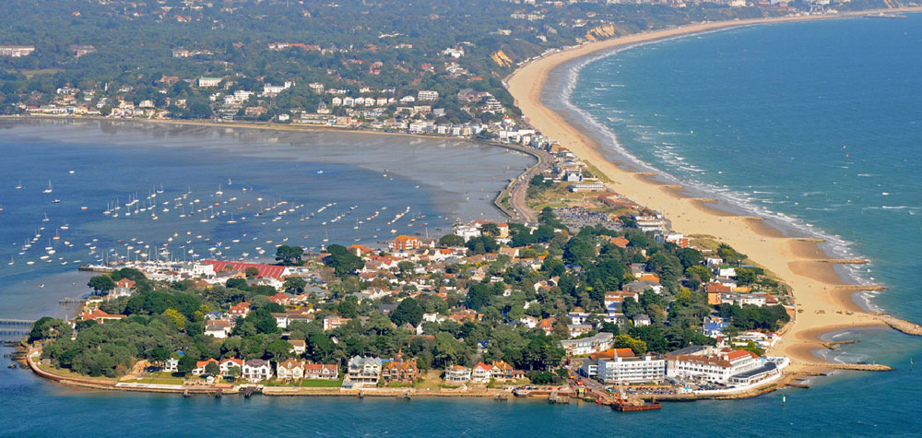
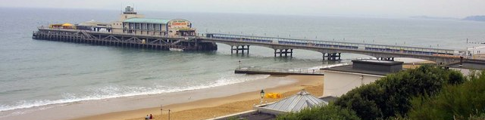

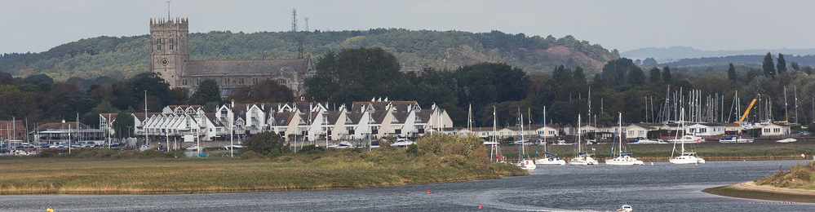

Growing our Occupational Health & Wellbeing people
University Hospitals Dorset - 2024 OPRHAS Award Winners & Highly Commended

Slide 2

Strengthening our Occupational Health & Wellbeing Service

Slide 3

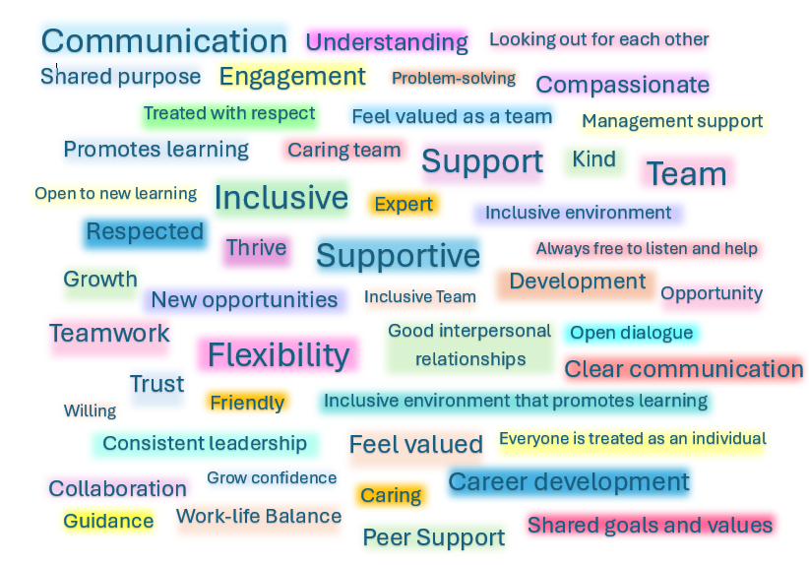

By expecting the best and providing the tools and environment to achieve it, we can help create a culture where everyone can

Slide 4
Pre-placement clearance: Average turnaround from submission to clearance within 3 days
Management referrals: First appointment offered within an average of 10 days from submission
Immunisation appointments: Scheduled and delivered within 24 hours
MSK therapy: Average wait time for Urgent appointment is 3 days and 10 days for a routine
Daily Duty Nurse managing sharps incidents, outbreaks, triage, resulting, queries and Duty Nurse Inbox.
OH representative at Networks and Wellbeing events
MULTIDISCIPLINARY TEAM WITH VARIED EXPERTISE, WORKING TOGETHER TO DELIVER HIGH-QUALITY OCCUPATIONAL HEALTH AND WELLBEING SUPPORT.
The impact of investing in OUR TEAM
PRO-ACTIVE PROJECTS TO SUPPORT HEALTH AND WELLBEING

Slide 5
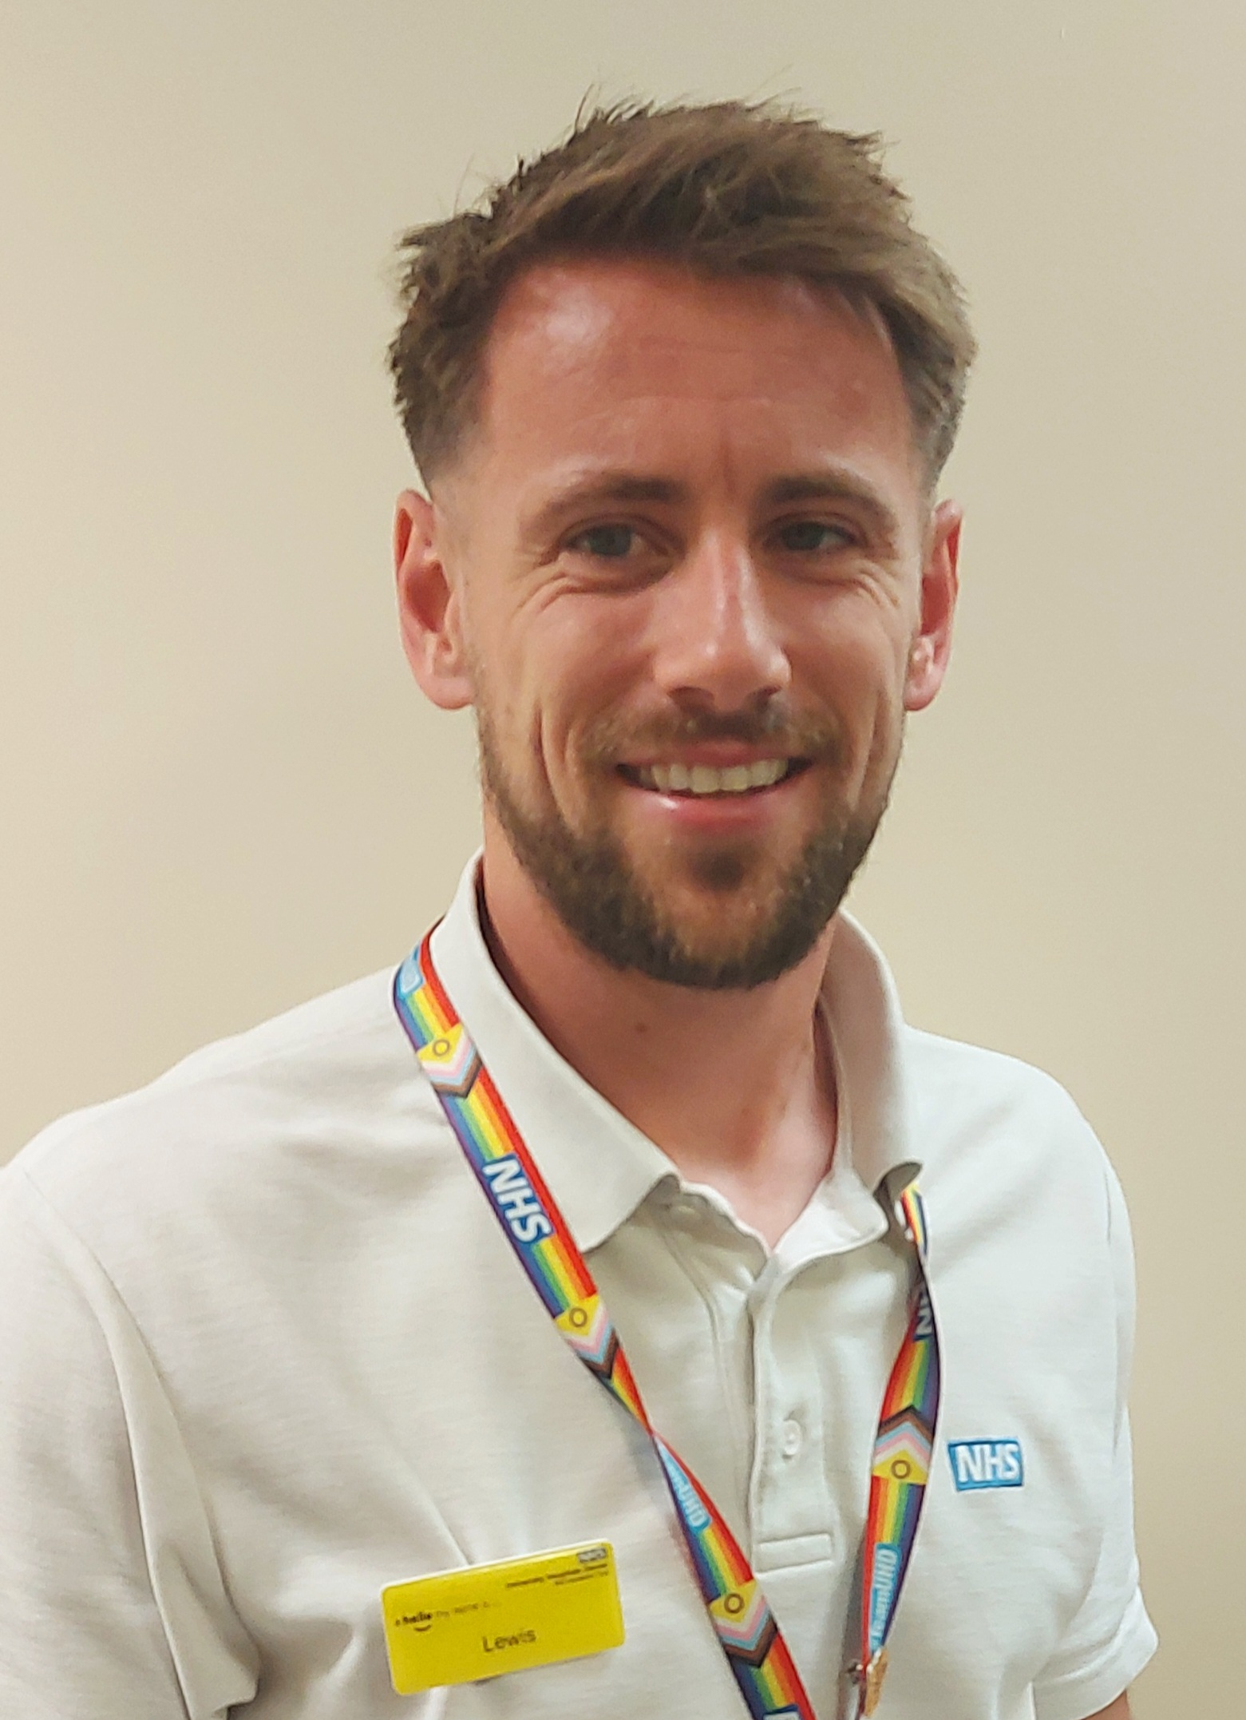
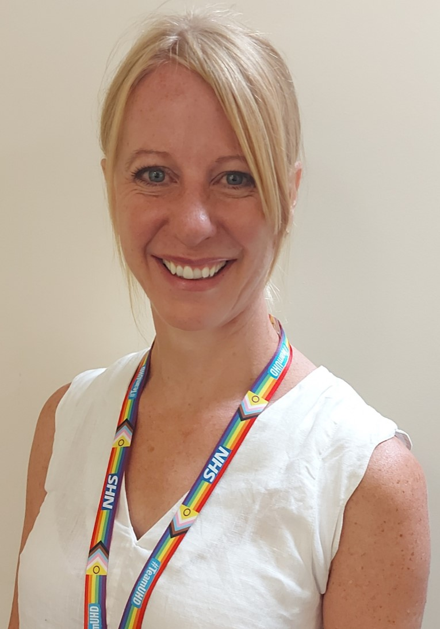
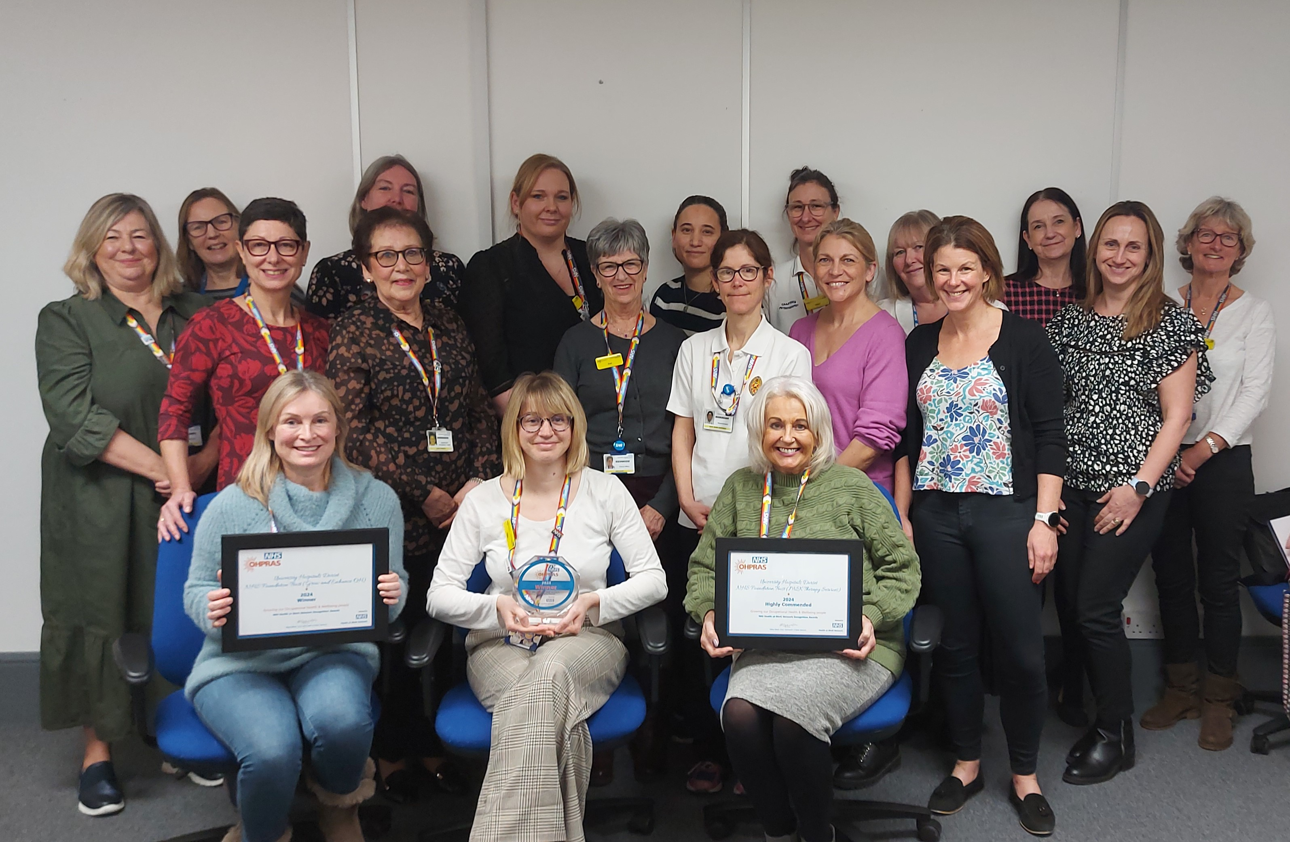
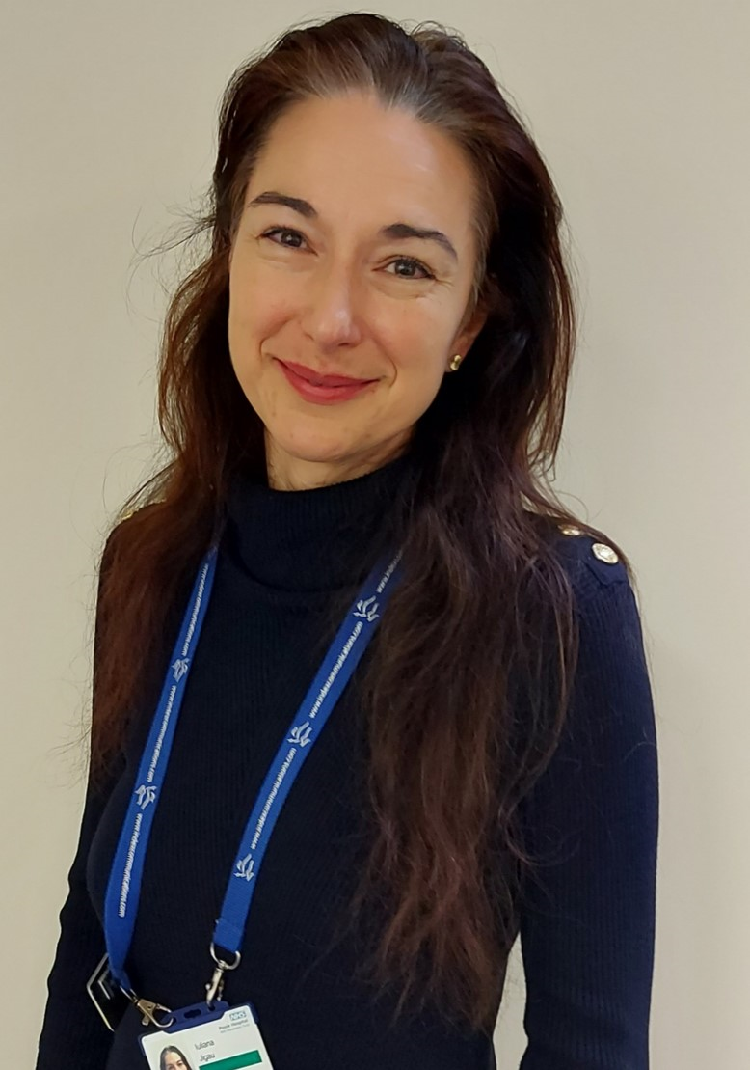
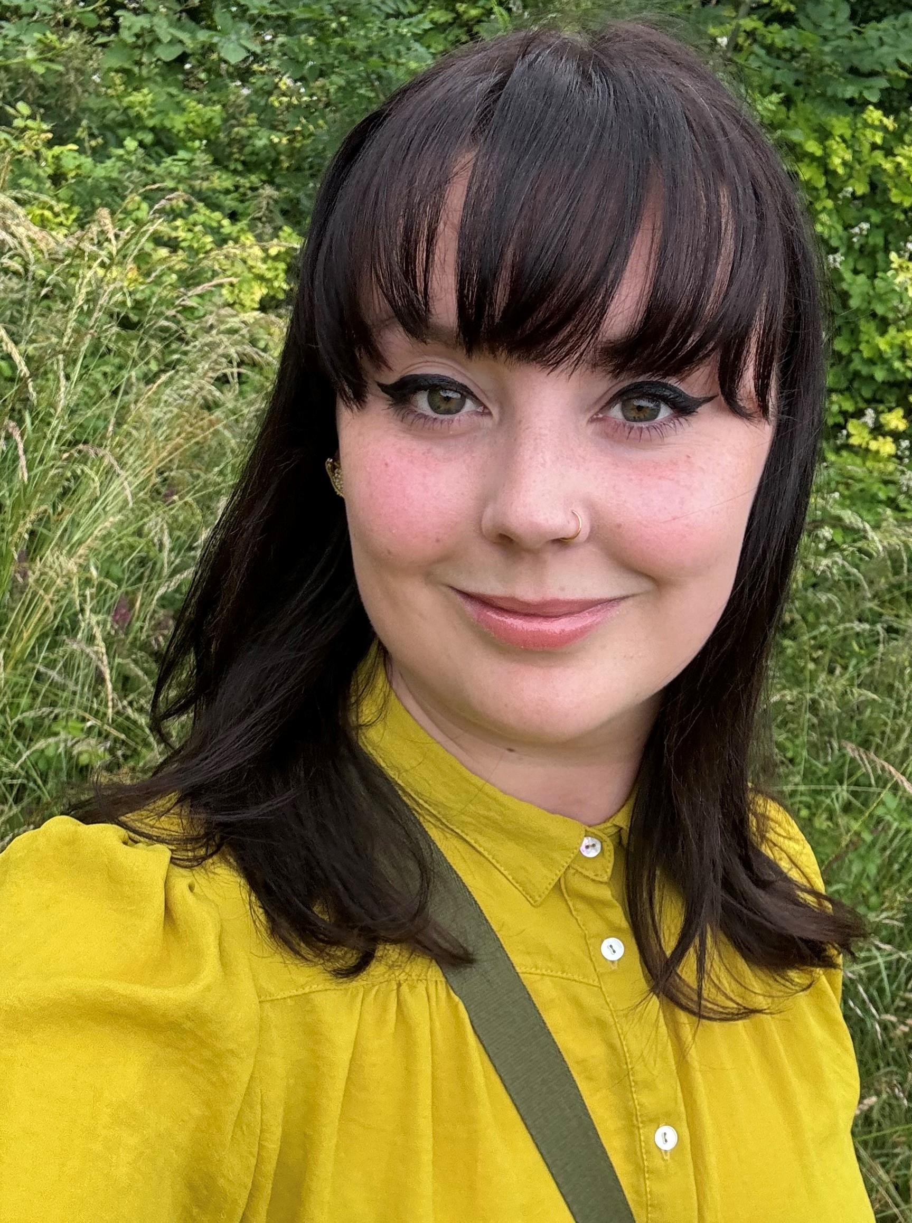
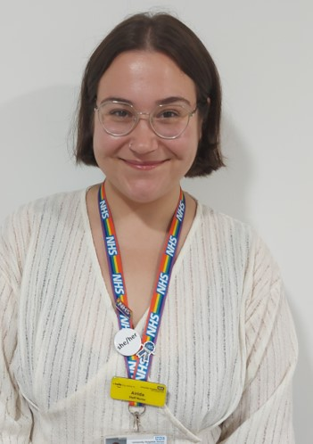
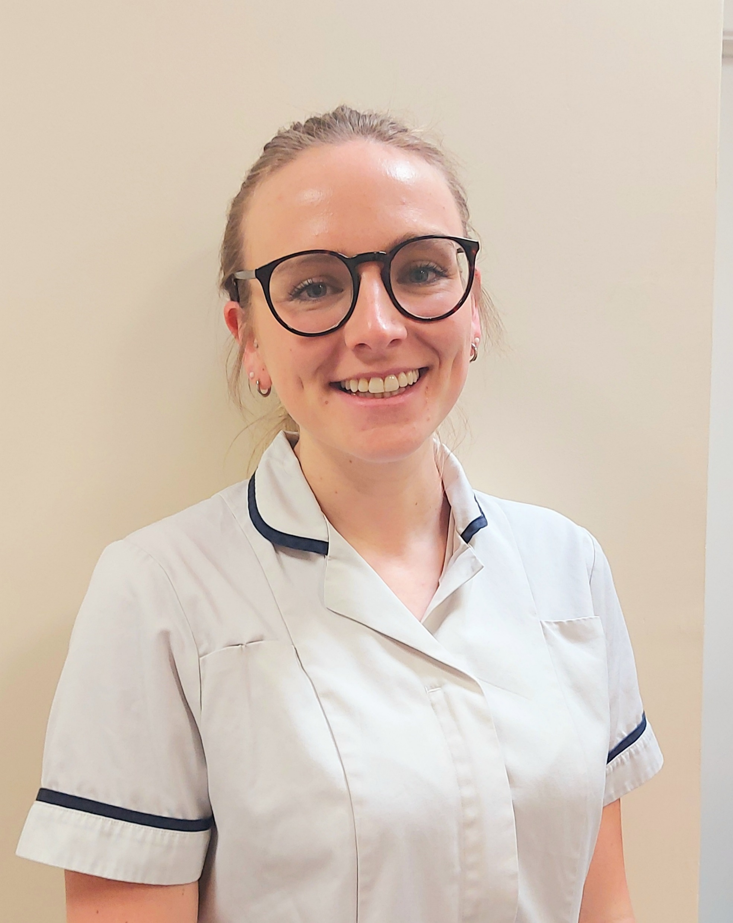
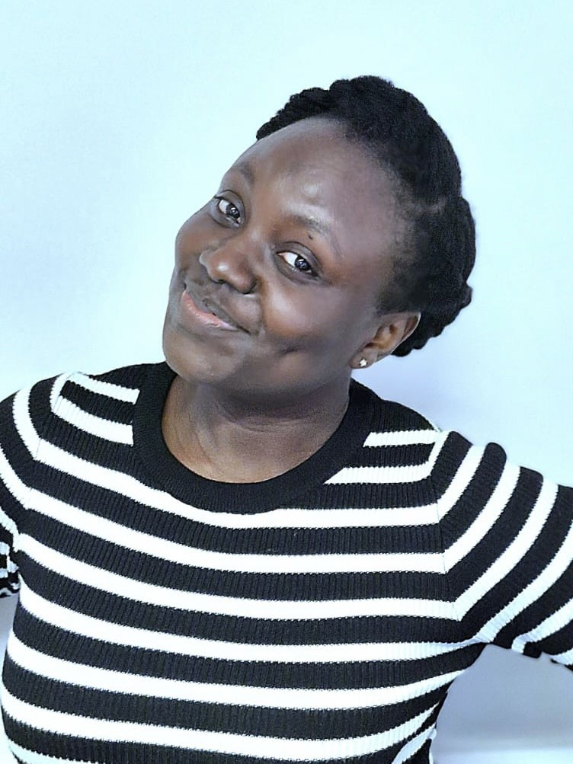
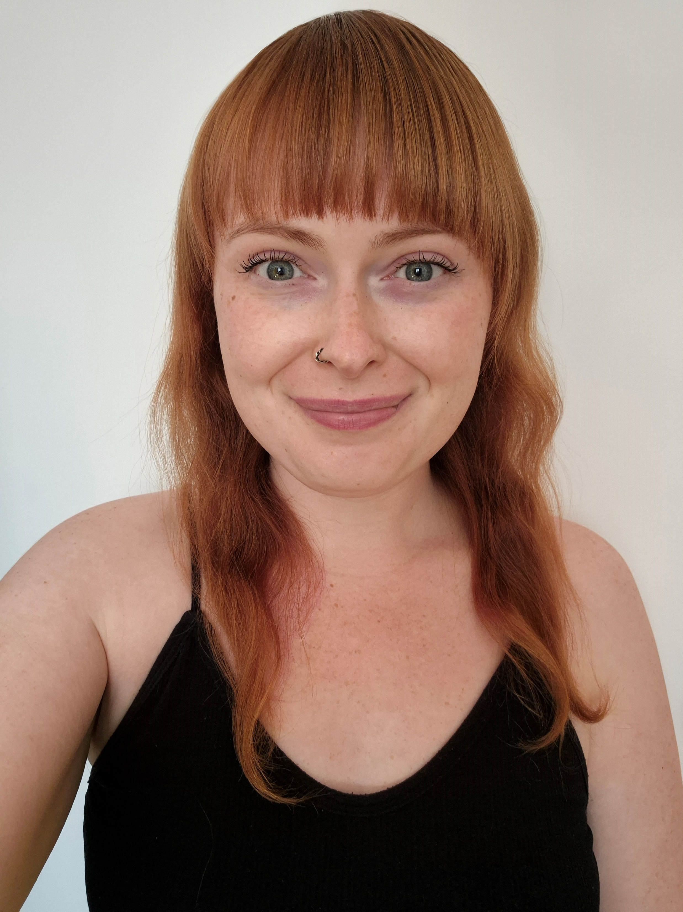
#TeamUHD
Occupational Health

