Slide 1
Physical Activity & Wellbeing Team
Occupational Health & Wellbeing Services
Northumbria Healthcare NHS Foundation Trust

Slide 2

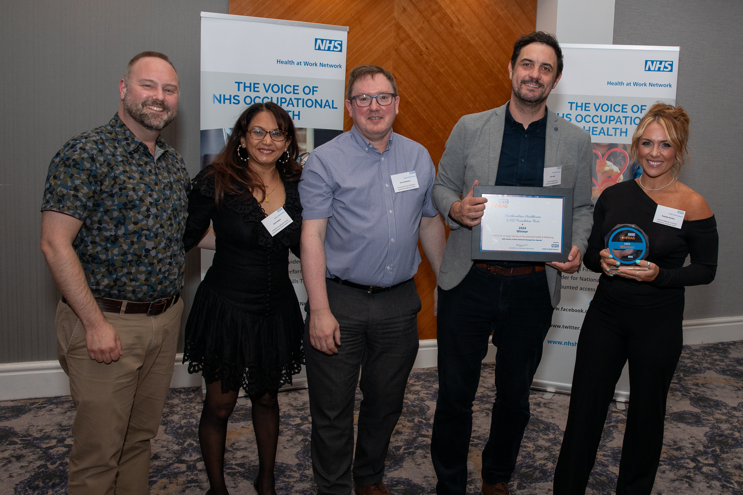

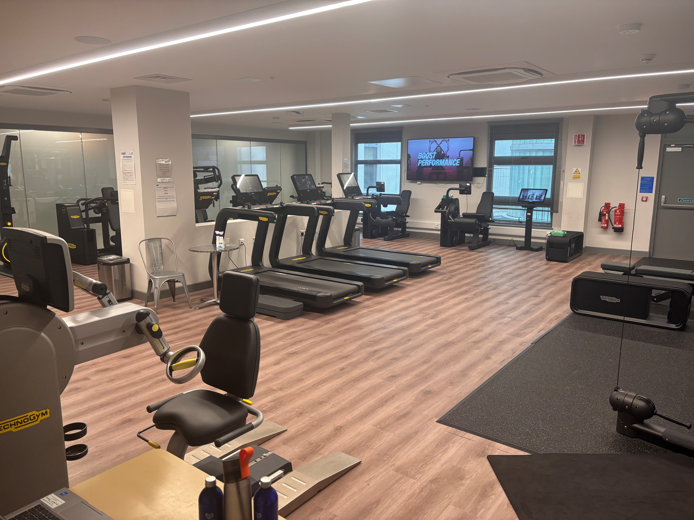
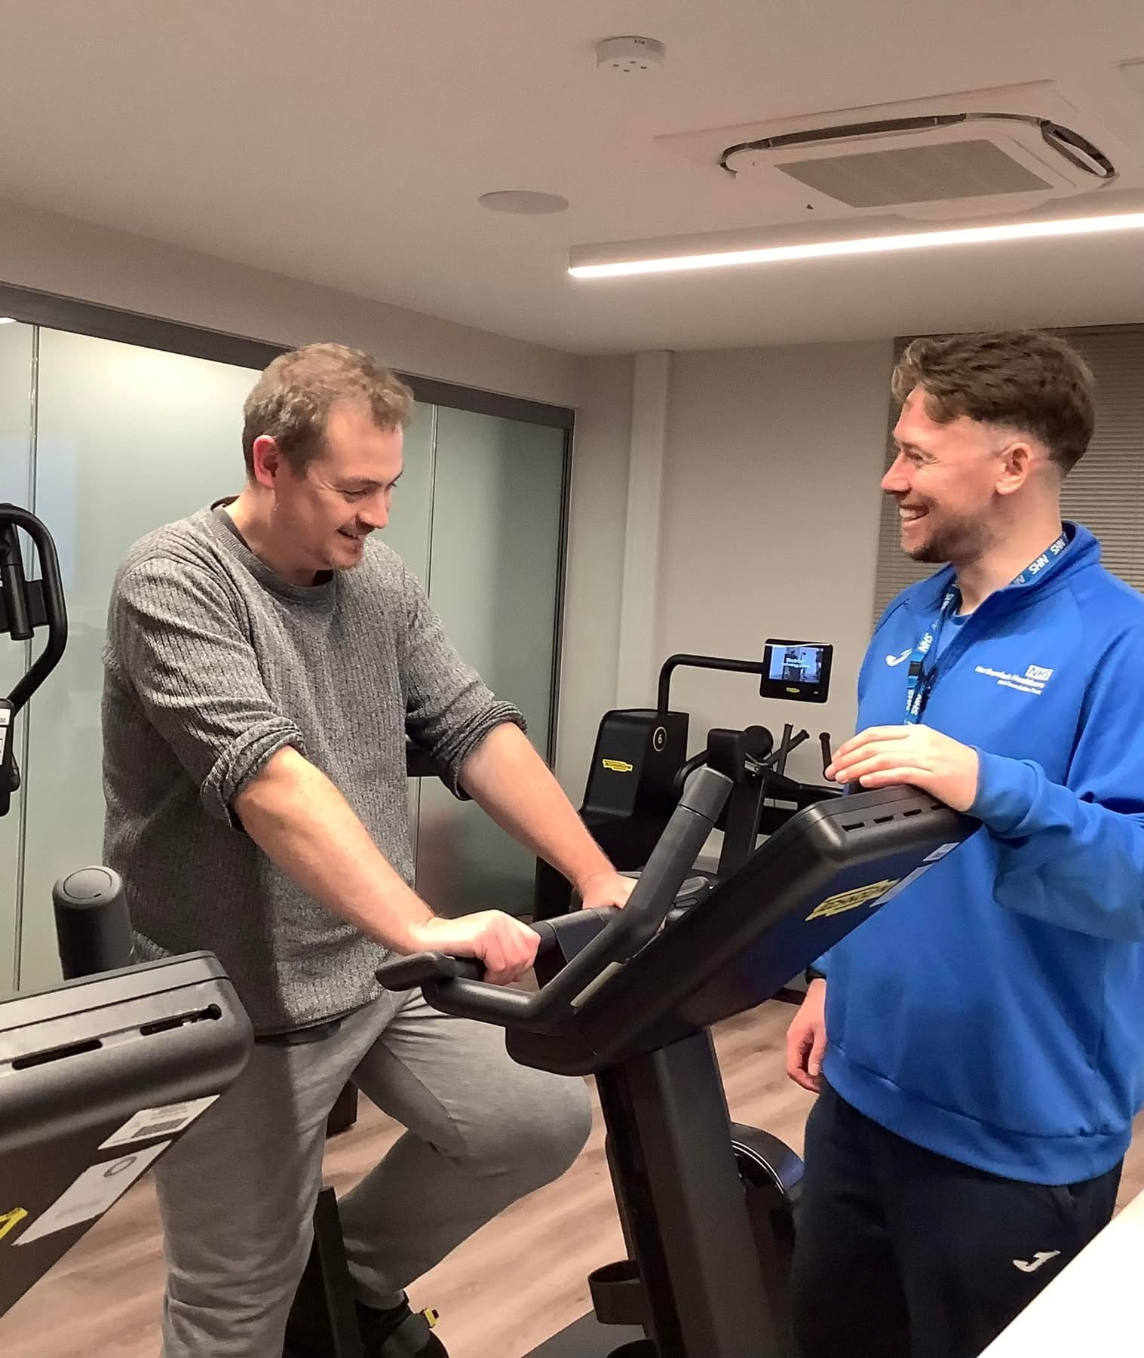
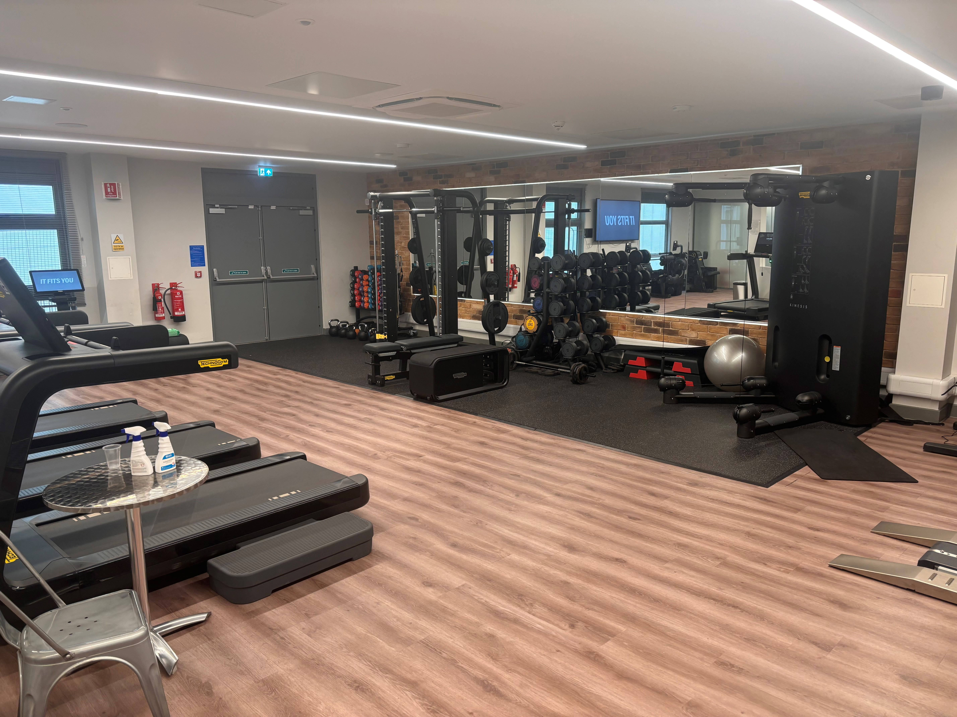
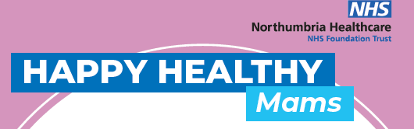
Notes:
Where we were….

Slide 3

JULY 2025 UPDATE
HOW CAN WE SUPPORT?
MECC APPROACH
ON SITE VISABILITY
ON SITE ENGAGEMENT
Referrals
Northumbria Safe, Fit & Well
Happy Healthy Mams
Staff Mini MOTs
Wellbeing Conversations
1-1 or Group
Personal Training
Classes
Midday Moves
6 Weeks to Wellbeing (Online Support programme)
Falcons Fit
Wor Scran
Nutritional guidance in collaboration with Dietetics
WOR Wellbeing Podcast
Supporting staff team away days
Complementary treatments
WOR Wellbeing Membership – 3039 active members (3,831 total applications received).
67 new applications in June.
78% Female, 21% Male, 1% Non-Binary.
24% Medical, 22% Surgery,12% Corporate, 11% Community, 11% Clinical, 9% NHFM, 4% Other, 3% Child Health, 2% Bank, 1% NPC, 1% Volunteers.
66 new inductions delivered.
225 1-1 personal training sessions.
322 participations in classes.
Links to People Services Team
Links to Public Health Team
Links to Staff Psychology
Links to Staff Physiotherapy
Links with Occupational Health
Notes:
Where we are now……

Slide 4
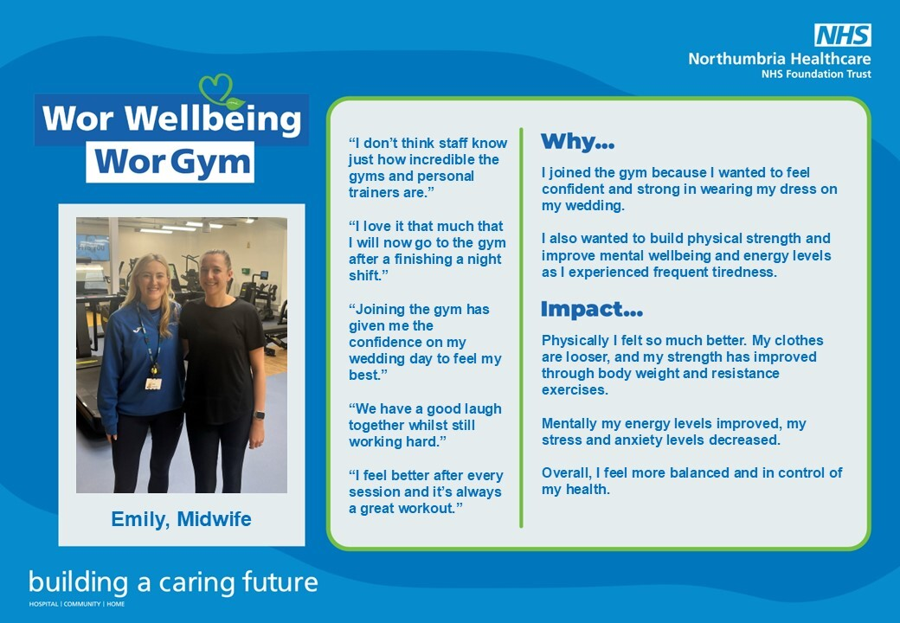


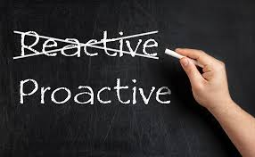
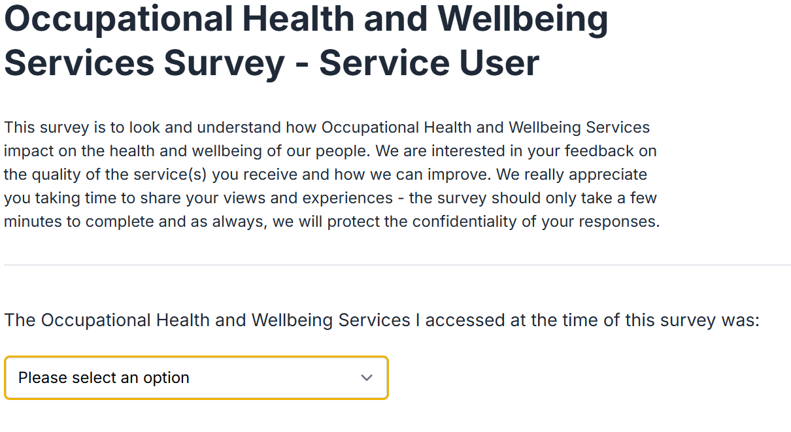
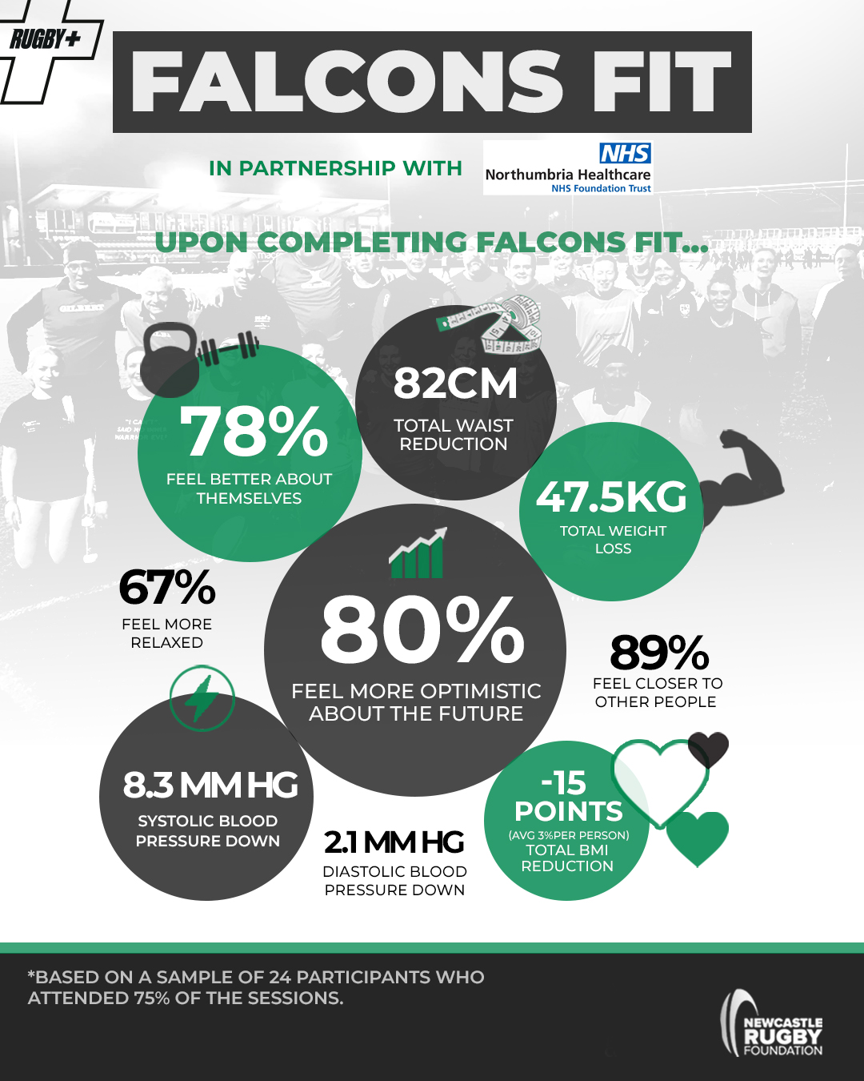

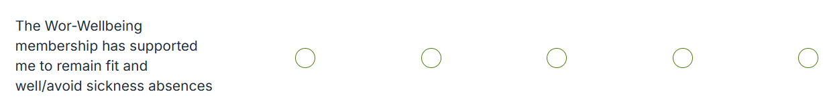
(138) Stories from Wor' Gym: Emily and Molly - YouTube
Notes:
Where we want to be……..

Slide 5
Thank you

