Slide 1
NHS Health at Work Network Conference 2025
OH in Action- 2024 OHPRAS winner.
Fiona Chance-Larsen – MSK Service Lead , Employee Health and Wellbeing Service

Slide 2

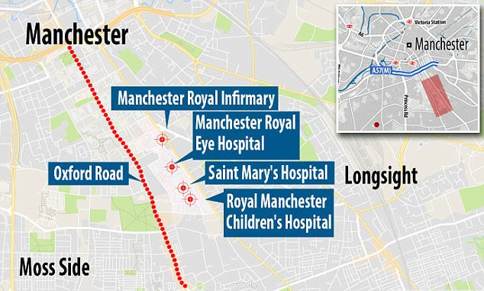
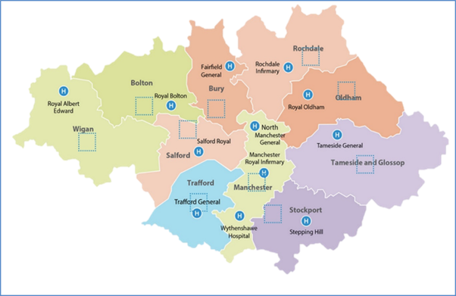

Who are we? – Manchester University NHS Foundation Trust (established Oct 2017)
32,000 staff
10 Hospital sites
Provides district general hospital services to population of approx. £1.2 million
Withington Hospital
Altrincham Hospital

Slide 3
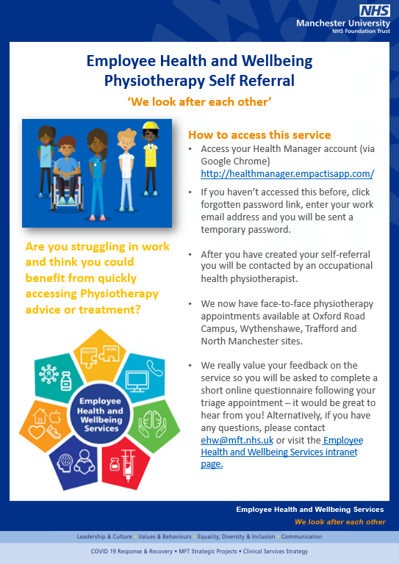
Manchester University NHS FT (MFT)
Musculoskeletal (MSK) Service Delivery Model
Rapid Access Self Referral
Absence Support Service
Prevention
and Education Strategies

Slide 4
Self-Referral Physiotherapy Service
Online self referral platform which is triaged by Occupational Health Physiotherapist within two working days.
Direct messaging to employee to request additional information or provide self management advice or offer initial assessment.
Initial assessment can be by telephone or in person.
Appointments offered across four different hospital sites.
No waiting list- first appointment offered within 7 working days from point of triage.
Automated booking and rebooking system with appointment notifications sent to employee and manager
Manger updates provided with advice to support return to work or modifications to duties if in work
Tailored exercise programmes sent directly to employee’s email using specialist physiotherapy software- Physio Tec.

Slide 5
Self- Referral Numbers
In 2024/25 we provided advice and treatment to 1403 members of staff in a physiotherapy appointment, and offered advice and support to 1399 members of staff via our Absence Support Service
MSK SERVICE
Provides timely access to physiotherapy advice and/or treatment, reducing MSK-related absence

Slide 6
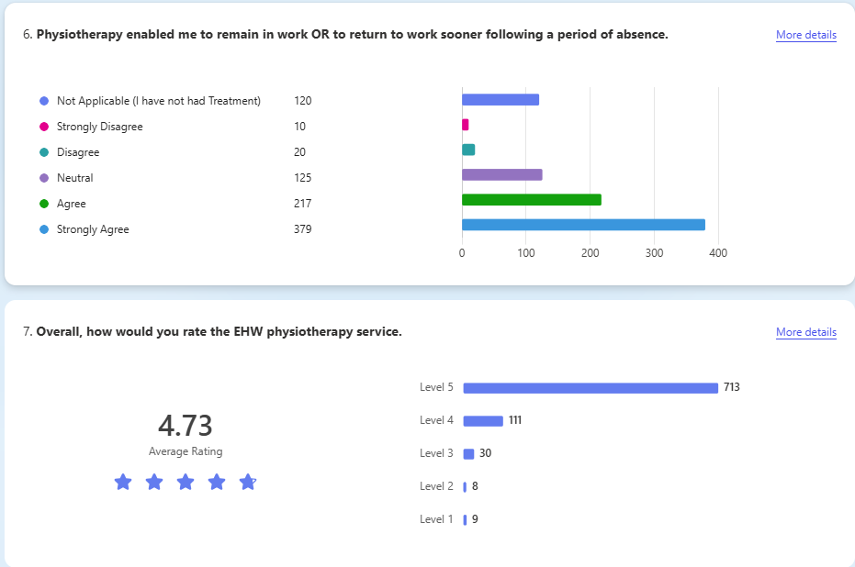
Physiotherapy Service Feedback
Notes:
4.66 Rating Self Referral

Slide 7
Absence Support Service
Employee requests call from physiotherapist via absence manager (automated system) having reported musculoskeletal related absence
1
Occupational Health Physiotherapist calls employee on first day of absence if reported Monday to Friday.
2
Manager notified of contact or noncontact with employee
3
Employee offered advice to support recovery or signposted to other appropriate services e.g., GP services/ Accident & Emergency or urgent care.
4
If appropriate employee is offered an in-person assessment appointment or a telephone review appointment.
5
If no appointment offered employee encouraged to self refer if condition not improving within expected recovery period.
6
Manager provided with feedback via automated email. This can include opinion on likely timeframe for return to work and recommendations on workplace adjustments.
7

Slide 8



Return on Investment
Key Dates
Jan 2022 – EHW Launched MSK treatment and advice services at 4 hospital sites
May 2022- Absence Support Service started
Oct 2023 – Revised Absence Support Service implemented with ‘opt in’ for MSK call back. Previously all MSK sickness absences cases were called by the MSK service, but a poor response rate resulted in wasted clinical resources.
Sickness Absence Data (S11 & S12)
The MSK service model supported an average 4-day reduction in MSK sickness absence length over the last 3 years
MSK Absences (S11 and S12) were continually the second highest cause of staff sickness absence. However, despite MFT available FTEs increasing, the number of MSK absences continues to drop and is MFT’s 4th cause of sickness absence.
83% agree it has saved them taking time off work to seek treatment elsewhere.
100% of employees agree the prevention and education Programmes support their health and wellbeing and help them to better manage their condition.

Slide 9
MSK Service Prevention and Education Programmes
Individualized exercise programmes using PhysioTec
Online Back Care Workshop
Bespoke MSK Interventions by work area/job role
Work Conversations Training for AHPs
Reasonable adjustments and return to work advice.
Manger training on MSK Health in the Workplace
Active Menopause Guidance
Fibromyalgia education programme
Strength training workshops

Slide 10


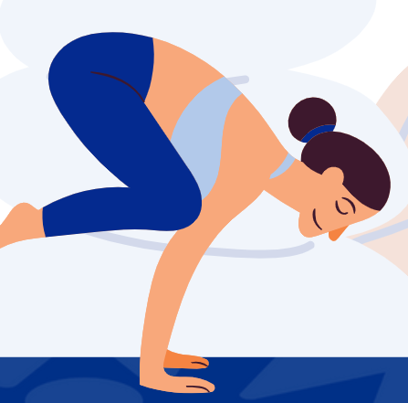



MSK Training and Education Programmes
Back Care Workshop
Q11b In the last 12 months have you experienced musculoskeletal problems (MSK) as a result of work activities?
This workshop provides an intro into common back pathologies, education on back care and myth busting. For those who wish to learn more about the prevention of back pain as well as those experiencing ongoing nonspecific low back pain.
Increased MSK prevention programmes following investment from the Trust. At 26.05% this is the lowest rating over the past four years.
Yoga for Healthy Backs
A practical 4-week course aimed at sedentary employees/those who classify themselves as physically inactive
100% of attendees strongly agree/agree that attendance has improved their overall health and wellbeing
90% of attendees intend to continue with some form of regular physical activity having completed the course
Active Menopause Programme
This 3-week programme is for anyone who experiences symptoms of peri menopause / menopause. It aims to Improve understanding in the importance of exercise for managing symptoms & increase confidence in engaging with different types of physical activity.
Fibromyalgia Support Programme
Bespoke Sessions on Strength Activity
4-week programme for colleagues who have fibromyalgia, looking at ways to improve self-management in the workplace. A structured programme with information provided by MSK specialists. It provides opportunities to share experiences.
Bespoke MSK interventions provided across the MFT footprint.

Slide 11
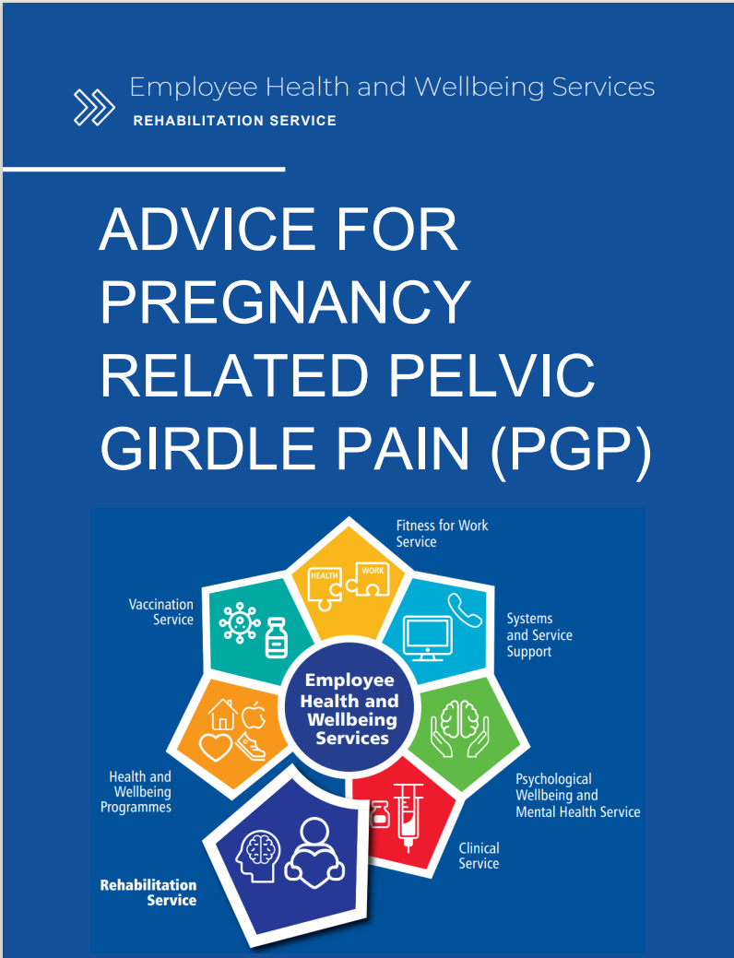
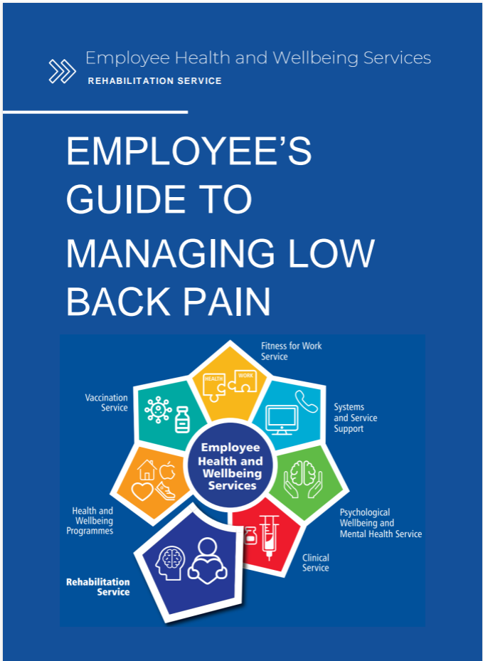
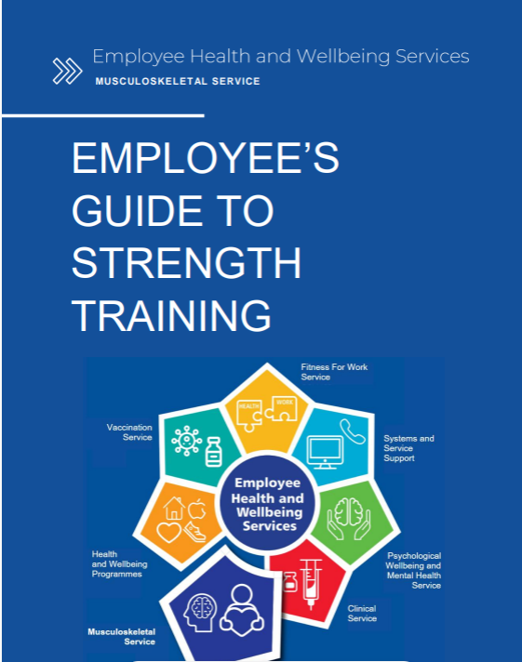
Employee Guides

Slide 12
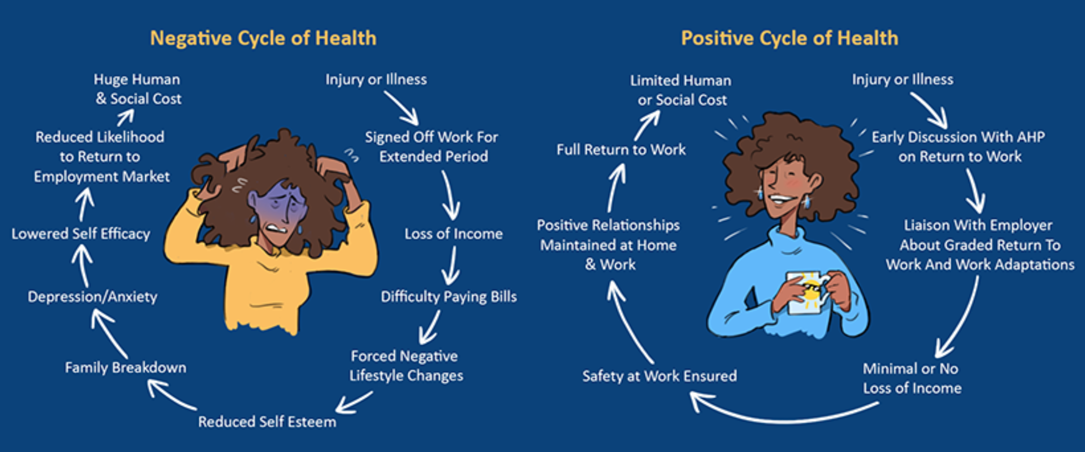

Training for Physiotherapists: Why talk Work and Health?

Slide 13
Physiotherapy Self-Referral
Outcomes
Absence Support Service
Outcomes
On average 175 referrals received every month
Web based portal so referral can be completed 24/7 at home or work
New referrals are triaged within two working days
Employees offered a face to face or telephone appointment within 7 working days
Equitable access for all MFT employees with clinics at 4 different sites
Managers provided with regular updates and guidance on reasonable adjustments
Employees value not needing to take time off work to attend appointments
70% employees reported service supported then to remain in work or return to work sooner
Employees report better overall MSK health on discharge using MSK HQ validated questionnaire
Average of 600 new referrals a month in first 18 months of project
Process redesign to improve efficiency now sees average of 150 referrals a month
95% of calls made are for self- certified absence.
Access to early professional advice promotes faster recovery
66% report the service enabled them to return to work sooner
90% report a better understanding of their health issues
Training in OH physiotherapy for 30 different MSK practitioners
Improvement of absence call categorisation, which improves accuracy of MSK sickness absence reporting
Fibromyalgia support Programme
4 week online programme designed to support employees in the workplace with a diagnosis/suspected diagnosis.
100% of employees would recommend the course
90% of attendees report it has improved their understanding of the condition.
Feedback from previous courses has ensured continued improvements. E.g. the next course will include some guided exercises/stretches at the end of each session.
Yoga for Healthy Backs
A practical 4-week course aimed at sedentary employees/those who classify themselves as physically inactive.
100% of attendees strongly agree/agree that attendance has improved their overall health and wellbeing
90% of attendees intend to continue with some form of regular physically activity having competed the course
Education and Prevention Programme Outcomes

Slide 14


