Slide 1
Financial Wellbeing at Leeds Teaching Hospitals
Anna Edgren-Davies – Head of HR

Slide 2
The Problem
Increase in staff needing financial support.
Cost of living crisis driving in work poverty.
2020 – 91% of LTHT staff paid the Real Living Wage, 2025 – 71%
2025 - 46% of LTHT staff who live in Leeds AND paid below RLW live in an area of high deprivation.
Notes:
In work homelessness including street homeless
29% of staff equates to approx. 8,000.

Slide 3
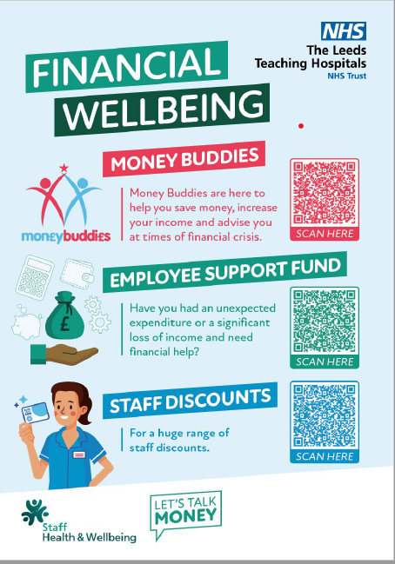
The offer
Notes:
Simple, easy to access, comms,
Posters, leaflets, stands

Slide 4
Employee Support Fund
Award is for reduction in income or sudden and unexpected expense.
Spend has reduced from around £100k a year during the pandemic to around £20k.
On average 250 applications a year.
Open to substantive staff and in house bank staff.
Assume good intent – trust our staff.
Notes:
Restrictions – sickness, debt
Cost of living award and refer to MB
Meet 2x a week with panel making decisions

Slide 5
Money Buddies
55 clients in 2024-25, financial gains of £266k
43% of attendees have a deficit budget
On average £4.8k per person
Debt managed - £110K
Benefit gains - £100K
Energy and food vouchers - £52k
Notes:
2022 – 24 - £540k
£16k a year investment – ROI best of any HWB intervention!
Plus seminars, bespoke training

Slide 6
What have we learnt
Awareness is key
Barriers to access – language, shame, financial literacy
Welfare Officer – not sustained
Long term solutions are extremely challenging for some individuals
Loan sharks
Notes:
How has it evolved – we have got the core offer right and it supports those who attend.
Focus on how we address barrier, compassion fatigue of panel
Rarely get a thank you which reflects shame and chaos, have case study if helpful.

