Slide 1
Workplace trauma support
Zoé Brooke PhD, RN(Adult)
Notes:
Thank you for the invite – delighted to be here. Intro self +/- MoS

Slide 2
Workplace trauma support
Who?
What is trauma?
Who is at risk of experiencing trauma at work?
What?
Traumatic events
Moral Injury
How do people react?
What does NICE suggest?
Who?
Workplace
support
Referral
Effective support
Specialist referral
What? When and how is it delivered? Who by?
When? Why? Who to?

Slide 3

Who is at risk?
Notes:
We generally consider places like ED, critical & intensive care, maternity and acute mental health as “high trauma” areas.
Whilst some roles and areas are more challenging on an every day basis, anyone can be exposed to a traumatic event – clinical AND non-clinical staff, front line and behind the scenes.

Slide 4
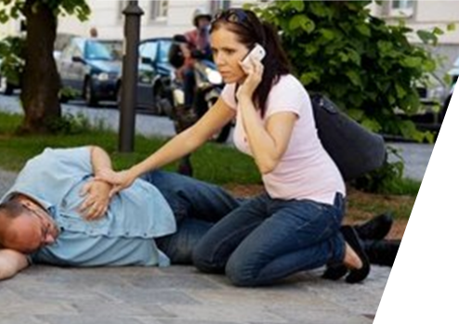
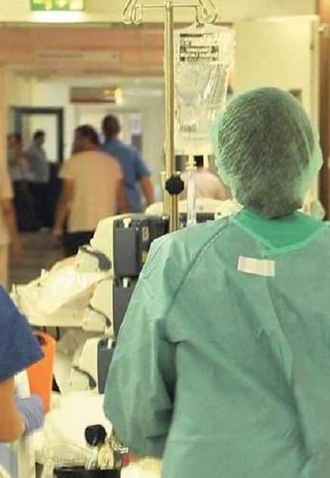
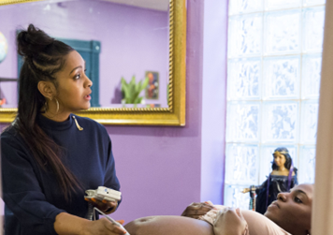
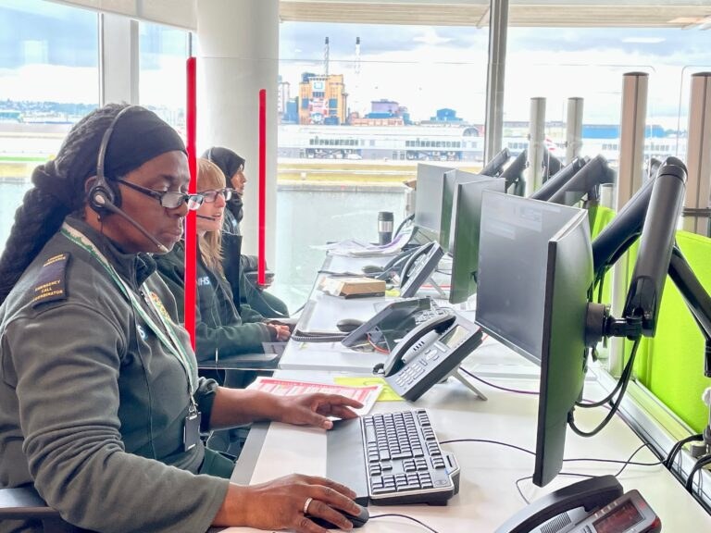
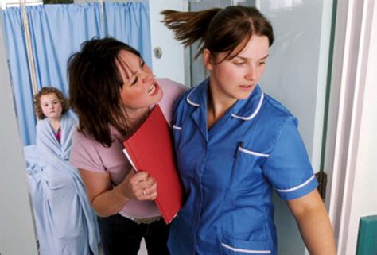
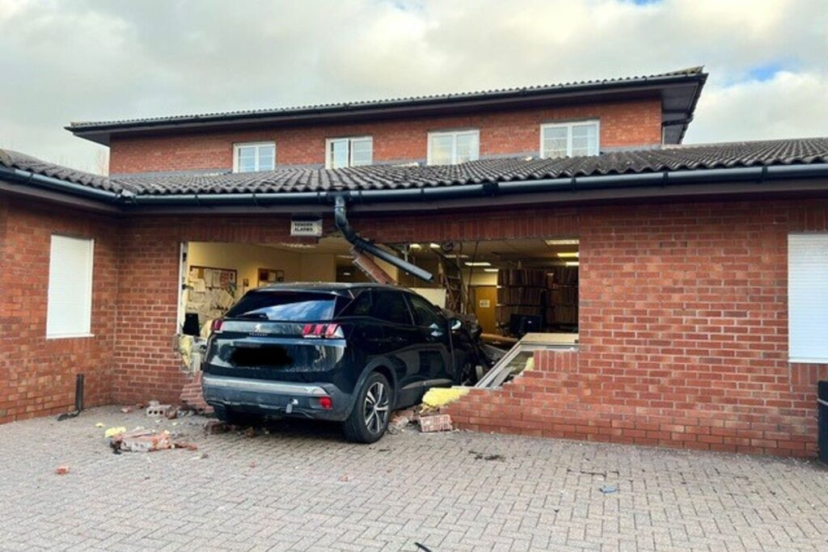
Potentially traumatic events?
Notes:
These could all be described as stressful situations but whether an event is actually psychologically traumatic depends very much on the individuals involved, how they are at the time & what the event means to them.

Slide 5
What is a Potentially Traumatic Event (PTE)?
Being exposed to:
  Death
  Threatened death
  Actual or threatened serious injury
  Actual or threatened sexual violence
By
  Direct exposure
  Witnessing in person
  Indirectly learning of a close relative/friend’s trauma
  Repeated or extreme indirect exposure to aversive details of the event(s), usually in the course of professional duties
APA Diagnostic and Statistical Manual of Mental Disorders, Fifth Edition, Text Revision (DSM-5-TR)
Notes:
From DSM 5
Near misses can linger – often we don’t mention them because nothing actually happened.
Threats can still impact on people – it doesn’t have to happen.
Exposure includes people hearing it e.g. control room. Indirect – ripple effect eg after someone dies

Slide 6
Types of trauma
Sudden - Type I trauma
100%
Type II - The final straw
Performance
Morale
Productivity
Self-esteem
Time
Notes:
6
Type 2 might also include elements of compassion fatigue, vicarious trauma (“secondary” trauma” and MI

Slide 7
What is Moral Injury?

Slide 8
Moral Injury
Profound psychological distress following event(s) which clash with our moral or ethical codes.
Potentially Morally Injurious Events:
  Commission - something you have done
  Omission - something that you didn’t do
  Feeling betrayed by a trusted person (often a higher authority)
Not a mental health illness but associated negative emotions increase the risk of mental health problems
Notes:
**Animated slide**
Huge issue for those in healthcare. Many instances where there is no “easy” choice or answer.
MH problems includes PTSD

Slide 9
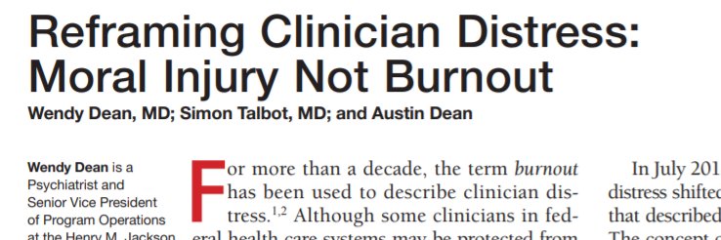
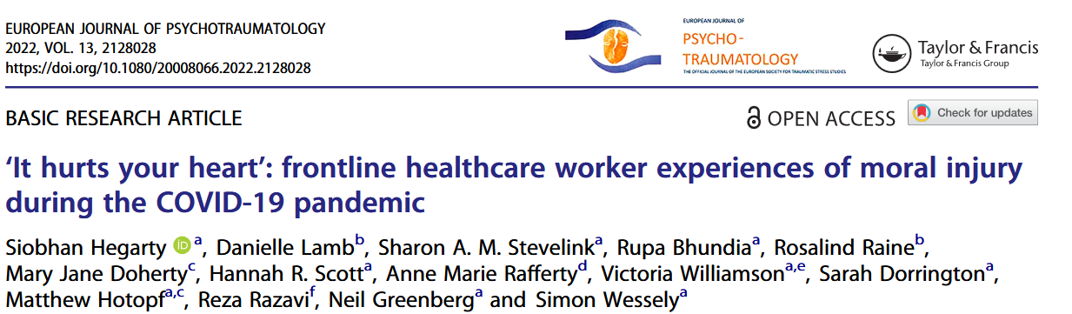
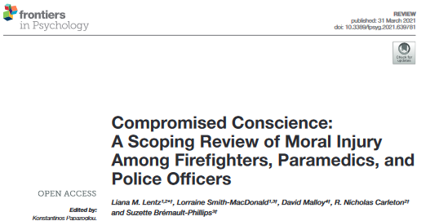
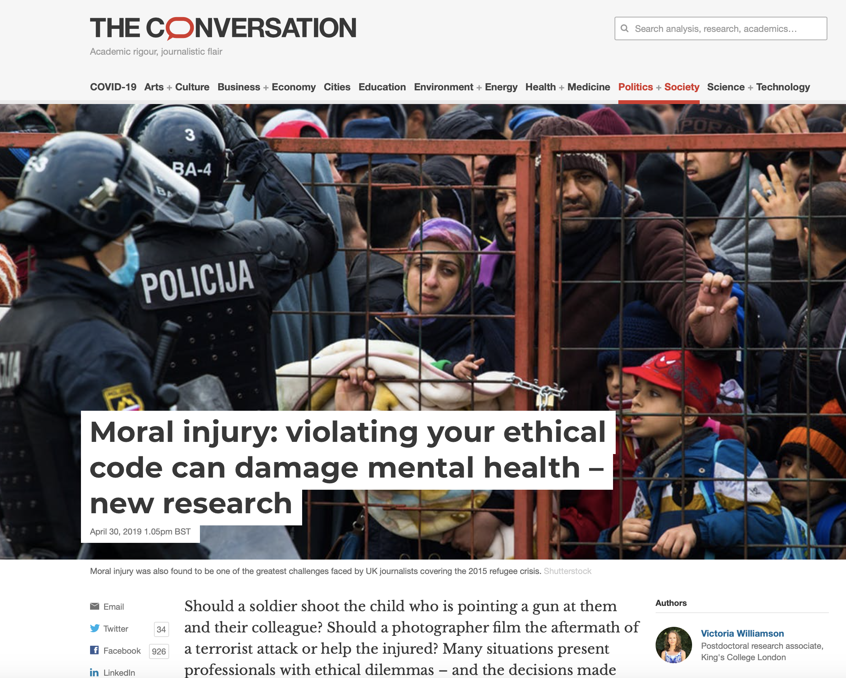
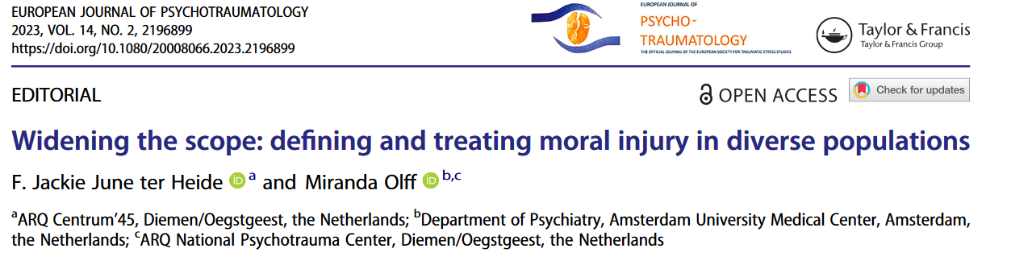
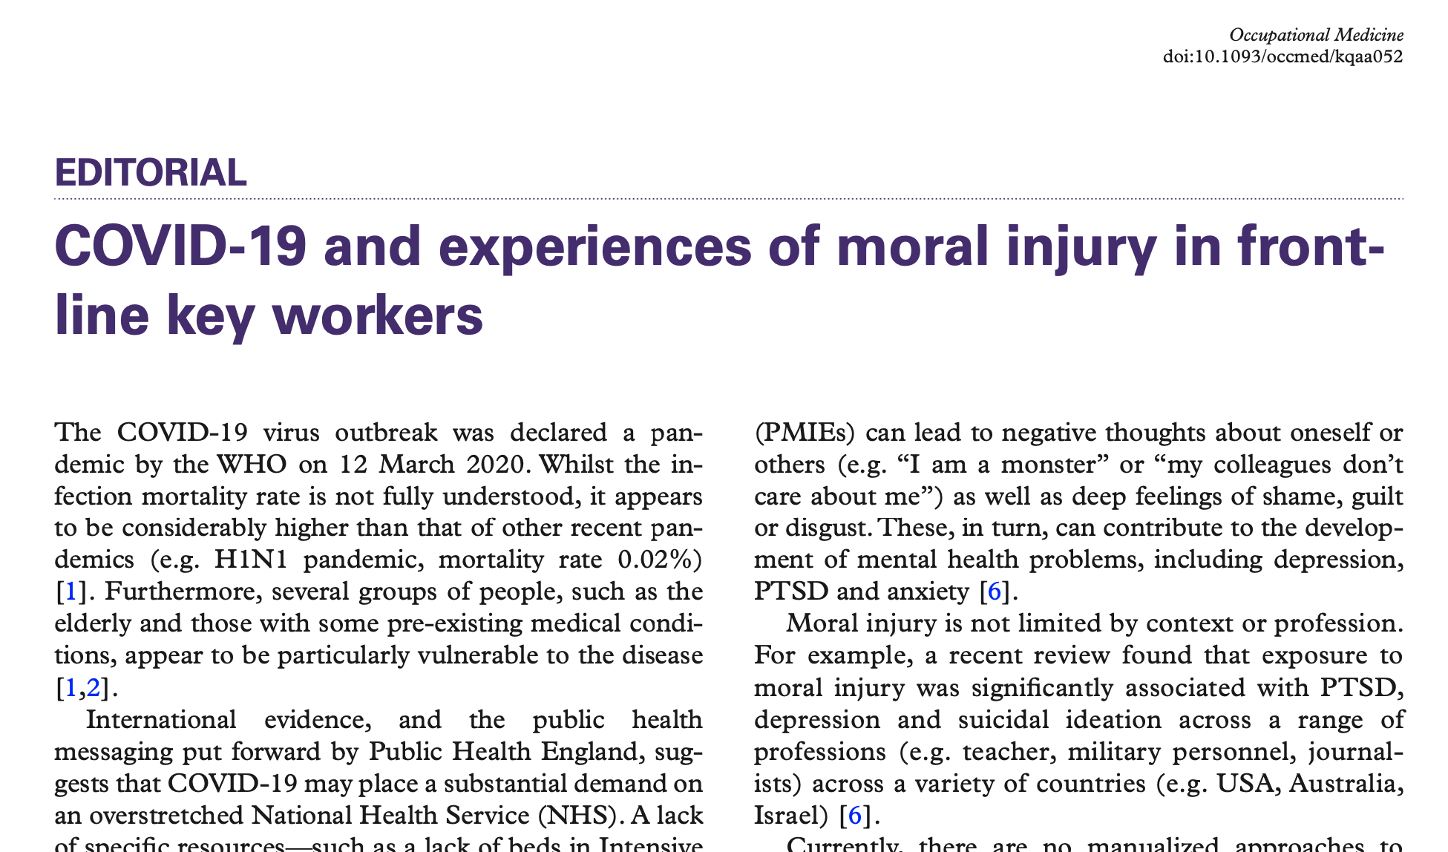
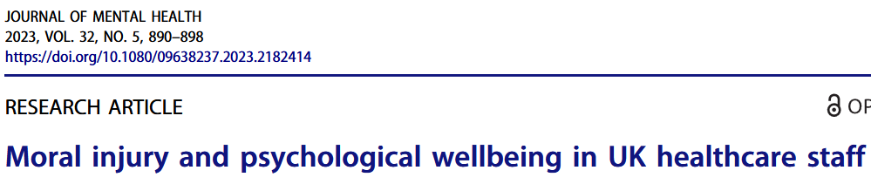
Notes:
Covid has massively increased research interest into MI especially in health care

Slide 10


Sources of ‘Stress’
Wellbeing
(Mental Health)
Work
Home
Ability to function
Trauma
Notes:
Work related can include MI, compassion fatigue & vicarious trauma

Slide 11
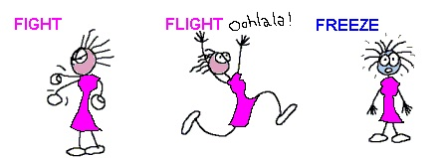
How we respond to acute stress varies between people AND between events.
Stress is a physiological and psychological reaction to the way you see or understand a situation
Notes:
How we respond to acute stress varies between people & between events
Many associated with fight, flight & freeze – normal but can be disconcerting & impactful e.g. affect concentration or sleep
Normalise but also identify if/where impacting and what we might be able to do to keep everyone safe

Slide 12

Normal reactions to abnormal events
Notes:
Sometimes we have no particular reaction but at other times we can experience a whole range of things (e.g. finding it hard to relax, dreams, short temper) which is called an Acute Stress Reaction. I explain it as our brains trying to make sense of what happened in order to file it away and to learn from it to keep us safe in future. Whilst not normal for most of us in our everyday life, they’re not unusual in the context of what’s happened. Most should start to settle in 6-8/52

Slide 13
Reactions can be worse if…
There has been a death
There is a feeling of wanting to have done more
There is little or no perceived support from colleagues, family or friends
The incident follows closely on top of stress creating events in your life
There is an appraisal of safety
Notes:
Death especially of a colleague
Wanting to do more “If only” – powerful & common response
They may be lots of support but again it is perception that counts
Appraisal of safety – an event happens in a time/place where you have previously felt safe eg Borough Market.

Slide 14
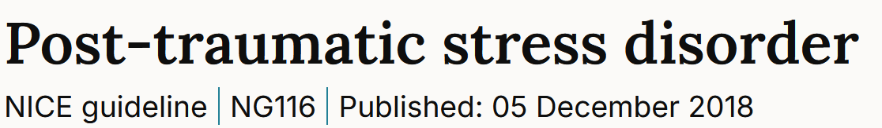

How should we deal with PTSD?
Recommended
Active monitoring
Check-in after 1 month
If unwell at 1 month⁺
Trauma-focused CBT
EMDR
Not recommended
Psychologically focussed debriefing e.g. CISD
No “prevention” drugs
No first line drug treatments

Slide 15

So what should we be doing?
Notes:
If NHS workers are potentially going to be exposed to some sort of PTE, some reactions are normal AND the recommendation is “active monitoring”
Timely access to trauma-specific care is important for the relatively few who develop significant issues.
Equally as important is using opportunities at every level of the organisation to provide a safe, supportive working environment. Many of the things I’m going to talk about now contribute to having a good “everyday” rather than simply being useful when things become particularly challenging.
A real key to how people are able to deal with challenging events is the perceived support around them….

Slide 16
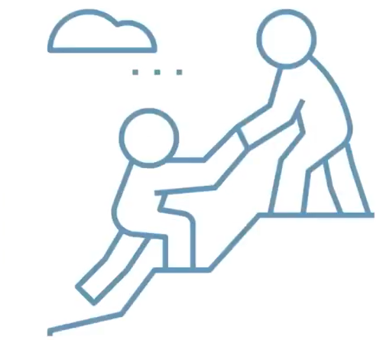

Effective leadership is fundamental to staff wellbeing
Intensive care as a positive place to work:
Workforce wellbeing best practice framework (2020)
https://ics.ac.uk/resource/wellbeing-framework.html
Notes:
Relationship with managers, and having the right leadership approach, is the strongest predictor of workplace wellbeing. Managers and supervisors have the most influence on people’s day-to-day working lives.
Intensive Care Society's groundbreaking framework for promoting workforce wellbeing and creating positive working environments in intensive care units. Released in October 2020, this best practice framework was developed collaboratively by various intensive care societies across the UK. With 10 overarching principles, the framework emphasises preventative and responsive interventions to prevent psychological harm and support staff. Effective leadership, clear communication, access to education and progression opportunities, and providing access to evidence-based psychological therapies are among the key principles outlined.

Slide 17

Good people management = good mental health
Leaders need to know their teams well, to be able spot changes and support them.
Good leadership and support helps
  maintain good mental health within the team
  enables the team to function efficiently and effectively
  reduce the impact of “everyday” and traumatic events
Notes:
Large & consistent evidence base for this.
Relationship with managers, and having the right leadership approach, is the strongest predictor of workplace wellbeing
But leaders/managers aren’t necessarily equipped to do this crucial part of their role

Slide 18
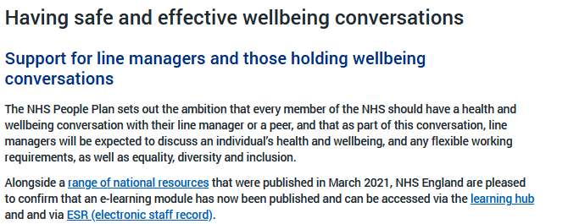

We need to give managers the skills, time and confidence to have “check-in” conversations with their teams
Notes:
Range of potential options including this NHS training.
It’s not enough to see it as a one off box tick exercise, to be effective it needs to be regular and ongoing. It can be very difficult to find the time though.
“Team” building activities are equally important but potentially even more difficult to actually do.

Slide 19
Organisational Resilience
Does not lie within individuals; it lies between individuals
“Horizontal” (camaraderie)
“Vertical” (leadership)
Notes:
We often talk about personal resilience but that’s not what research shows really matters – it’s the bonds between people that makes teams resilient.
If we’re thinking about trauma support, it’s also important to think about how we build and maintain bonds between colleagues and with managers/supervisors. And these are all 2 way relationships. In healthcare, there are often multiple teams coming together in different ways at different times to deliver it.

Slide 20
“Forward” Psychiatry

Slide 21
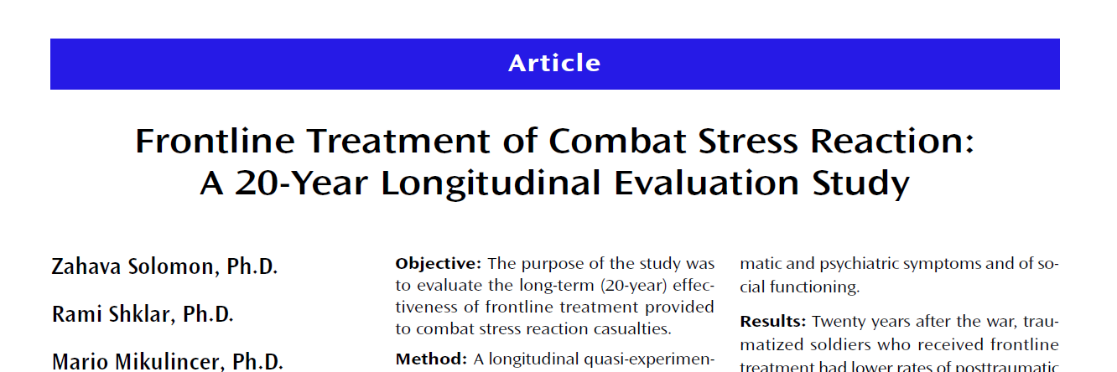

“Forward” psychiatry
Straightforward, effective, early “frontline” intervention
Can be used to effectively support staff
Uses 4 principles
Notes:
A really useful simple approach which started in the military is “forward Psychiatry”

Slide 22

Principles of “forward” psychiatry
Proximity – keep people & support close
Immediacy – check-in as soon as possible
Expectancy – tell people what to expect. Remember most people cope well
Simplicity – make sure basic needs are met
Notes:
Proximity: Keep people close by- try not to send them off alone. Check in with staff. Make use of natural ways people process- conversations, checking in on each other. Try huddles at the start and end of the shift. Buddies
Immediacy: Act quickly, by making an immediate acknowledgement of anything difficult.
Expectancy: Let them know what is usual to feel in these circumstances, and what to expect with any follow up
Simplicity: Keep your approach simple & ensure basic needs are met.

Slide 23
Debriefs
Notes:
Debriefs is a very broad umbrella term which can encompass all sorts of things in all sorts of ways
Numerous models of this in healthcare – at different timepoints relative to the event(s) & all with a slightly different focus.
We know that Critical Incident Stress Debriefing isn’t helpful after PTE
Staff can sometime be expected to attend multiple debriefs for the same event.
Psychologically they can be potentially difficult if not managed correctly
Clinical often “lessons identified” which is important but unless immediately critical, wellbeing should take priority
PIES can help!

Slide 24
On the day “debrief”
Purely supportive with a wellbeing focus.
Thank everyone for their work, time & effort.
Say what happened & what will happen next.
How is everyone? Safe to continue?
Remind everyone about available support.
Thank everyone once more.
Notes:
This very simple debrief purely focusses on how people are rather than anything else.
Could be after a specific event or simply at the end of the shift
Doesn’t have to take very long, no pressure on people to talk
Anyone of concern can be identified and supported appropriately

Slide 25
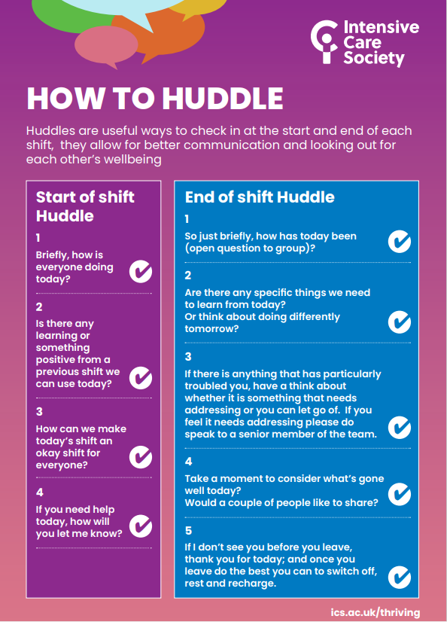
Notes:
This is the Intensive Care Society’s guidance on huddling ad the start and end of shifts. Again, it doesn’t add much to the time but it helps reinforce those bonds between everyone and help people to either prepare for work or start to decompress at the end of their day.

Slide 26
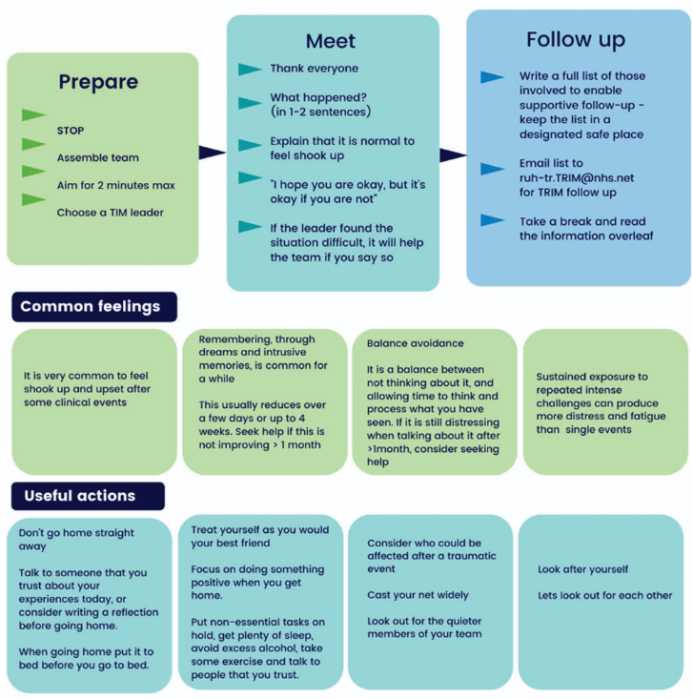
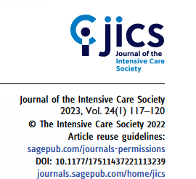
Team Immediate Meet (“TIM”)
Notes:
This is another example of a short debrief, this one is specifically to use after a particularly challenging or PTE
Any of these are really good as they’re easy for people to refer to as they go along which gives people confidence that they are able to say and do the “right thing”.
This has some psychoeducation about “common feelings” (It’s not unusual) as well as some useful actions that people can do…. NEXT SLIDE

Slide 27
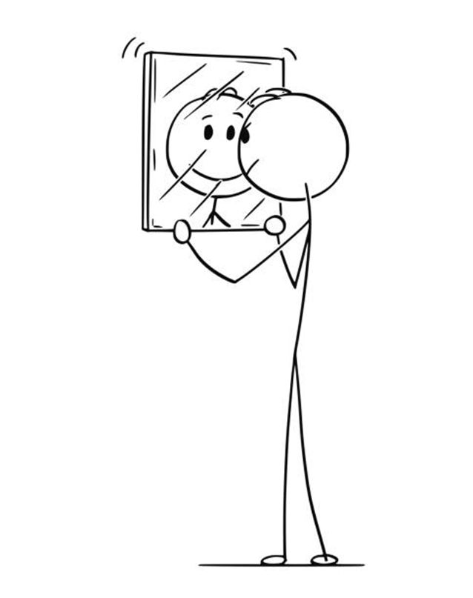
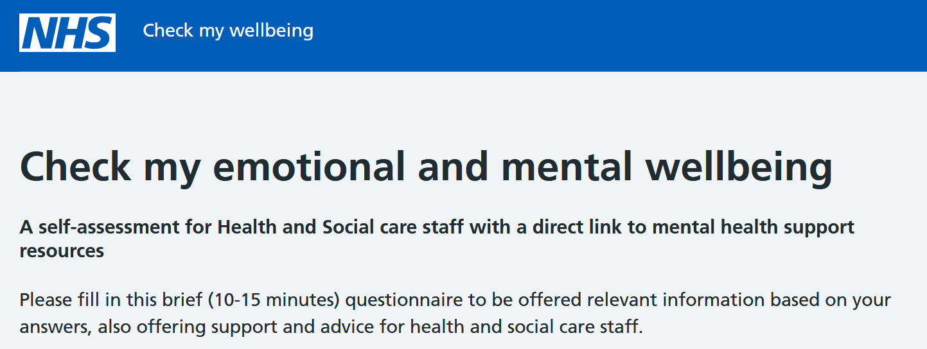
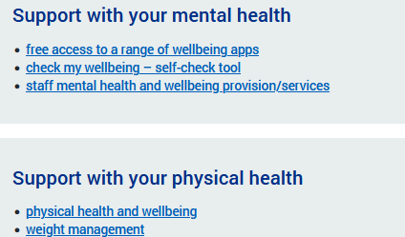
Encourage people to look after themselves
Remember PIES!
Be mindful of communication
Take rest breaks and leave
Routines, hobbies & enjoyable activities
Promote using available support
Notes:
And to look out for each other
Leaders, managers & supervisors may need reminding that they’re the example

Slide 28
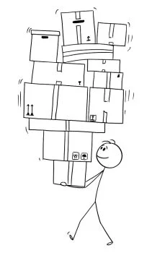
What else might help?
Time away from work*
Boundaries
Work load
Task and skill mix
Supervision
Consider referral if concern
Notes:
If people are having difficulties, there are some simple steps that managers can consider with them. They could form part of “reasonable adjustments” to help people either continue working or return to work if they’ve taken time off.

Slide 29
Peer support
Notes:
Our peers understand our jobs, culture & language. Often we have shared experiences or very similar experiences meaning that we understand each other in ways that other people may not.
We spend a considerable amount of time together – opportunities to check in
Well placed to identify if colleagues are having difficulties and might be able to spot if we’re not our “usual” selves

Slide 30
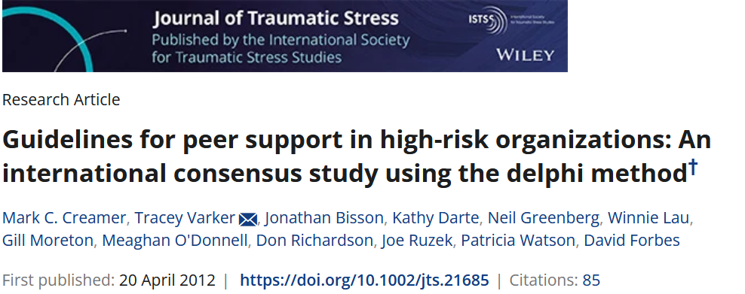
Peer supporters = people like us
Research shows we prefer to speak to people like ourselves
Peer support may be informal or formal
Peers can provide low-level psychological support
Peers encourage & facilitate pathways to professional help
Notes:
Lots of research to show that we prefer to speak to people like ourselves over anyone else. Peers can be a crucial support.
With training peers can provide effective support, reassurance & education
Encourage & facilitate pathways to professional help (not just for mental health, for all sorts of concerns)
Some options coming up…

Slide 31
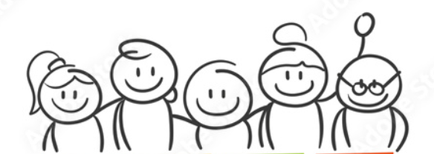
Peer support options
Informal “tea room” chats, often ad hoc
More formal conversations which may be routine (planned) or reactive (something has happened)
Variety of evidence-based peer support options including reflective practice and trauma specific “TRiM”
Notes:
Conversations can be simply between 2 people or may involve more (groups).
Mentoring
Trained peers can provide very effective support, reassurance & education. Well placed to spot colleagues having difficulties
All sorts of options including Reflective Practice, active listening conversations, TRiM, StRaW (not counselling or therapy).

Slide 32

Reflective Practice
Aims to:
  create a “meaningful narrative”
  improve working relationships
  reduce stress
Structured open discussion of facts, emotional & psychological impacts
Needs to take account of multiple levels within organisations especially where staff feel let down +/- betrayed
Notes:
Use with small groups who do challenging work together.
Considers emotional & psychological impacts.
Share, normalise, validate, reflect & access peer support.
Numerous different models to use but considers Facts, Impacts, Now (including individual and team function) and some Education
Multiple levels – may be a group simply for one “grade” of staff but also consider whole teams. Interesting work at Kings around Covid working, MI and carefully bringing together different levels including managers.

Slide 33
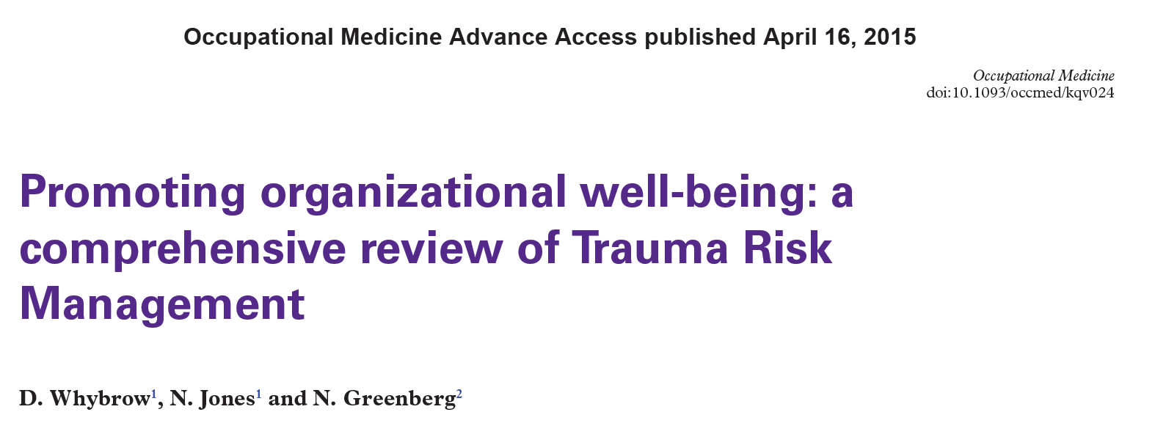
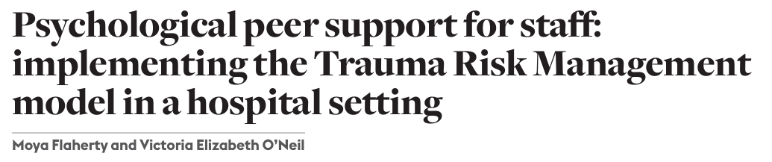
Trauma Risk Management (TRiM)
Research evidence based and supported
A way to help us to understand normal reactions to potentially traumatic events
Effective – keeps people doing what matters
A proven way to spot people in difficulty early and get them to professional help if they need it
Nursing Management 2021
doi:10.7748/nm.2021.e1977
Notes:
You may well have heard of TRiM – anyone have it in their workplace?
Started in the UK military in the late 90s Now widely used in the NHS (and elsewhere) – NHS TRiM Network
Research evidence based Trauma-focused peer support system to help people who have experienced a traumatic, or potentially traumatic, event
Focuses on doing the things that matter
Usually volunteer Practitioners undergo a 2 day course and will often do TRiM alongside their day jobs.
Uses “active monitoring” to pick up any signs of psychological distress and facilitate collaborative, acceptable support where possible involving people’s line managers

Slide 34
Referring on
Notes:
This would likely be for an occupationally focused mental health assessment +/- treatment

Slide 35

“Red flags”
Ongoing distress
Difficulty functioning at work +/- home
Isolating themselves
Out of character behaviour
Talk of harm
Struggling 4-6 weeks after PTE
Gut feeling
Notes:
It may be that there’s no clear “trauma” history – could be type 2 – but that shouldn’t stop referral

Slide 36
Referring on….
Staff need to know how to get help for themselves and colleagues
  Information should be easy to find
  Straightforward referral process
Timely access to occupationally focussed, evidence-based care
Notes:
REALLY important that people know how to get help for themselves and their colleagues.
Needs to be easy to find and relatively straightforward as time can be short and often number of ongoing tasks.

Slide 37
Workplace trauma support
Strong bonds matter!
Peer supporters
Foster and encourage vertical & horizontal bonds.
Bonds
Peers
Informal & formal.
Can encourage & facilitate further help
Time, skills & confidence
Enable all staff to be able to look after themselves and each other.
Time & skills
Use PIES
PIES
Be guided by PIES. Keep support close & simple.
Clear Pathways
Support options
Options
Pathways
Straightforward timely access to evidence-based advice, guidance or care.
Remember PIES!
Offer both proactive & reactive support.

Slide 38

info@marchonstress.com
Questions welcome!

