Slide 1
Upper limb injuries in the context occupational health.
Mr Al-achraf Khoriati
T&O Consultant
Specialist interest in Upper Limb
Notes:
Good morning everybody,
My Name is Al Khoriati. I am a consultant orthopaedic surgeon working out of Ashford and St Peters Hospital in Chertsey.
I cover general trauma but I have a specialist interest in Upper Limb pathology, I.e. disorders of the shoulder, elbow and hand.
I’m going to try and give you a summary of the impact of upper limb conditions on a patient’s day to day living and
hopefully cover the optimal treatment strategies that should be taken in order to ensure your patients have the speediest
possible recovery and return to normal function on a day-to-day basis.

Slide 2
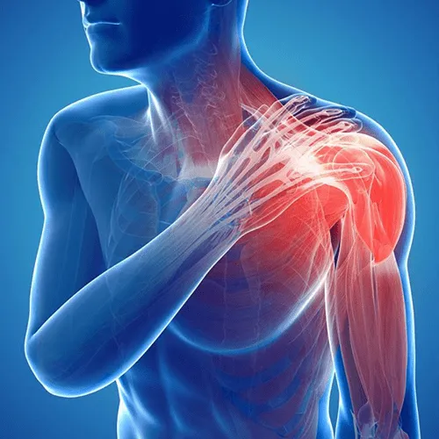
Prevalence of upper limb disorders (ULDs) is very high in the
general population
One in two people experiencing symptoms in the neck or arm each week^{1,2}
Notes:
Upper Limb injuries or pathology are highly prevalent in the UK population with some studies reporting that up to 1 in 2 people a week experience pain in their upper limb or neck each week. The pathology involved is often complicated and can be difficult to treat if the correct diagnosis is not made early and appropriate treatment is not initiated early.

Slide 3
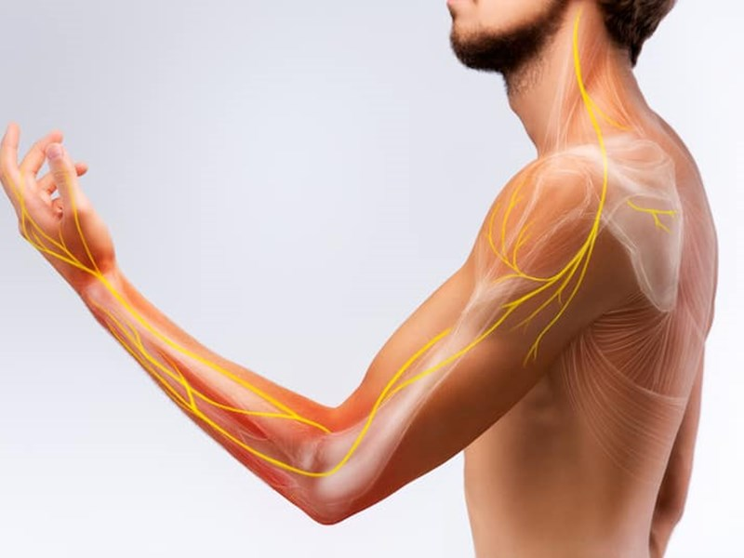
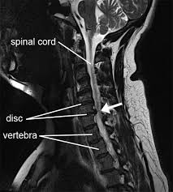
Referred pain
Notes:
It is important to consider the neck as a potential source of upper limb pain - impingement of the spinal nerves by intervertebral discs can often be missed so it is always worth thinking about radiculopathy as a potential cause. Sadly, I do not have time to cover this today but it is always worth bearing in mind when assessing a complex patient. If the patient complains of neck pain or the pain shoots down the arm or is associated with numbness/ tingling or the pain isn’t exacerbated by particular movements – always think SPINE and refer onwards for further assessment. This can be an MRI/nerve conduction studies or simply review by a spine specialist.
Individuals at risk include those in occupations where the neck remains in prolonged neck flexion/extension (desk work, drivers, manual work)
Ensure ergonomic assessments of the workstation or job tasks are conducted, focusing on neck posture and repetitive use of the upper limbs.
Temporary job modifications may be required, including:
Reducing overhead or repetitive arm use.
Avoiding prolonged static postures.
Introducing micro-breaks and posture variation.

Slide 4
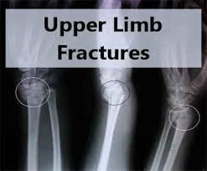
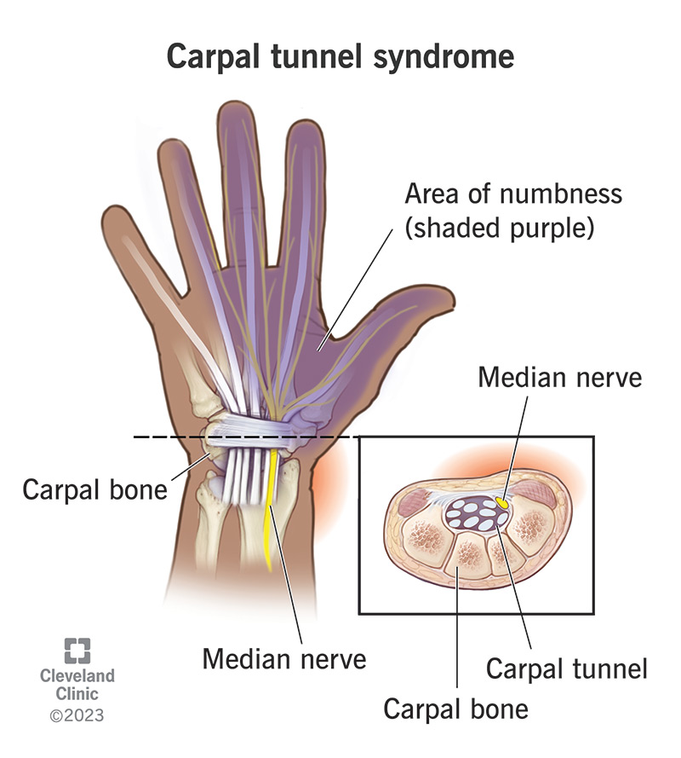
Elective Vs Trauma
Notes:
To make upper limb pathology easier for you to understand I’m going to break down my talk in to upper limb trauma vs elective pathologies. Acute Vs Chronic conditions. These are managed slightly differently but in an ideal world – Both should be treated by specialist, fellowship trained surgeons with key support from allied health care professionals – Nurses, physios, hand therapists and Occupational therapists.

Slide 5
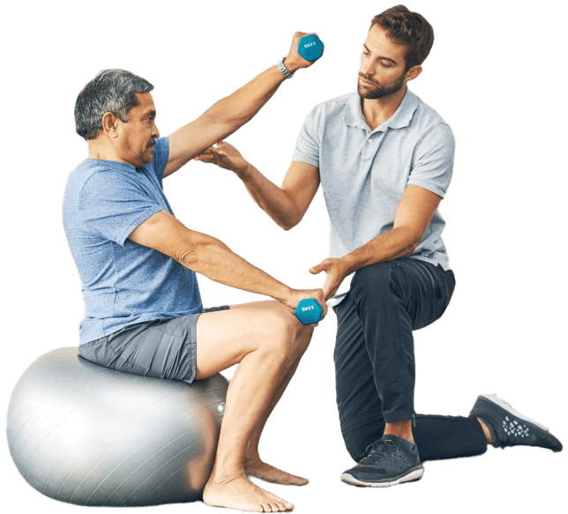
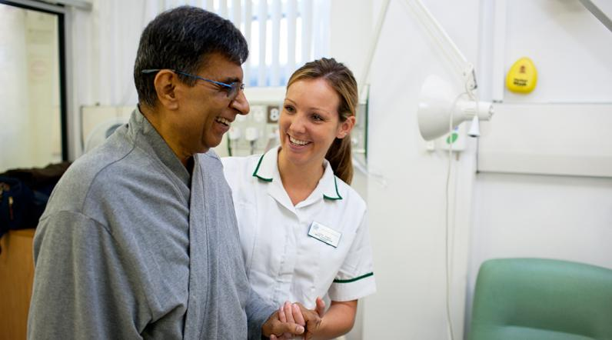
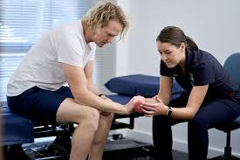
Allied healthcare professionals ae key to rehab!
Notes:
You can do the best operation in the world but in the absence of correct and PROMPT rehabilitation outcomes will inevitably ne worse!
From an occupational health perspective, it is equally crucial to ensure that timely and appropriate workplace rehabilitation is part of the recovery pathway. Delays in rehabilitation can lead to prolonged absence, deconditioning, and even psychological barriers to returning to work.

Slide 6
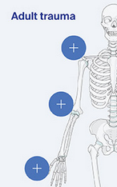
Upper limb trauma
Injuries to the shoulder / girdle
Injuries to the elbow
Injuries to the hand
The basic unit of orthopaedic healing:
6 Weeks!
Pain/Weakness/STIFFNESS!
Notes:
Injuries from Shoulder to the fingertip
Although I cannot cover every type of injury in detail – as a rule of thumb fractures to the upper limb will take 6 weeks to heal
More or less factoring in age, comorbidities and lifestyle (Smoking/steroid use)

Slide 7
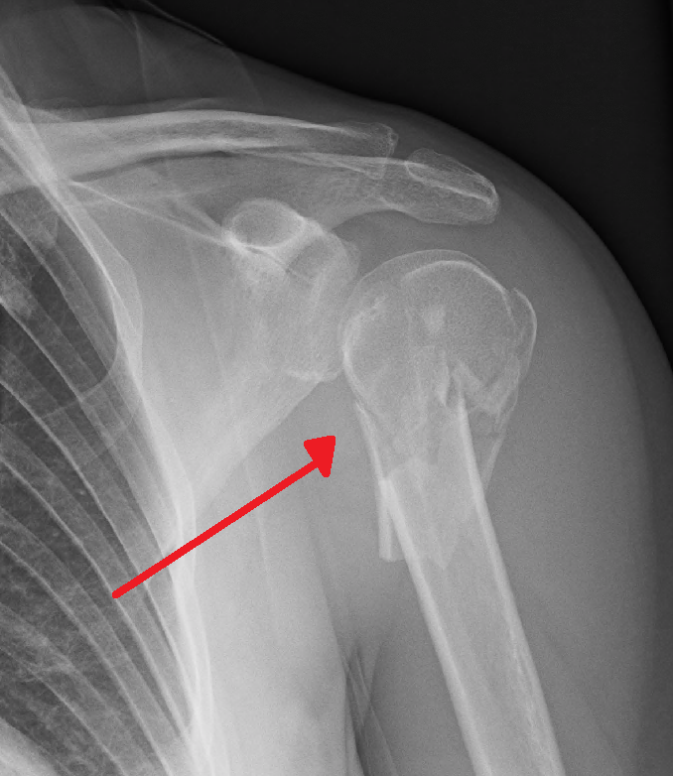
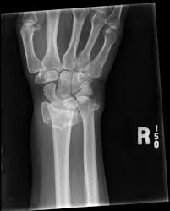
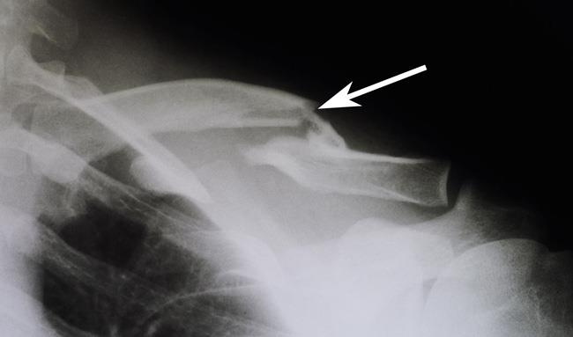
Examples of upper limb trauma
Notes:
Here are some examples of common upper limb traumatic injuries. A fractured humerus, clavicle and distal radius

Slide 8
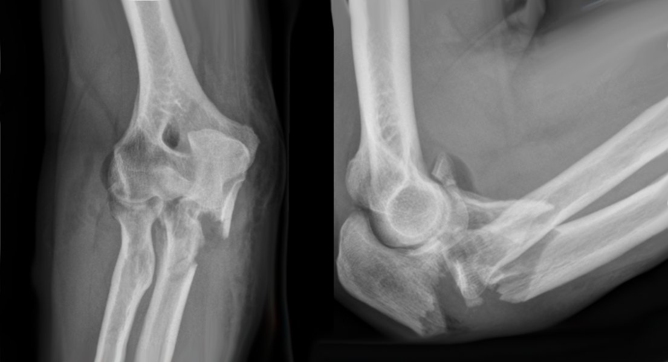
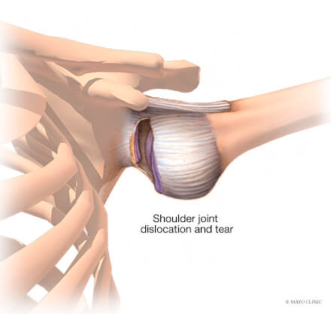
Get to a specialist ASAP!
Notes:
These injuries can be complex and require subspecialist training in order to manage correctly.
An upper limb specialist will be accustomed to seeing these fractures regularly
Although basic upper limb trauma can be managed by a generalist – a significant number of these injuries can present with subtle symptoms or sequalae which must be managed by a specialist.

Slide 9
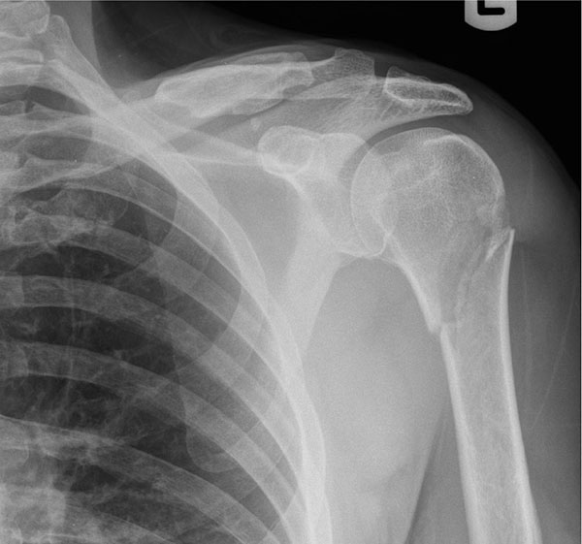
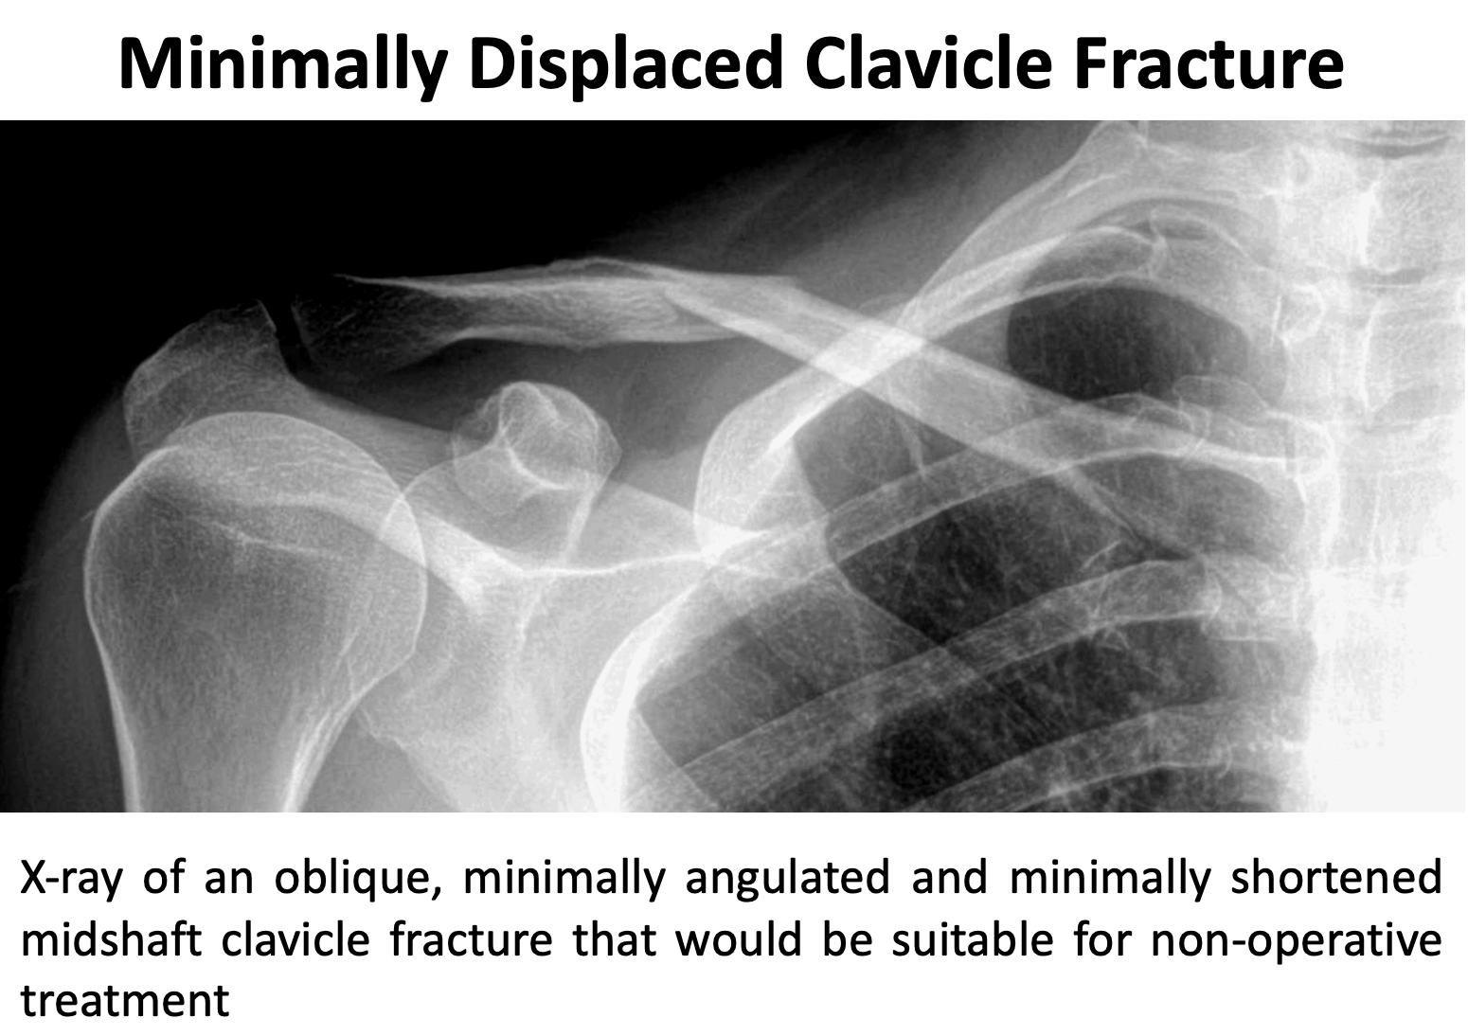
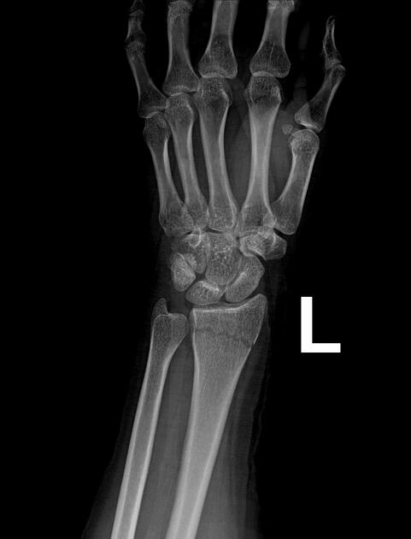
Not all injuries need surgical management
Notes:
Splinting and non operative management of these injuries can be acceptable in the right patient.
It is important to know that some subtle fractures can have a big work impact on a patient’s ability to work

Slide 10
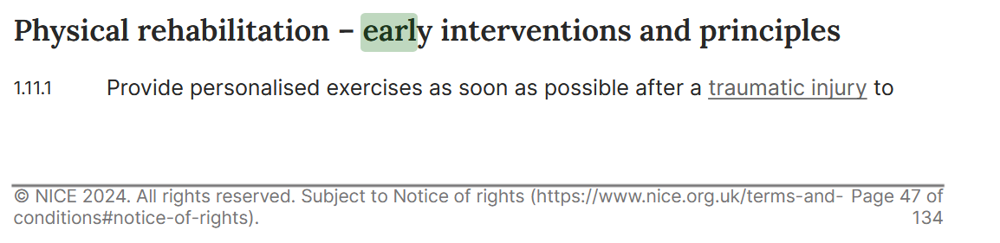
Early rehabilitation is key!
Notes:
The quicker you can get a patient to rehab – the better the outcome! Early detection and onward referral is key. Patients always do better when the physio sees them sooner.
physiotherapy is essential not only for physical recovery but also for improving mental well-being, confidence, and reducing the risk of reinjury. Taking dedicated time for therapy supports full engagement in rehabilitation and reduces stress.

Slide 11
Examples of how trauma will affect an employee
Shoulder trauma: elevation above shoulder height
Elbow trauma: stiffness – ability to reach the face or down low
Hand trauma – fine control, typing, gripping pens or keys.
Posture: ability to hold in certain positions
Strength: ability to lift heavy objects.
Fatigue and pain.
Loss of concentration or dexterity.
Notes:
Shoulder trauma: elevation above shoulder height
Elbow trauma: stiffness – ability to reach the face or down low
Hand trauma – fine control, typing, gripping pens or keys.
Posture: ability to hold in certain positions
Strength: ability to lift heavy objects.
Fatigue and pain.
Loss of concentration or dexterity.

Slide 12
Complications of surgery
Infection
Scarring – sensitivity/stiffness
Nerve injury: numbness/weakness
Revision surgery – removal of metal.
Notes:
Surgery is not without risk and the potential for post operative complications.
Infection can lead to further long-term treatment with antibiotics – patients can feel washed out and develop other health related issues (deafness, liver disfunction)
Scarring, particularly in the hands can lead to hyper or loss of sensitivity as well as stiffness
Remember anyone that has metal put in may need a second surgery to extract it.

Slide 13
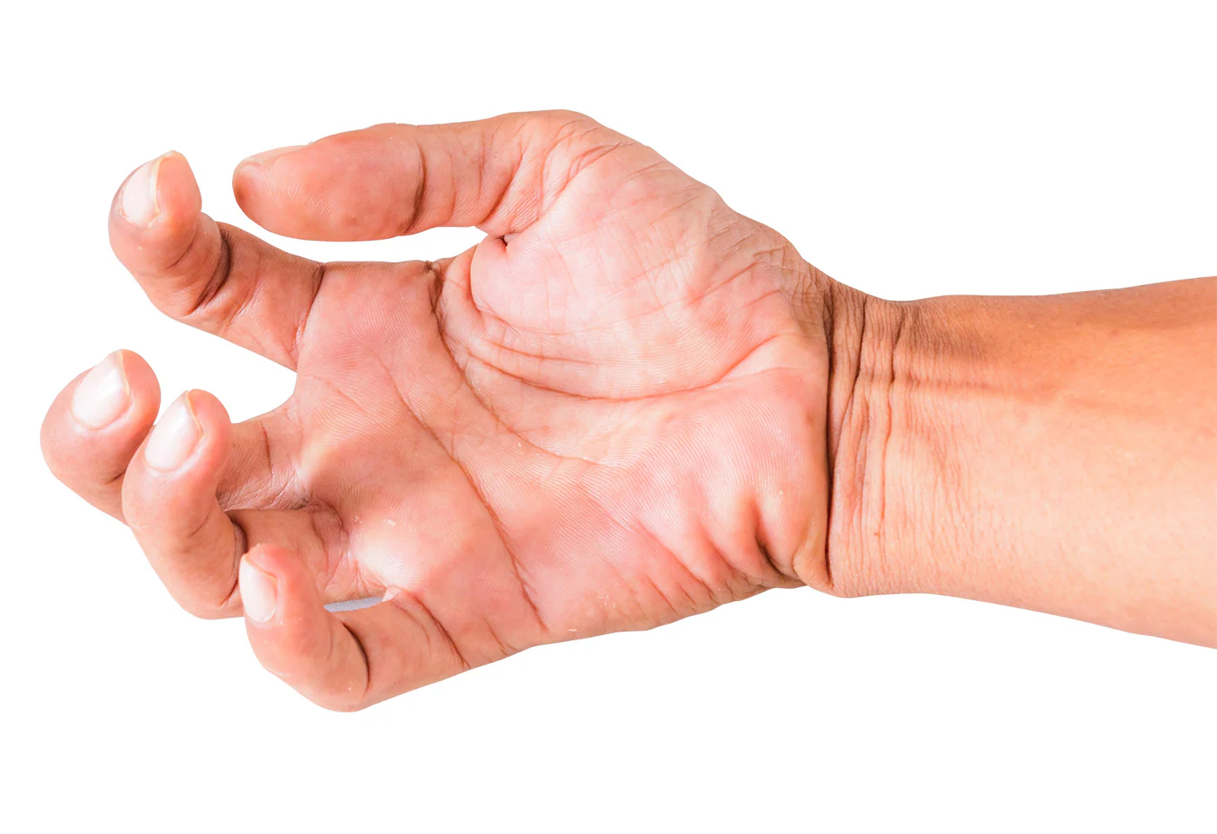
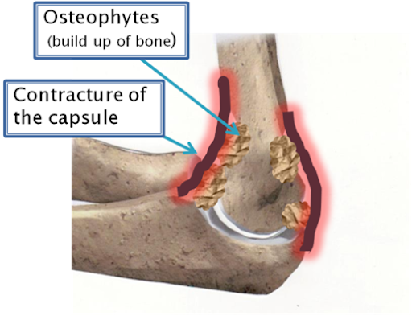
How quickly will patients recover?
Recovery is dependent on early intervention
Prolonged immobilisation can be disastrous!
Basic unit of bone healing 6 weeks – full healing can take months
Recovery dependent on patient factors and occupation
No heavy lifting – strenuous activities for MONTHS
Communication is key
Notes:
Early intervention – leads to earlier recovery.
Patients left in a sling or a brace will often be left with permanent stiffness – very difficult to treat. Contractures occur and these are very difficult to manage!
Bone takes a minimum of 6 weeks to initially heal in adults and months to strengthen to the point where strenuous activity can be done safely
Patient factors are key – hand dominance and smoking/lifestyle/psychological factors
Beware of patient subtypes – anxious patients or those with no insight into the recovery process (those too keen to return to work/sports early
Communication is key – hence the early need for specialist input.

Slide 14
How much time do patients need off work?
Job dependent.
Desk based job. Ability to place the arm in prolonged periods in one position – consider assistive tools.
Limb dominance.
Manual work.
Long term outlook.
6 weeks minimum! 2-6 months with more manual jobs.
Notes:
How much time do patients need off work?
This depends very much on what is required in the patient’s job and what is required of them
Patients in desk-based jobs may have to maintain a certain posture with their shoulder and repetitively use their wrist/hand
Examples:
Difficulty lifting, raising, or extending the arm may hinder basic office tasks like using keyboards, phones, or accessing files.
Pain and Fatigue. Desk work may cause shoulder pain and fatigue, especially when overcompensating with the opposite arm.
Consider modification tools to ease their passage back to work
With any kind of traumatic injury – most patients
Eg dictation software
Manual work:
Strength needs to return – can speed up recovery with physio to strengthen muscles.
Longterm outlook:
If complications (e.g., frozen shoulder, radial nerve injury) arise, there may be longer-term impacts on job performance.
With appropriate support, most desk based occupations can fully return to their role within 6–12 weeks, depending on severity and recovery.
With manual type work, the recovery can take months as muscles/tendons take longer to recover and rebuild.

Slide 15
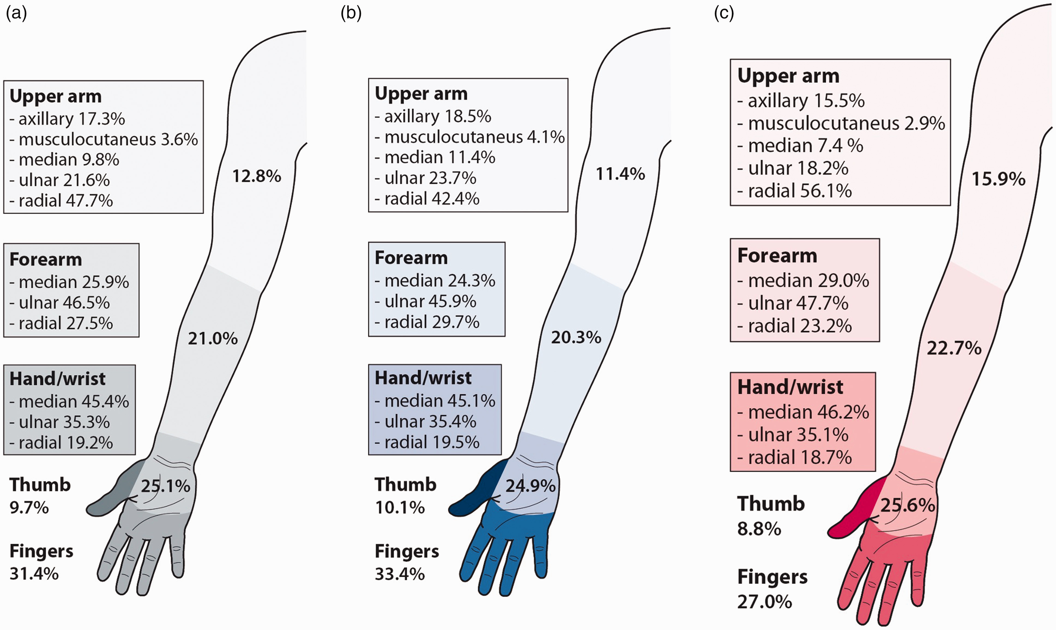
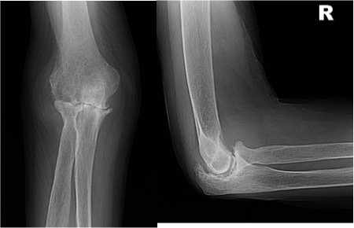
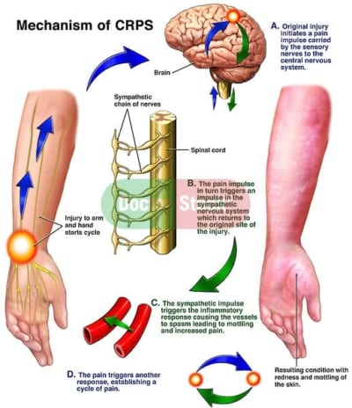
Long term sequalae of trauma
CRPS
Nerve injuries
Arthritis
Notes:
Arthritis – incidence varies depending on severity of trauma and limb, and intervention – limbs such as the elbow can be very unforgiving (approximately 30% of patients who experience elbow fractures will develop PTOA). Ultimately the only cure is joint replacement – This has a huge impact on patient function and can often mean the end of a manual job.
Stiffness and weakness are extremely common
Nerve injury can seriously hamper rehabilitation – nerve recovery can take months to years
Complex Regional Pain Syndrome (CRPS) incidence is higher in the upper limb compared to the lower limb, with a reported incidence rate of 5.5 per 100,000 person-years in the US according to Orthobullets. Women are more commonly affected (3-4 times more frequently than men)
It is extremely difficult to treat and requires prompt recognition and intervention to prevent permanent disability.
Ill health retirement (IHR) may be considered when the shoulder fracture results in permanent functional impairment that prevents the individual from performing their job safely, reliably, and with reasonable adjustments.
Common Criteria Include:
Failure to regain functional use of the arm (e.g., due to stiffness, non-union, or complex trauma)
Chronic pain unresponsive to treatment
Associated nerve damage (e.g., axillary or brachial plexus injury)
Development of frozen shoulder or post-traumatic arthritis
Inability to return to the specific demands of the job (e.g., lifting, overhead work, repetitive arm use)
Ill health retirement (IHR) may be appropriate when a shoulder fracture leads to permanent impairment that prevents the person from safely or reliably performing their job, even with adjustments. Key reasons include loss of arm function, chronic pain, nerve damage, or complications like frozen shoulder or arthritis, especially when the job involves physical tasks.

Slide 16
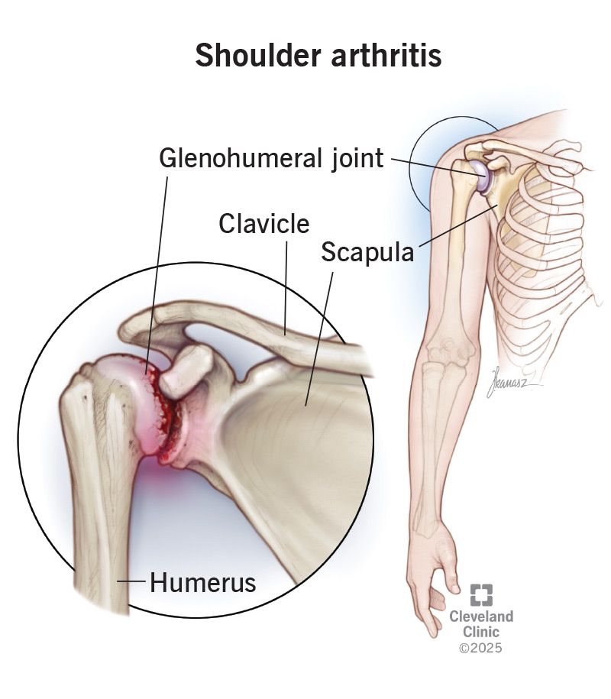
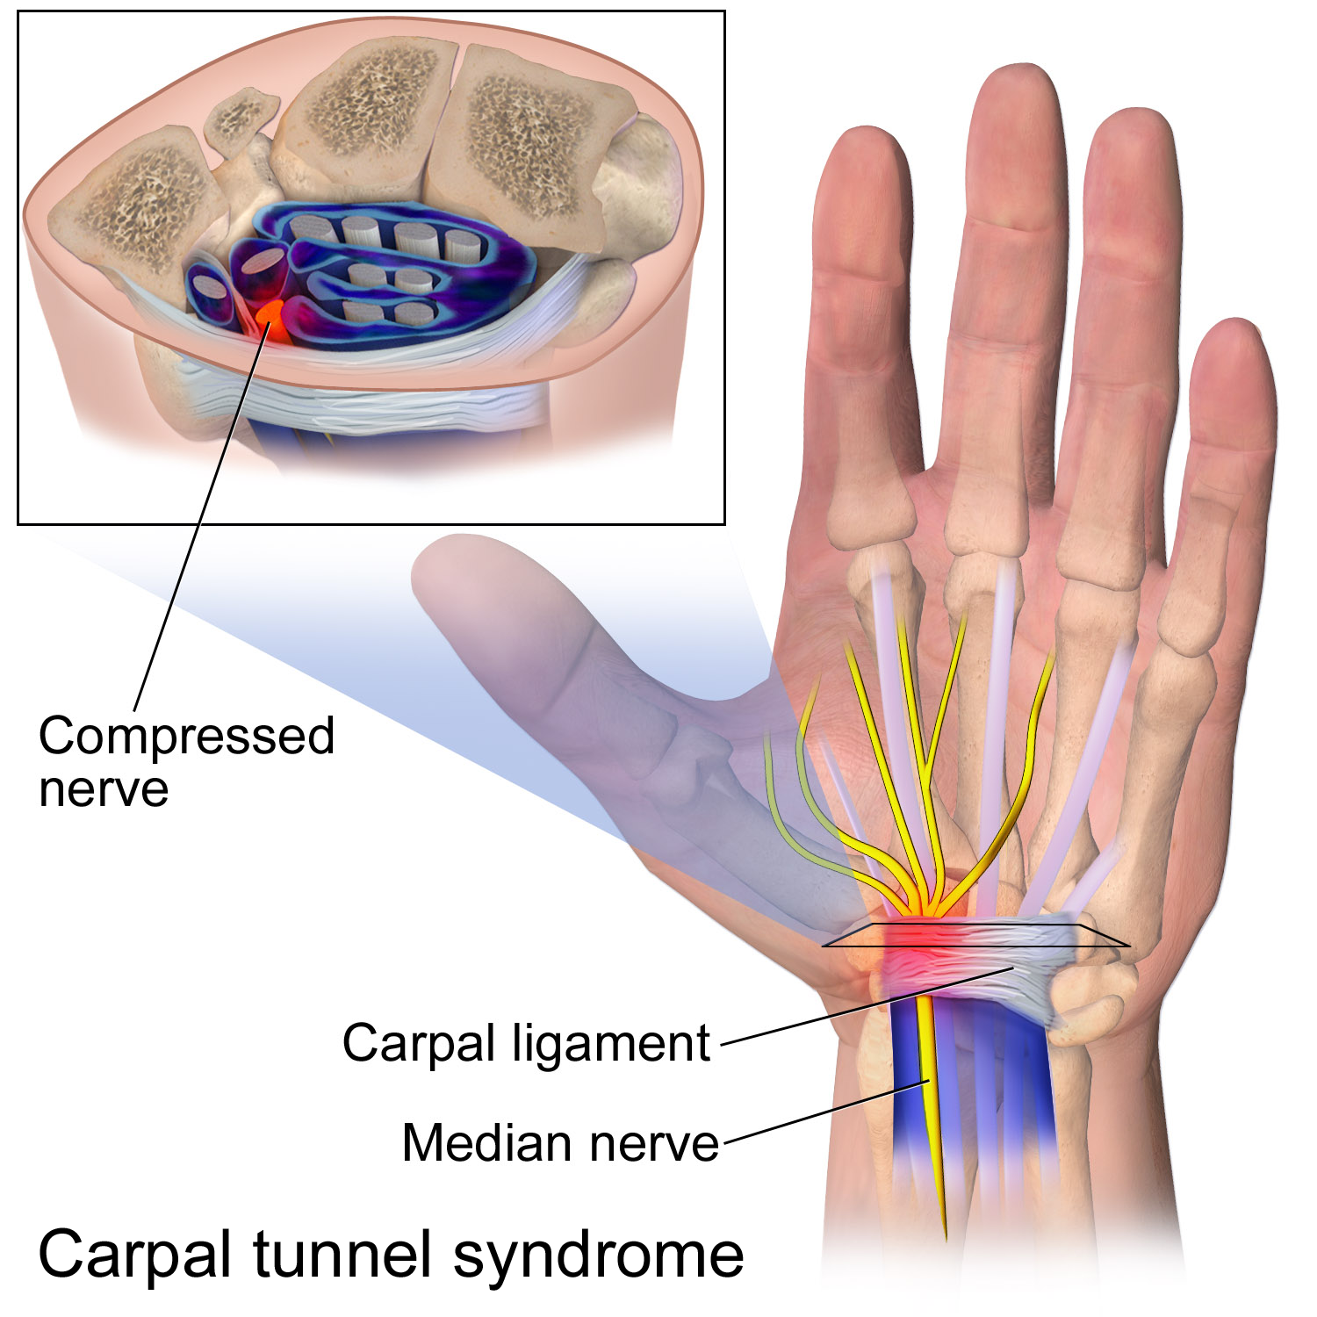
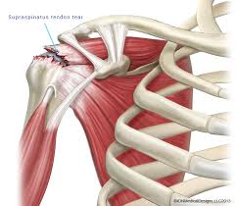
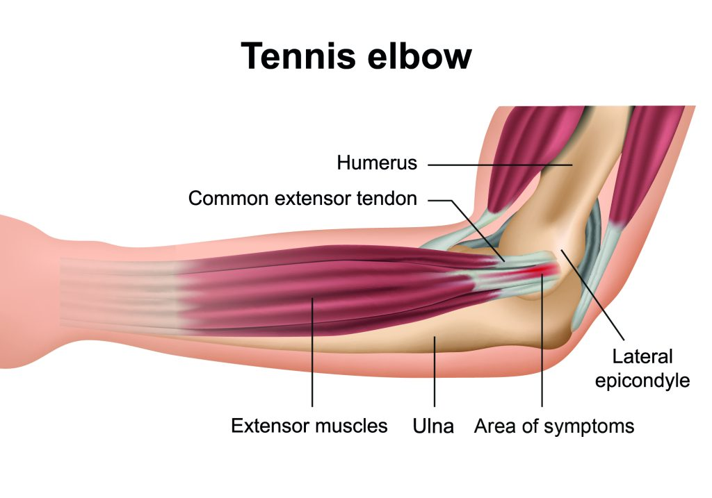
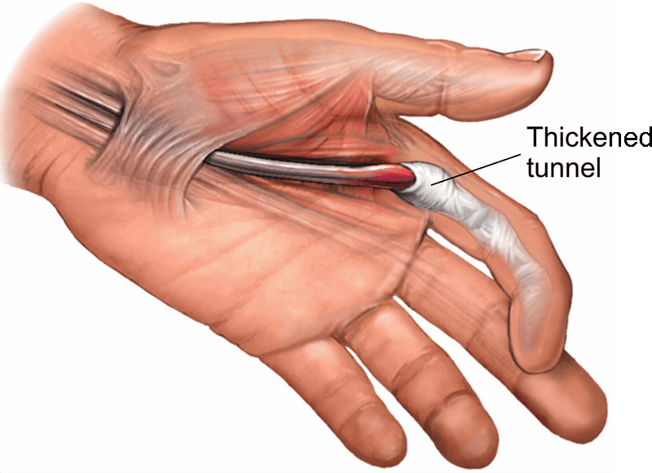
Elective or chronic conditions
Notes:
Electively treated conditions progress slowly over time and management of these conditions is much more staged and planned
Again – early diagnosis is key and the correct management strategy depends on prompt diagnosis and early specialist intervention where appropriate
These broadly fall into 3 categories:
Neurological entrapment (carpal/cubital tunnel)
Tendinopathy (trigger/tennis elbow/rotator cuff)
Arthritis

Slide 17
Patient factors
Limb dominance
Occupation
Modifiable/non-modifiable factors
Workplace adjustments
Notes:
The management of these conditions depends on a number of factors.
The limb dominance of the patient
The type of work the patient does – e.g. shoulder injuries might not affect a desk-based job as much as a builder
Modifiable factors affect recovery – smoking/ blood sugar levels/medications and drugs
Workplace adjustments must be made – ie a police officer that can go from a patrol-based job to a desk-based role till they have recovered.

Slide 18

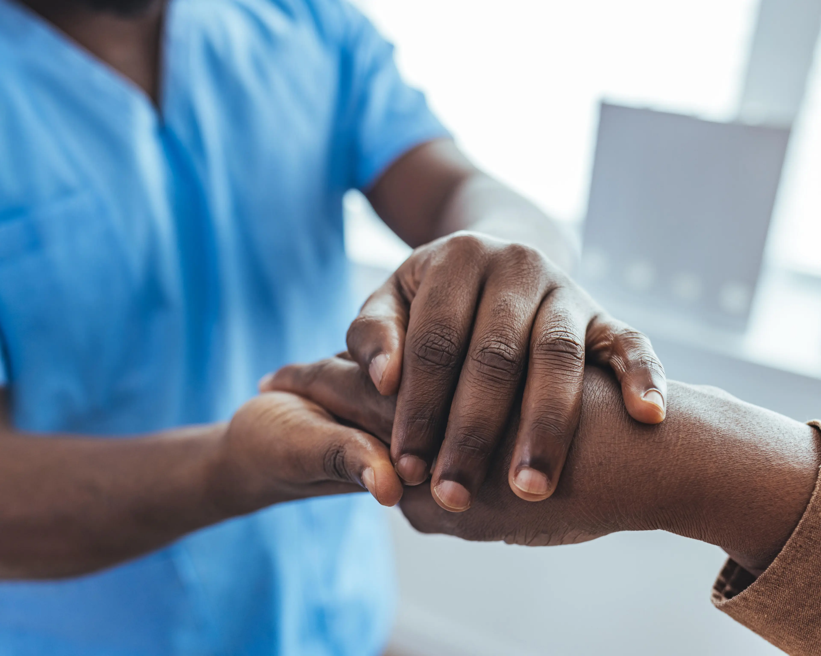
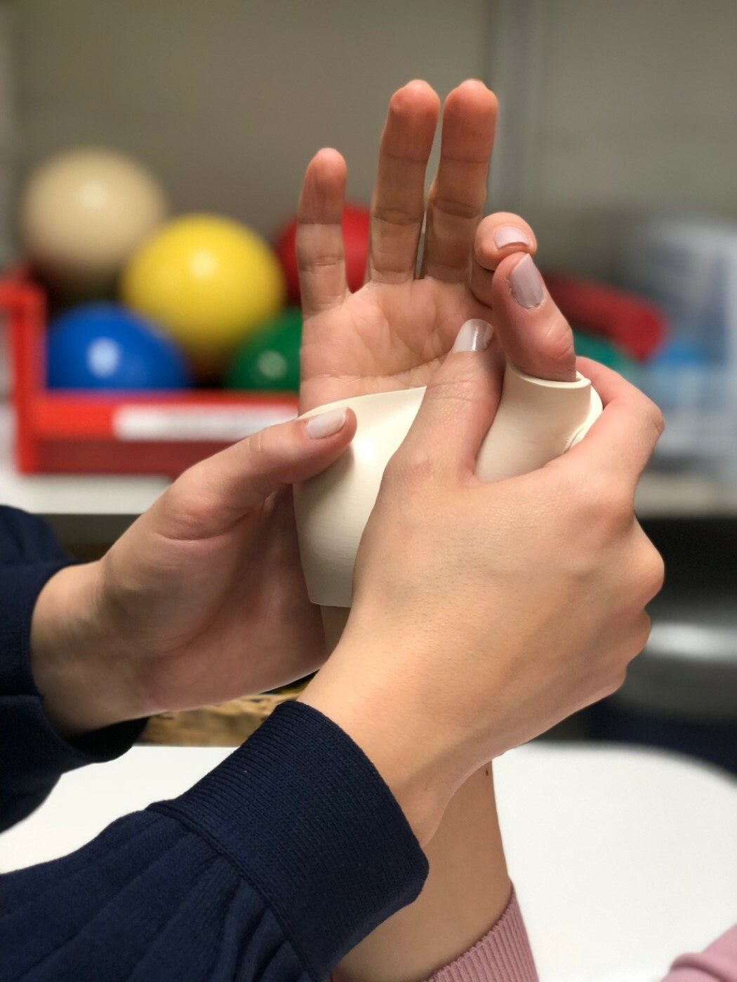
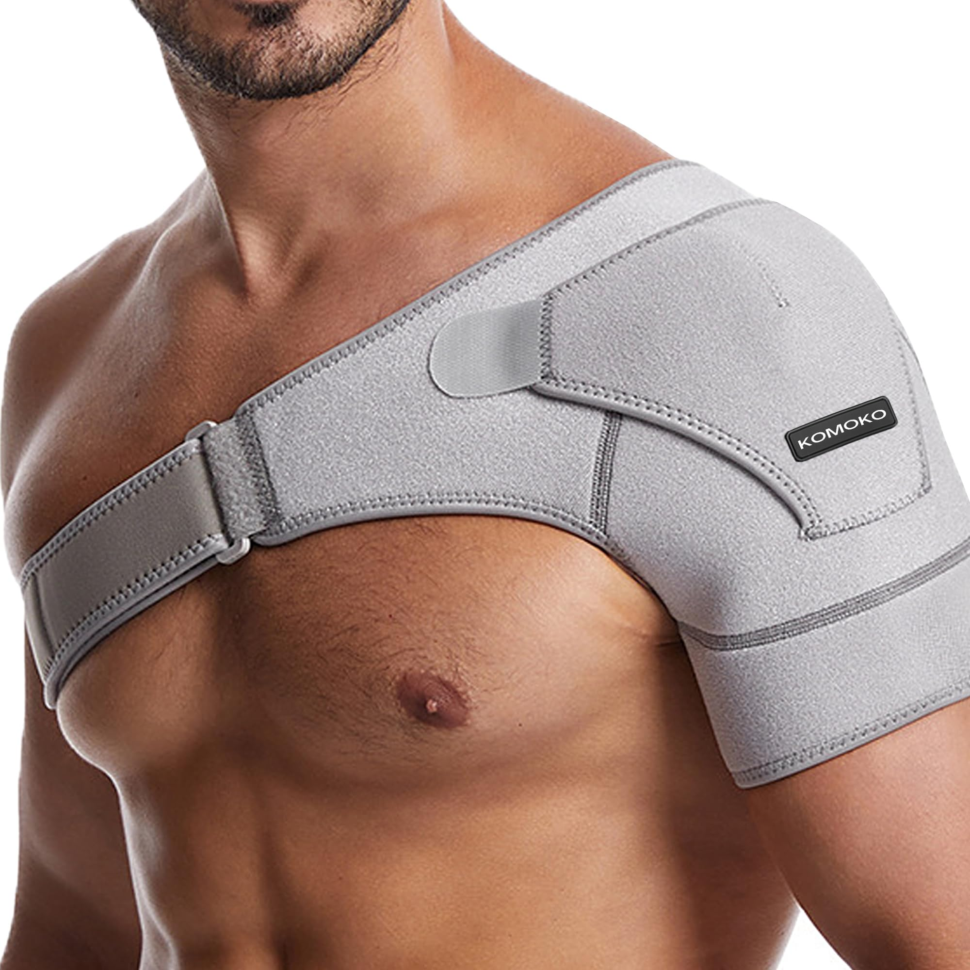
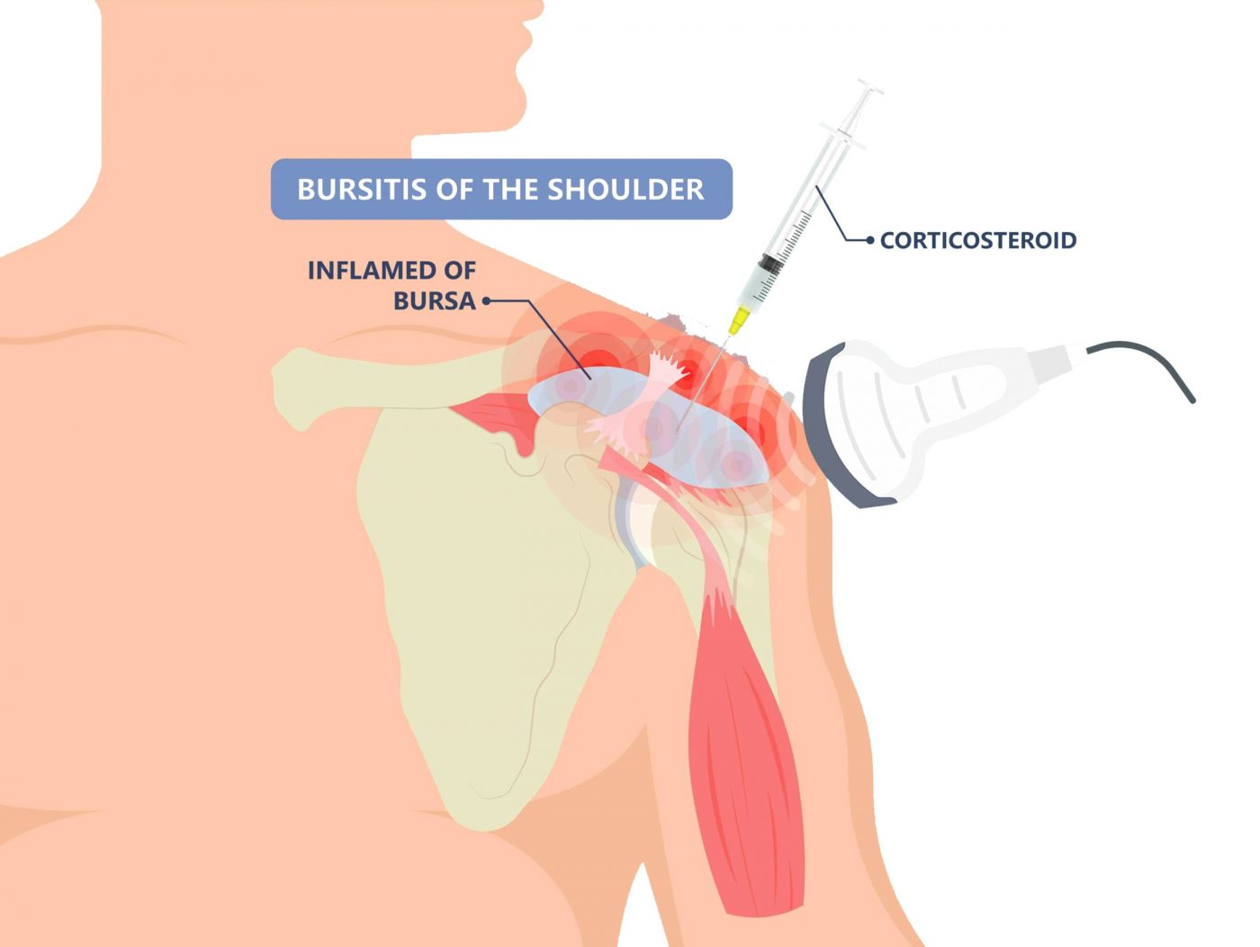
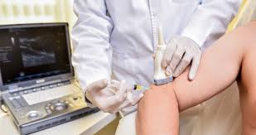
Non operative interventions
Notes:
Hand therapy and physio can play a vital role in the management of these conditions – particularly the tendinopathies. A combination of exercises and splinting can prove invaluable IF the patient is disciplined and motivated.
Steroid injections should be mainly used DIAGNOSTICALLY – they carry risk and at best can offer transient therapeutic value (though if the pathology is mild they can give long term relief)
BEWARE of injecting those with poor quality tendons with Steroid! Risk of tendon rupture!
PRP holds promise – variable success in terms of the available literature but anecdotally I have found it to be useful in tennis elbow. Different doses needed for different joints and the quality of the PRP extracted will differ from patient to patient.

Slide 19
Occupational health modifications to the workplace
Neurological conditions
Tendinopathies
Cuff tear
Arthitis
Notes:
Summary of OH Advice for Electively Treated Upper Limb Conditions
Neurological Entrapment (e.g. Carpal/Cubital Tunnel) –
Symptoms: numbness/pain/weakness
Advice: Ergonomic assessment, splints, task rotation. Light duties or restrictions may be needed during treatment.
Tendinopathy (e.g. Trigger Finger, Tennis Elbow, Rotator Cuff)
Symptoms: Pain with movement, swelling, limited range.
Advice: Early physiotherapy, activity modification, and avoiding repetitive or overhead tasks. Gradual return to work after interventions after weeks-months
Rotator Cuff Tear Non-surgical: Improvement in 6–12 weeks. Surgical: Basic recovery in 4–6 months; full function may take up to 12 months.
Advice: Joint protection, regular breaks, and workplace adaptations (e.g., assistive devices). Phased return and long-term adjustments may be required.
Arthritis: the primary symptom is pain. Avoid exacerbating activities. Impact related activities. Manage with analgesia

Slide 20
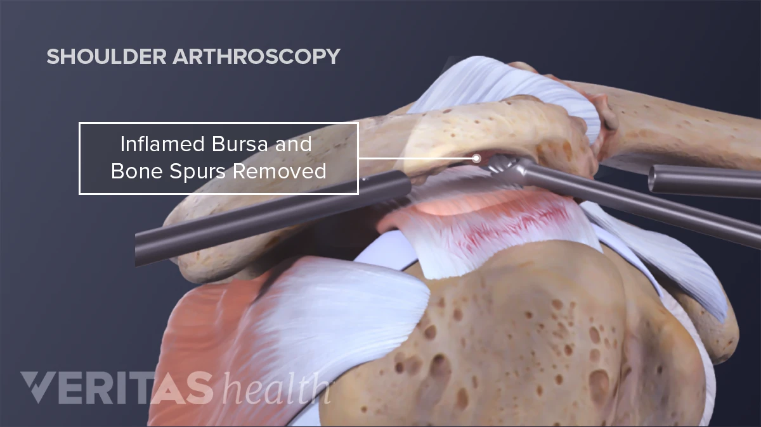
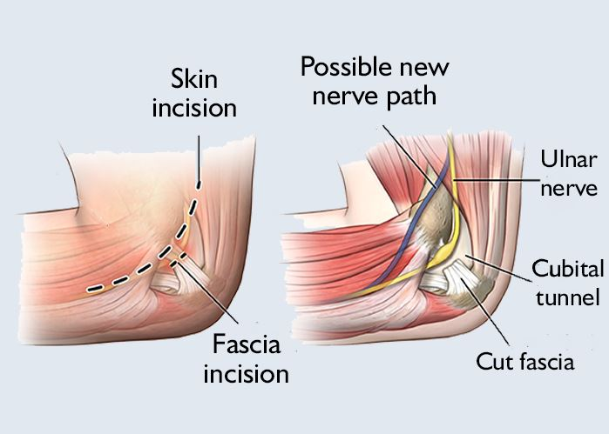
Surgical intervention – decompressive procedures
Notes:
Decompressive procedures (ASAD) can relieve trapped or irritated tendons or joints and regain ROM – success depends on how advanced the disease is and HOW QUICKLY you get the patient to physio- I will personally arrange for the physio to see them on the day and arrange follow up.
Failure to do so will result in stiffness, weakness and incredibly poor outcomes. Patient selection is key. Pick the wrong patient and you will have a very poor outcome
The success of nerurological decompression depends on the severity of the compression as well as its duration and the patient’s ability to recover (diabetes/smoking)

Slide 21
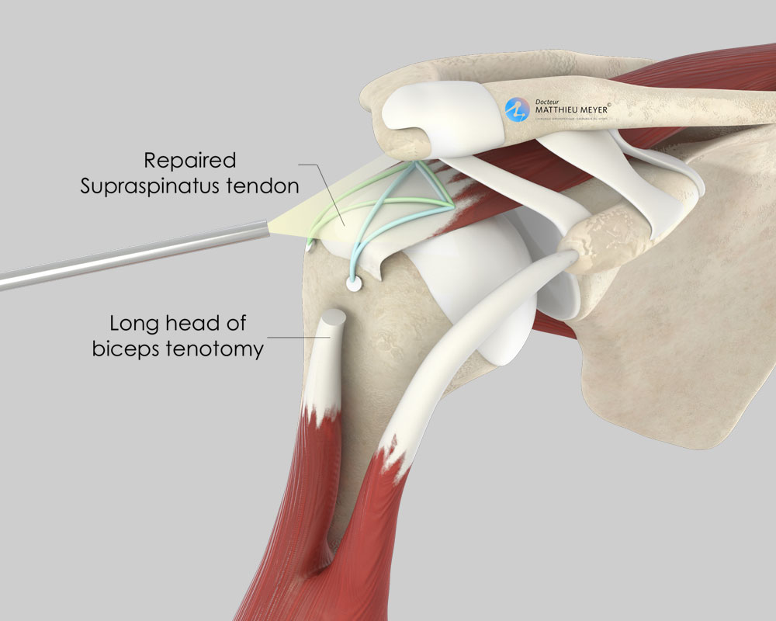
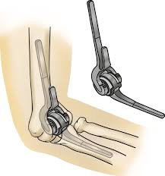
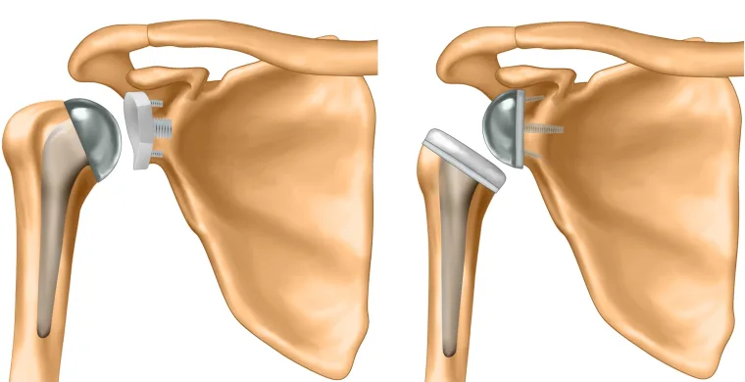
Reconstructive or salvage procedures
Notes:
Reconstructive procedures – such as cuff repair are complicated procedures undertaken by a specialist when non op intervention is inappropriate or has failed.
Joint replacements are salvage procedures
Recovery from these operations is at least 3 months and there will be a limit to what the patient can do after a joint replacement in the upper limb
Limited ROM and weight liftable
Patients must be warned of this preoperatively – to manage expectations

Slide 22

How do we apply these principles to Occupational health?
Guidance for healthcare professionals on the management of upper limb disorders in working-age people
Notes:
Excellent guidelines are available from the Faculty of occupational medicine of the RCP

Slide 23
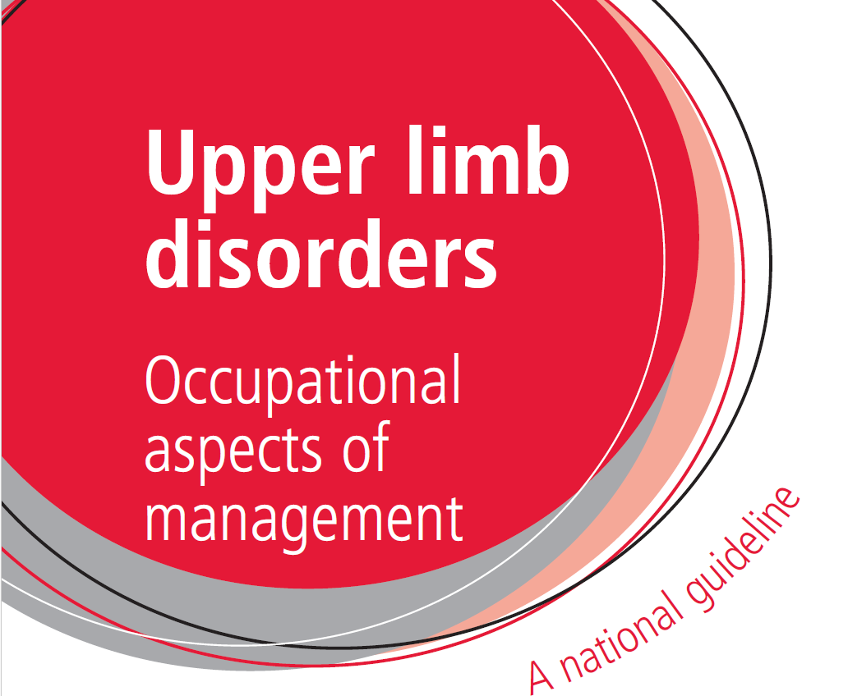

Slide 24
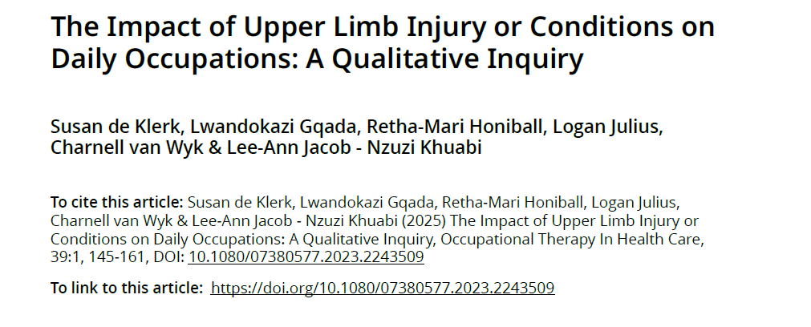

Slide 25
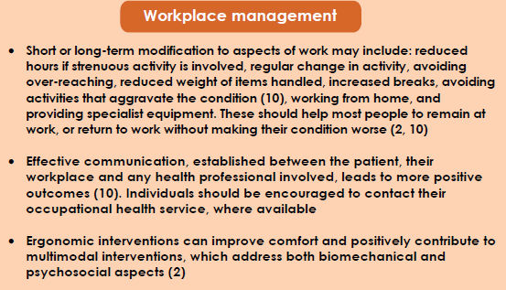
In summary
CATCH AND TREAT IT EARLY
MDT approach
Close liaison between the occupational health doctor, rehab teams and the treating surgeon to set realistic treatment and rehabilitation goals

Slide 26
Any questions?

Slide 27
Bibliography
Burton, K., Kendall, N. A. S., Pearce, B. G., Birrell, L. N. and Bainbridge, C. Management of work-relevant upper limb disorders: a review. Occupational Medicine 2009;59:44–52
HSE (2021) Work-related musculoskeletal disorders statistics in Great Britain, 2021 https://www.hse.gov.uk/statistics/causdis/msd.pdf

