Slide 1



The Vital Role of OH and wellbeing in the NHS 10-Year Plan

Slide 2
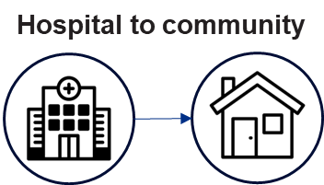




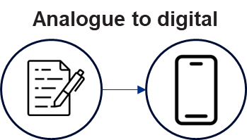



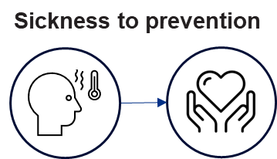

10-year health plan ‘fit for the future’ headlines: Overview
The new Fit for the Future: 10 Year Health Plan for England is based on the following drives:
Case for change
Three shifts
Five enablers
Public satisfaction and productivity fallen
1. New Operating Model
Financial unsustainability
2. New transparency of care
Demographic challenges
3. Workforce transformation
4. Innovation and technology
5. Finance and productivity

Slide 3






10-year health plan headlines: Workforce
The 10 Year Health Plan focuses on the following workforce enablers. This will be further supported by the development of the 10 Year Workforce Plan later in the year.
Digital as enabler to support staff, including training in digital
Improving training / development for nursing, AHPs, and doctors
Skills in research, innovation and system change to support 10YHP
Leadership at the heart, supporting good leaders to lead well
Social mobility, focusing on developing our local workforce
Enhancing the staff experience leading to improved productivity

Slide 4



10-year health plan headlines: Focus on staff experience
The new 10 Year Health Plan for England establishes the need to care for our workforce, to enable them to care for our patients.
Ambitions
Enablers
“A positive experience of work and the workplace should not be a ‘nice to have’… We will bring joy back to work so more people join, learn and stay”.
New staff standards (by April 2026)
Staff Treatment Hubs
Improving flexible working
“We will aim to reduce sickness absence rates to the lowest recorded national average level (approximately 4.1%), saving a potential £200 million a year from reductions in temporary staffing costs”.
“Modernising the NHS as an employer means offering staff more flexibility and freedom to choose where, when and how they work … eliminate agency staffing in the NHS by the end of this parliament”.

Slide 5

Growing OH and Wellbeing Together: Continues to underpin the 10YHP ambitions
The Growing Occupational Health and Wellbeing Together strategy (2022) remains our ‘north star’ for driving change to improve the health and wellbeing of our NHS workforce, and underpins ambitions within the NHS 10-year health plan.
All of the work we do nationally aligns to the four improvement drivers on improving culture, transforming OHWB services, growing the workforce, and demonstrating impact / return on investment to drive forward improvements.
“Improving the health and wellbeing of our NHS people by growing our Occupational Health and Wellbeing services and people to be trusted, strategic and integrated partners, creating a proactive, preventative, and supportive wellbeing culture for our workforce”
Growing the strategic culture and identity of OHWB
Growing our OHWB services across systems
Growing our OHWB workforce
Growing OHWB impact and evidence-based practice

Slide 6






Focus on Staff Treatment Access Review (STAR): Case for investing in staff health and wellbeing and treatment hub model
        Hypothesis (proven): Providing access to treatment for common short-term acute conditions for NHS staff will improve their wellbeing, productivity and demonstrate clear financial return on investment in delivering quality and safe patient care.
Case for change
Solutions options appraisal
Increasing NHS workforce sickness is costing billions
Sickness absence is rising annually and is higher now (e.g. 5.4% Nov 2024) than before the pandemic (e.g. 4.6% Nov 2018) where the main reasons include:
  Mental health: 42% staff report being affected by work related stress (Staff Survey 2024), accounting for 27% of all sickness absence in November 2024 alone.
  Musculoskeletal: 29% staff report being affected by MSK issues (Staff Survey 2024), accounting for 13.2% sickness absence in November 2024 alone.
Cost of NHS workforce economic inactivity (being too ill to work): £1.12bn and furthermore losing over 51,000 NHS workers to ill health alone, over the next 5 years.
NHS workforce sickness relating to MSK and Mental Health alone: £1.48bn annually.
Nursing and Midwifery agency spend due to sickness: c.£391m annually. Significantly more when considering wider professions.
Moral and legal considerations
NHS Constitution supports our duty of care to staff, to enable them to care for patients.
ICSs and NHS organisations have a duty of care to staff, where failings have financial and reputational implications.
There is scope to intervene to support NHS organisations meet these duties of care, addressing variation and equity of support available.
1. Do nothing
2. Preferential treatment
Not viable
3. Organisation mandate
4. National transformative universal access model
Not viable, yet
5. Commission Non-NHS support to treatment provision
Supportive, short term
6. System ‘staff treatment hub’ model
Most viable
Productivity and Return on Investment modelling
⬇1% point decrease in sickness absence associated with ⬆ 2.3-3.3% productivity increase.
ROI from practice examples demonstrate on average a £1 investment in staff treatment creates £5 cost savings.
System staff treatment hub pathway
Signposting
Front door and sorting
Self- management
Policy alignment and momentum
STAR is a strong enabler for Government and SoS policy ambitions to keep people economically active, addresses Darzi workforce challenges, and levelling-up of primary care.
There is significant willingness and readiness to create sustainable change from NHS leaders, subject to support.
Clinical intervention
Emergency care
‘Postcode lottery’ of staff support
Unanimous evidence identifies high levels of variation in treatment services for staff, including mental health and MSK. Many have no access to such services.
Financial deficit and lack of sustainable ring-fenced funding is the main reported reason for this.
Hub of treatment interventions
Musculoskeletal
Mental health
Other…
Feedback
System wide services for NHS staff

Slide 7
Groundwork for 10YHP: 2025-26 national deliverables for OHWB
Setting the groundwork for the 10YHP, during this financial year we are focusing on:
Contributing to co-designing the new 10-year workforce plan.
Contributing to creating new staff standards.
Advancing Staff Treatment Hub model - STAR publication and readiness for implementation.
Re-commissioning the national staff mental health treatment service.
Implementing NHS Charities Together health and wellbeing fund.
Publishing the national staff policy framework for attendance and health (i.e. sickness absence).
Advancing Violence Prevention Reduction recommendations as part of AfC Non-Pay in partnership with SPF/DHSC.
Exploring creation/publication of OHWB service standards and directory of services.
Publishing Growing OHWB Together update, focusing on local adoption and case studies.
Train the trainer for the Leader Wellbeing programme.
Continued support to HWB leads community through bulletin updates and events, including partnership with Health at Work Network and NHS Employers.

Slide 8

Collaborating on next steps
Co-design and collaboration with our OHWB community remain a fundamental principles of making the 10 Year Health Plan a success.
Building upon Growing OHWB Together ambition putting OHWB in the ‘driving seat’ to bring about change, there will be many opportunities to engage, for example:
Co-design of the new Staff Standards.
Creating and enhancing resources linked to Growing OHWB, such as OH service standards and metrics.
Implementation of Staff Treatment Hubs, ensuring alignment to an integrated and multi-professional OHWB model.

Slide 9

Finally, thank you
Thank you for your continued support as our OHWB community, to improve the health and wellbeing of our healthcare people, to enable them to continue to pass on care to our patients

Slide 10
Appendix
NB - this is hidden from the main slide deck. It is added as useful information for delegates to review post presentation
10 Year Health Plan overview
Growing OHWB Together drivers and outcomes
Staff Survey 2024 - HWB
Staff Sickness Absence trends from the past 10 years

Slide 11
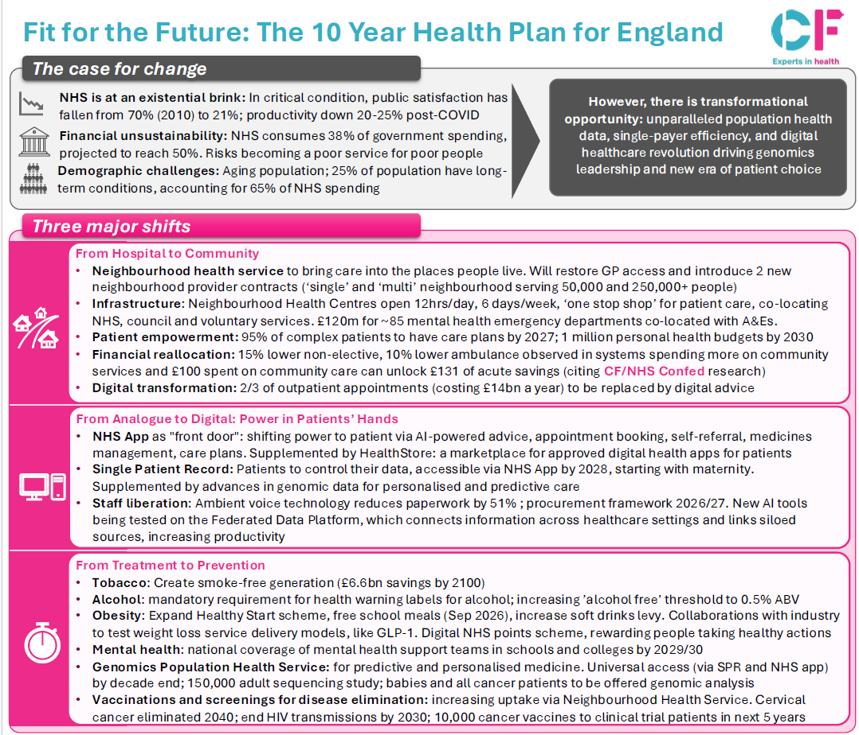
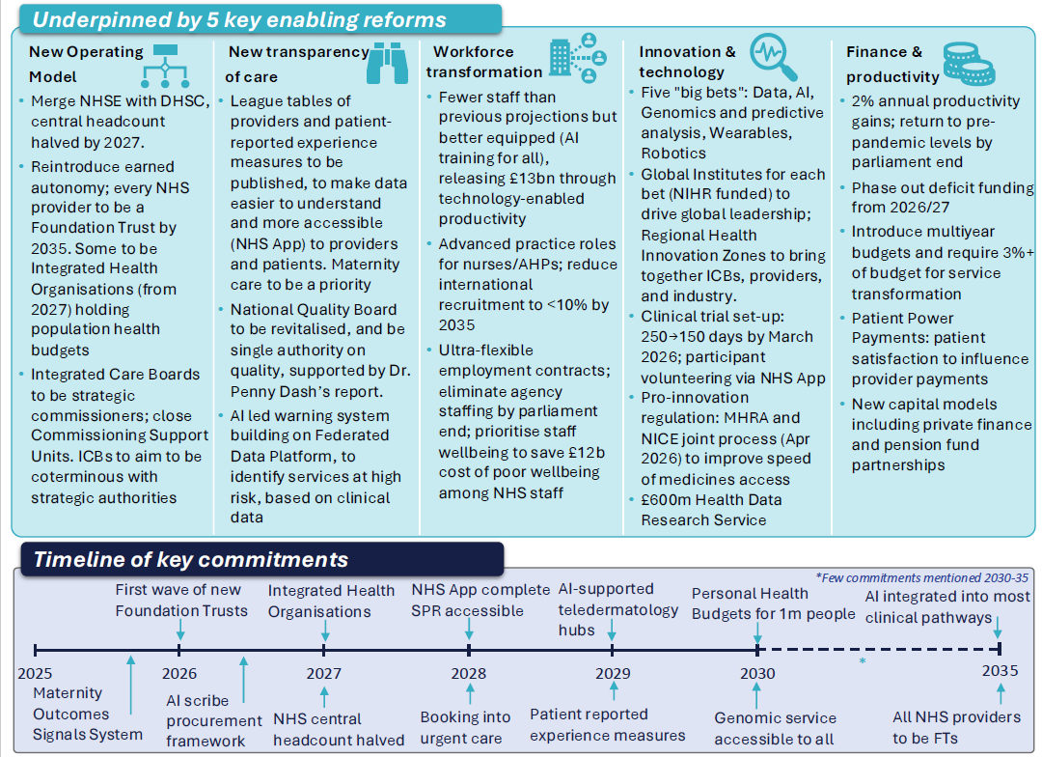
Appendix 1: The NHS 10-year health plan summary
Summary taken from: Fit for the Future: The NHS 10 Year Health Plan for England - CF

Slide 12
Appendix 2: GOHWB improvement drivers and long-term outcome measures
1. | Growing the strategic identity and culture of OHWB
1.1 | Integrated OHWB: OHWB is experienced by service users as one integrated service and multi-professional family who are working toward the shared goal of improving the health and wellbeing of our NHS people.
1.2 | Strategic voice of OHWB: OHWB has a strong voice in all organisation and system-wide decisions that impact the health and wellbeing of our healthcare workforce. This is supported by a comprehensive OHWB strategy.
1.3 | A trusted and proactive brand: NHS employees and managers are the service users of OHWB, and experience OHWB positively as a trusted service that helps them to proactively prevent ill health and improve their personal health and wellbeing, and the health and wellbeing of their teams.
1.4 | Collaborative action and visible investment in OHWB: All stakeholders at national, system and organisational level are united around the Growing OHWB Together strategy. They are working collaboratively to realise the vision, improvement drivers, and demonstrate the positive impact of OHWB in the NHS.
2. | Growing our OHWB services across systems
2.1 | Inclusive, needs-driven, and well-resourced OHWB: All healthcare organisations can articulate their OHWB requirements strategically and operationally, inclusive of their entire workforce health and wellbeing needs. OHWB services and solutions are well-resourced and fully supported by senior/board-level leaders. This is consolidated within each organisation’s OHWB strategy.
2.2 | Integrated service user pathways: All OHWB services are working in an integrated way to improve the health and wellbeing of our NHS people. Services and interventions are inclusive of the entire OHWB clinical and employee support pathway, that holistically encompasses surveillance, proactive, preventative, diagnostic and treatment services, and interventions.
2.3 | Common service development framework: There is an established maturity framework that describes core delivery, through to transformative and exemplary levels of OHWB service. This is actively used to drive up standards for both internally delivered, externally procured, and hybrid models of service delivery.
2.4 | Service innovation: OHWB professionals are actively engaged in work that supports service innovation. They are empowered to lead innovative initiatives and are supported to work collaboratively together to realise these opportunities to advance practice.
2.5 | Quality improvement: All OHWB services demonstrate a commitment to continual quality improvement by maximising the use of accredited quality management standards and service development tools.
2.6 | Maximising technology and digital: The benefits of integrated and innovative OHWB digital technology are maximised. This is reducing demand on OHWB services, increasing OHWB service capacity, and widening access to OHWB services for all our NHS people.
2.7 | Integrated Care System collaboration: Integrated Care Systems (ICSs) have OHWB as a core part of their people strategy. They are collaborating around OHWB service delivery to maximise their combined OHWB expertise and resources, economies of scale, standardisation of services, increased equity of access, and improved quality of OHWB across all their healthcare organisations - inclusive of all healthcare providers, commissioners, and primary care.
2.8 | Improving access to OHWB for smaller healthcare organisations and Primary Care: There is improved and equitable access to the benefits of OHWB services and interventions in smaller healthcare organisations, including Primary Care.
3. | Growing our OHWB people and wider workforce
3.1 | Multi-disciplinary OHWB workforce planning: A new, national OHWB workforce development plan is in place and representative of the multi-professional OHWB family of roles that collectively contribute to improving the health and wellbeing of our NHS people. This plan includes growing capacity and capability of existing professional roles (e.g. OH physicians and OH nurses), growing newer roles (e.g. wellbeing leads, OH allied health professionals, wellbeing guardians, and wellbeing champions) and innovating in new roles (e.g. chief OHWB officer, health business partner, OH apprentices). National NHS bodies and partners are working in a united way to deliver this workforce plan.
3.2 | Attractive career pathways and talent management for OHWB professionals: The family of OHWB professions in the NHS is seen as a valued and attractive vocation. Career pathways in OHWB are clear, accessible, and inclusive of a variety of professional entry routes, both clinical and managerial. A talent management approach is utilised to ensure that there are sustainable talent pipelines, and we are growing our OHWB talent to maximise their potential. This is considered at organisational, Integrated Care System, and national levels.
3.3 | Credible and accessible OHWB education and training: Credible professional training and education enables entry into the OHWB family of roles through a variety of flexible pathways. Higher education partners and expert OHWB bodies are working collaboratively to develop the family of OHWB professional vocational roles in the NHS.
3.4 | Empowered OHWB leaders: Through professional development and peer learning, OHWB leaders are enabled to effectively lead their teams, develop their services, and enable innovation in OHWB.
3.5 | Empowered OHWB workforce: The multi-professional OHWB community are enabled to collaboratively develop their skills, capabilities, and specialised practice through a combination of personal development and peer development opportunities.
3.6 | Developing all NHS managers in supporting employee health and wellbeing: All NHS managers are supported to look after their own health and wellbeing and are empowered to pass this wellbeing onto their teams. They are trained in basic health and wellbeing skills, are confident to engage in good wellbeing conversations with their employees, and are actively signposting and supporting interventions that improve their employees’ wellbeing.
4. | Growing OHWB impact and evidence-based practice
4.1 | Using data to demonstrate the impact of OHWB: OHWB services are using common quantitative and qualitative output-focused metrics, data, and service evaluation methodologies to demonstrate their impact. This routinely forms part of organisational and ICS/system-level board discussions, where wellbeing guardians (or equivalent assurance roles) actively hold organisations to account for improving the health and wellbeing of their NHS people.
4.2 | Driving OHWB practice: The NHS is recognised for driving best practice in OHWB. OHWB research and innovation is supported, and best practice that advances OHWB is captured, shared, scaled, and spread.
4.3 | Demonstrating the value of OHWB: Impact data is continually built upon to clearly demonstrate the value proposition for OHWB in keeping our NHS people well and delivering quality patient care, as part of a wider integrated people strategy.
4.4 | Driving the OHWB market: The united and collaborative voice of OHWB in the NHS is driving up service standards in the OHWB market. This is enabling higher quality, needs-driven, value for money, and impactful OHWB services, interventions and support (both internally delivered, and externally procured) that benefits NHS organisations and NHS people.
4.5 | Demonstrating the impact of this strategy: The Growing OHWB Together strategy is regularly reviewed to establish how all healthcare organisations, systems and strategic partners are supporting realisation of the vision and to oversee progress across all areas for collaborative action.

Slide 13
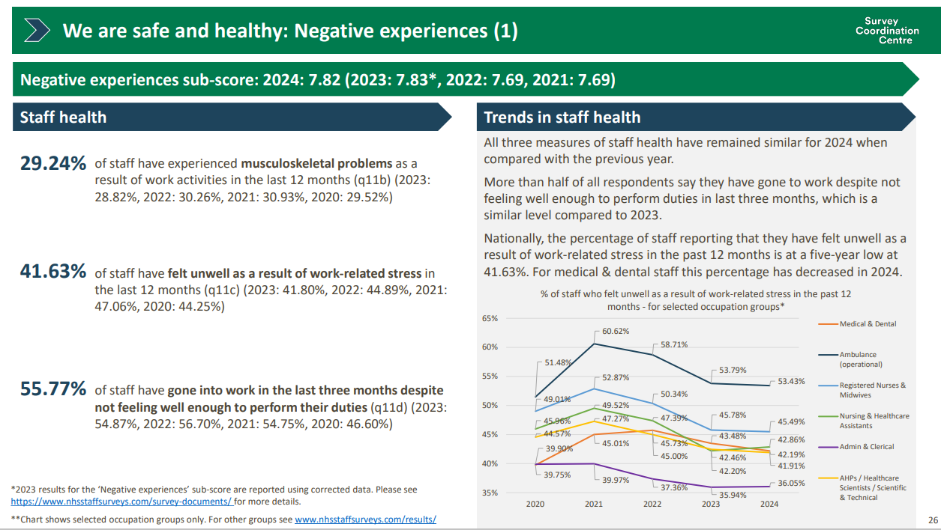
Appendix 3: NHS Staff Survey (2024) HWB Trend Data

Slide 14
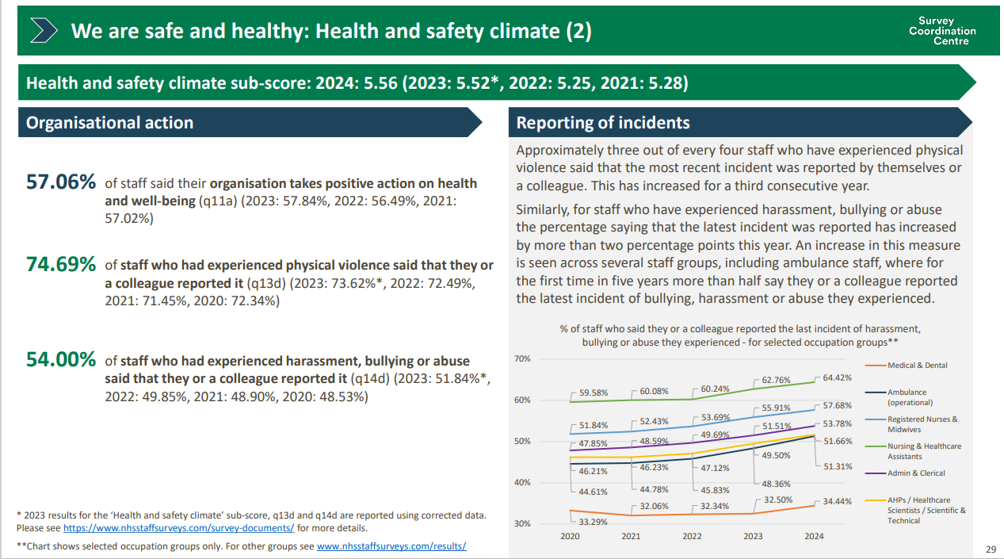

Slide 15
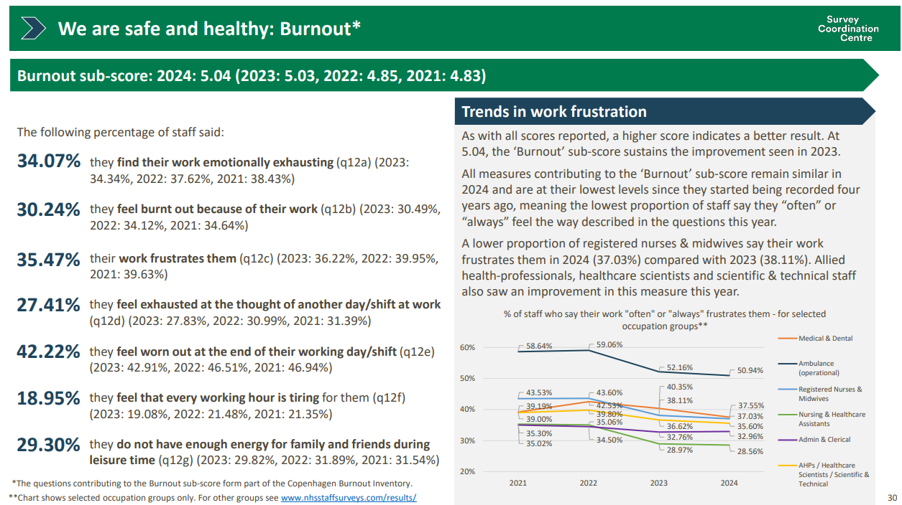

Slide 16
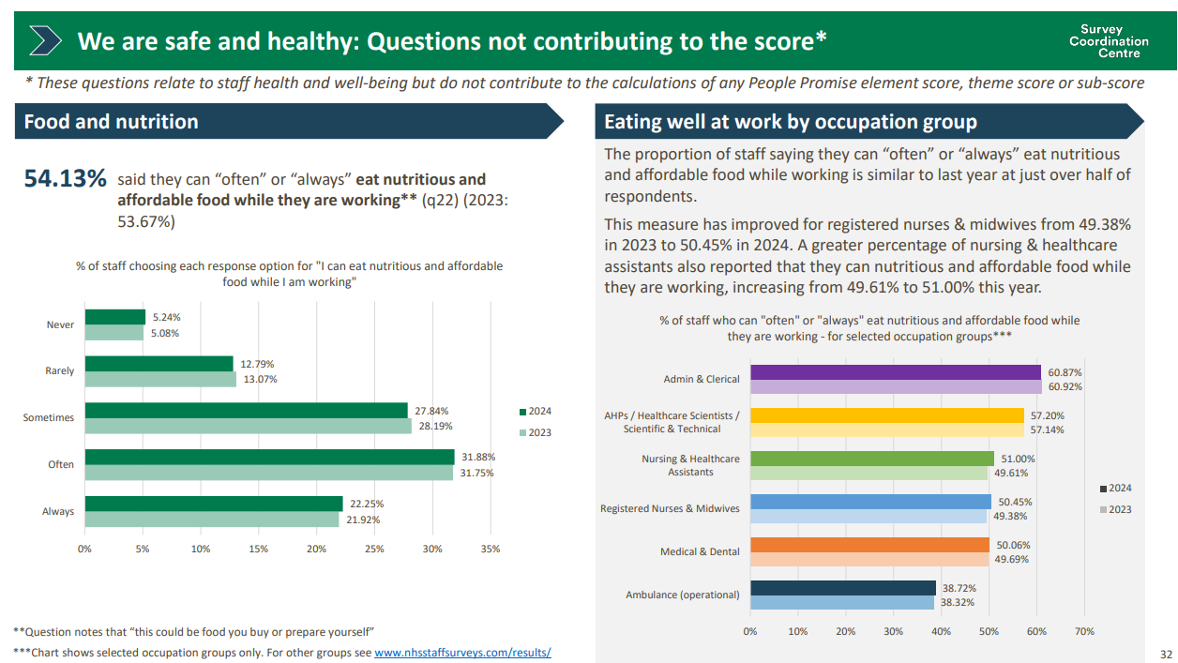

Slide 17
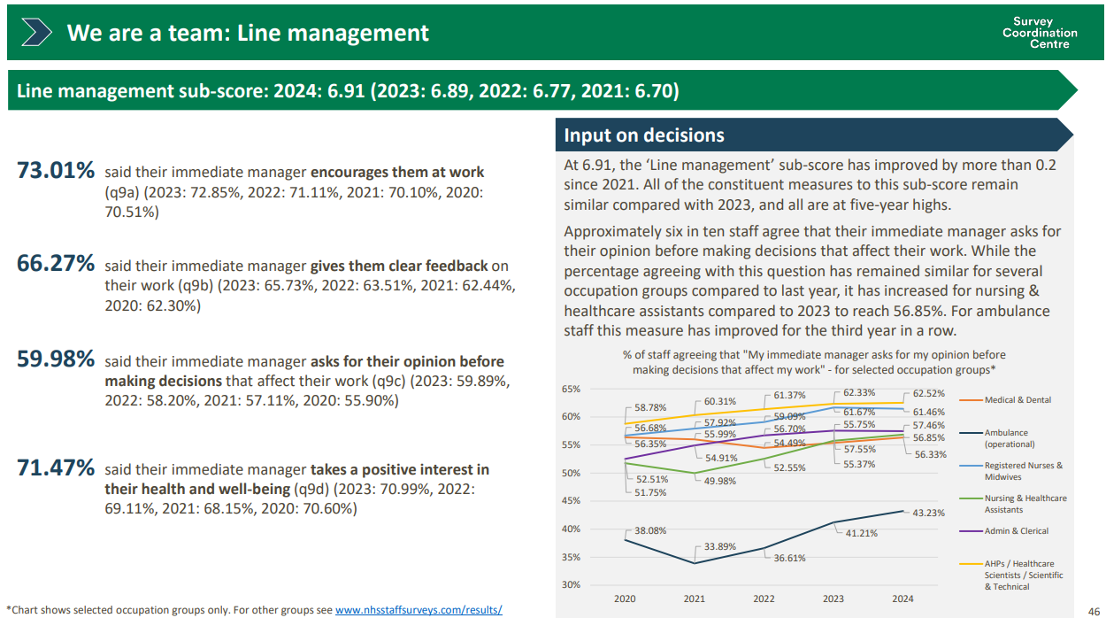

Slide 18
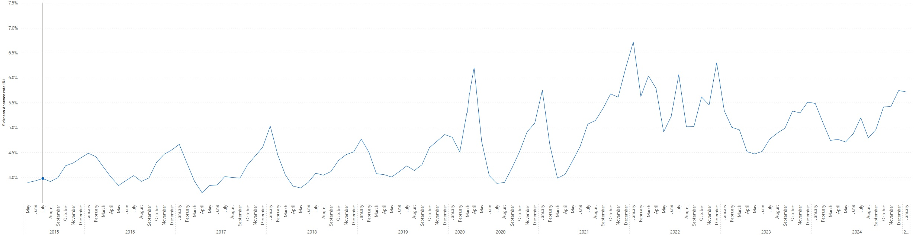
Appendix 4: NHS Sickness Absence Data trends over 10 years

