Slide 1
Weaving the thread tightly for the future of occupational health medicine
Dr Justin Varney
Director of Public Health
Birmingham City Council

Slide 2
Framing the future
Challenges & opportunities
Proactive vs Reactive
Wider context of the world

Slide 3
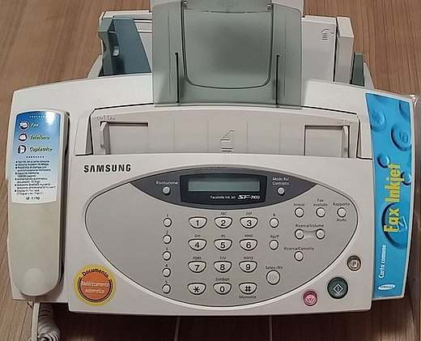
“The pace of change has never been this fast, yet it will never be this slow again.”
If you think in your life time what changes have you seen both at work and at home, the pace of technological acceleration and social change is moving faster now than ever before through global interconnectedness and stronger interdisciplinary science.

Slide 4
Challenges & Opportunities
“Accept the presence of thorns, but let the rose inspire you.”
Steve Pavlina
“Leaders think and talk about the solutions. Followers think and talk about the problems.”

Slide 5
Challenges or opportunity?
Ageing Workforce
Global Workforce
New Paradigms
Name
Title
Title
Title
Gender Identity
Neurodiversity

Slide 6
“He who sweats more in training, bleeds less in battle”
Greek Proverb

Slide 7
Proactive or Reactive?
“I think so many people are reactive... they see things in a short term way they're right up against it.”
Ray Dalio
“If you're proactive, you focus on preparing. If you're reactive, you end up focusing on repairing.”

Slide 8
Measles
Reactive
Proactive Embedding
Significant threat to NHS business continuity through infected staff and exposed unimmunised staff who needed to be excluded.
Reactive response involved rapid ad hoc mapping of immunisation coverage.
Staff sickness monitoring.
Standardised e-records of staff immunisation status?
On-boarding immunisation offer?
Vulnerable staff mapping?

Slide 9
Ageing Workforce
Reactive
Proactive Embedding
Reasonable adjustment advice
Medical retirement advice
Pre-retirement planning?
Caring strategy?
Reasonable adjustment working patterns and work roles for older staff?

Slide 10
Wider Context
“The universe is wider than our views of it.”
Henry David Thoreau
“All men can see these tactics whereby I conquer, but what none can see is the strategy out of which victory is evolved.”

Slide 11
Context
Political
ECONOMIC
social
National government missions place health and work relationship clearly linked to economic growth and cross-government challenge
NHS workforce sustainability is a political priority
Limited public purse so financial restraint is constant
Cost effectiveness and demonstrating impact is key
Shifting perceptions of duration of working life
Significant second and third careers narrative emerging
Portfolio careers becoming more common and implications for OH responsibilities

Slide 12
Context
technological
legal
environmental
Impact of social media
Self-monitoring technology
Digital health service access
Virtual workplace interactions impact on social contract in work and manager relationships
EU legal transitions
Significant landscape of OH legislation is quite old
Extreme weather impact on workplace health esp. heat
Climate shift and infectious disease paradigm e.g. malaria

Slide 13
“You must be the change you wish to see in the world.”
The future is a network of opportunity and there is huge potential to shape that future in a positive way if it is approached with intention. For occupational health medicine there are many tools like training, guidelines, good practice as well as our own leadership, to shape the future for a healthier, happier workforce.
Mahatma Gandhi

Slide 14
Thank You
Dr Justin Varney

