Slide 1
The mental health of NHS workers: an overview of the NHS CHECK study
Dr Danielle Lamb
Email: d.lamb@ucl.ac.uk
Twitter: @dannijl
On behalf of the NHS CHECK team

Slide 2
Funding and acknowledgments
Funding for NHS CHECK has been received from the following sources: Medical Research Council (MR/V034405/1); UCL/Wellcome (ISSF3/ H17RCO/C3); Rosetrees (M952); NHS England and Improvement; Economic and Social Research Council (ES/V009931/1); as well as seed funding from National Institute for Health Research Maudsley Biomedical Research Centre, King's College London, National Institute for Health Research Health Protection Research Unit in Emergency Preparedness and Response at King's College London.
We wish to acknowledge the National Institute of Health Research (NIHR) Applied Research Collaboration (ARC) National NHS and Social Care Workforce Group, with the following ARCs: East Midlands, East of England, South West Peninsula, South London, West, North West Coast, Yorkshire and Humber, and North East and North Cumbria. They enabled the set-up of the national network of participating hospital sites and aided the research team to recruit effectively during the COVID-19 pandemic.
The NHS CHECK consortium includes the following site leads: Sean Cross, Amy Dewar, Chris Dickens, Frances Farnworth, Adam Gordon, Charles Goss, Jessica Harvey, Nusrat Husain, Peter Jones, Damien Longson, Richard Morriss, Jesus Perez, Mark Pietroni, Ian Smith, Tayyeb Tahir, Peter Trigwell, Jeremy Turner, Julian Walker, Scott Weich, Ashley Wilkie.
The NHS CHECK consortium includes the following co-investigators and collaborators: Peter Aitken, Anthony David, Sarah Dorrington, Cerisse Gunasinghe, Stephani Hatch, Daniel Leightley, Ira Madan, Isabel McMullen, Martin Parsons, Paul Moran, Dominic Murphy, Catherine Polling, Alexandra Pollitt, Danai Serfioti, Chloe Simela, Charlotte Wilson Jones.
The NHS CHECK Chief Investigators are: Professor Sir Simon Wessely, Dr Sharon Stevelink, Professor Neil Greenberg, Professor Rosalind Raine, Professor Matthew Hotopf, and Professor Reza Rezavi.
The NHS CHECK team, past and present, includes: Rupa Bhundia (Project Manager); Dr Hannah Scott, Dr Brendan Dempsey, Dr Pam Almeida (Postdocs); Bethany Croak (PhD student); Siobhan Hegarty, Emelia Soulios, Sarah Rabin, Natalia Kika, Sofia Franchini (Research Assistants); Rosie Duncan (Communications); Danny Weston (Database Manager).

Slide 3
Overview
Introduction to the NHS CHECK study
Summary of cohort demographics
Prevalence of mental ill-health symptoms over time (survey data)
Accuracy of screening measures (diagnostic interview data)
Moral injury (survey data & qualitative interviews)
Reported suicidal ideation and self-harm behaviours (survey data)
Use and experiences of staff support services (survey data & qualitative interview data)
Results from an RCT of a smartphone wellbeing app (RCT)
Future work

Slide 4
Introduction
NHS CHECK – UK’s largest study of the mental health and wellbeing of healthcare workers through COVID-19
Includes ALL staff types (not just clinical)
Longitudinal - online surveys completed at baseline (started April 2020), 6 months, 12 months, and 32 months (limitation: data collection time ‘points’ overlap)
Analyses to date on mental ill-health prevalence over time, moral injury, suicidal ideation and behaviours, free text survey data
Also carried out qualitative interviews (experiences of support services, and moral injury experiences), diagnostic interviews, RCT of wellbeing app
Protocol paper out in BMJ Open: https://bmjopen.bmj.com/content/11/6/e051687.abstract

Slide 5
Demographics
18 NHS Trusts in England
Total sample size: 24,617 (N=152,113)
16% overall response rate
As far as we know, we have the largest data set, the highest response rate, and only weighted data set of any similar study
 | NHS workforce | NHS CHECK sample | NHS CHECK weighted sample
Mean age | 43 | 43 | 42
Sex | 77% female | 81% female | 75% female
Ethnicity | 78% white | 86% white | 77% white
Doctors | 10% | 7% | 10%
Nurses | 26% | 26% | 30%
Other clinical | 46% | 31% | 32%
Non-clinical | 18% | 36% | 28%

Slide 6
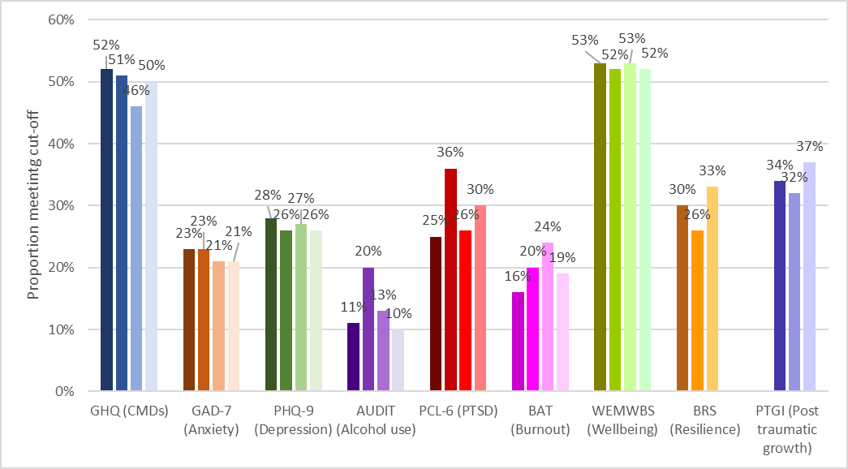
Proportions meeting cut-off scores on MH measures
CAVEAT!
‘Baseline’ data collected:
April 2020 – January 2021
“6 months” data collected:
November 2020 – August 2021
“12 months” data collected:
April 2021 – January 2022
So…how meaningful are these numbers?
Gives a snapshot of prevalence of mental ill-health over three overlapping 10 month time periods.
Figure 1 Bar graph of proportions meeting cut-off scores on each outcome measure

Slide 7
Regression analyses
Initial descriptive and exploratory cross-sectional analyses carried out.
Longitudinal trajectory analyses using growth curve modelling ongoing.
Multilevel multivariable weighted logistic regression models run on primary outcome variable (GHQ, common mental disorders) and secondary outcome variables (GAD-7, anxiety; PHQ-9, depression; AUDIT, alcohol use; PCL-6, PTSD; BAT, burnout; WEMWBS, wellbeing; BRS, resilience; PTGI, post traumatic growth).
Models explored associations between outcomes and a number of demographic (age, sex, ethnicity) and occupational (role, job setting, pay grade, PPE access, colleague/manager support, redeployment, moral injury) variables.
‘Burden period’ (period during which participants joined the study at baseline) was included to account for the differing levels of pressure experienced through the recruitment period.

Slide 8
Headline findings
Across outcomes and time periods, those most likely to report symptoms of mental ill-health were:
Female
Younger
Experienced moral injury
Felt unsupported by colleagues/managers
Associations found for some outcomes at some time periods for those who were:
Not in a relationship
Lower paid
Worked in ICU
Nurses/other clinical staff
Exception! AUDIT, measuring alcohol misuse. Across time periods, those more likely to report alcohol misuse were:
Male
White
Initial findings published in Occupational & Environmental Medicine: https://oem.bmj.com/content/78/11/801.abstract

Slide 9
Diagnostic interviews
Two-phase epidemiological design study
Full NHS CHECK sample used to identify sub-sample for 1-2-1 diagnostic interview – 50% meeting caseness on GHQ, 50% not meeting caseness (a score of ≥ 4/12).
251 participants assessed for depression/anxiety using CIS-R.
96 participants assessed for PTSD using CAPS-5.
Through weighting and use of diagnostic interviews, accurate prevalence for the population at risk (English HCWs) was estimated.
Further work on alternative caseness scores ongoing.
Important not to pathologise normal distress that will likely resolve without intervention.
Equally important to provide support to those who do need it.
Paper published in The Lancet Psychiatry – https://www.thelancet.com/journals/lanpsy/article/PIIS2215-0366(22)00375-3/fulltext
 | Screening tool (GHQ/PCL-6) | Diagnostic interview (CIS-R/CAPS-5)
Depression | 27% | 13%
Anxiety | 22% | 14%
PTSD | 25% | 8%

Slide 10
Moral injury – quantitative analyses
Moral injury is the psychological distress experienced following an event which violate one’s moral beliefs or expectations (Potentially Morally Injurious Events, PMIEs). Three elements: commission, omission, betrayal.
Measured by the Moral Injury Events Scale (MIES).
Analysed baseline survey data from 12,965 participants on PMIEs using multilevel logistic regression models.
28% reported experiencing PMIE(s), with acts of betrayal most commonly reported, and men significantly more likely to report PMIEs than women.
PMIEs were significantly associated with adverse mental health symptoms across different types of healthcare staff.
Specific work factors were significantly associated with experiences of moral injury, including being redeployed, lack of support from managers/colleagues, lack of PPE, and having a colleague die of COVID-19.
Paper published in the Journal of Mental Health: https://www.tandfonline.com/doi/full/10.1080/09638237.2023.2182414

Slide 11
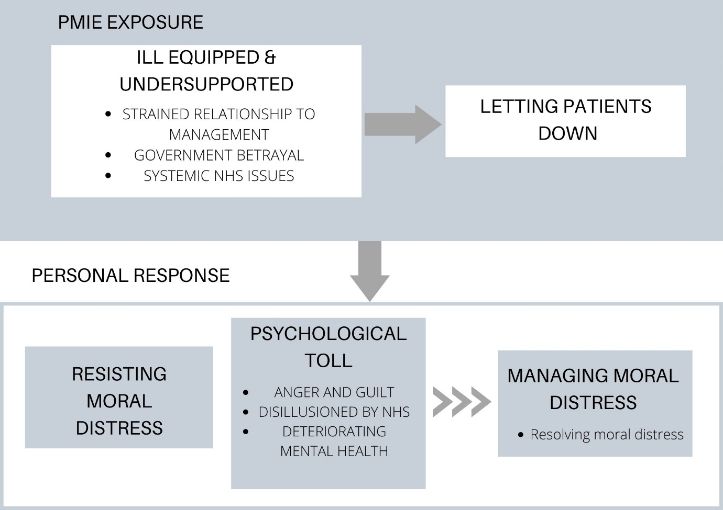
Moral injury – qualitative interviews
Aim: To better understand the experience and impact of PMIEs in a sample of frontline HCWs responding to the COVID-19 pandemic in England.
Procedure: 30 single time point interviews carried out with a diverse sample.
Analysed using reflexive thematic analysis.
Paper published in the European Journal of Psychtraumatology: https://www.tandfonline.com/doi/full/10.1080/20008066.2022.2128028

Slide 12
Suicidal ideation and self-harm
Analysis of baseline and 6 month data on suicidal and self-harm thoughts and behaviours (using CIS-R suicidality questions).
“Have you ever thought of taking your life, even though you would not actually do it?” (suicidal ideation)
“Have you ever made an attempt to take your life, by taking an overdose of tablets or in some other way?” (suicide attempts)
“Have you ever deliberately harmed yourself in any way but not with the intention of killing yourself?” (non-suicidal self-injury)
Answer options:
Yes, in the past 2 months
Yes, but not in the past 2 months
No
Descriptives of proportions at baseline and 6 months, and incidence at 6 months, and multilevel multivariable logistic regression models exploring factors at baseline associated with reporting at 6 months.
Paper published in PLOS ONE: https://journals.plos.org/plosone/article?id=10.1371/journal.pone.0286207

Slide 13
Results – prevalence & incidence
 |  | Prevalence |  |  |  |  |  | Incidence
Time | Response | Suicidal ideation |  | Suicidal attempts |  | Non-suicidal self-injury |  | Suicidal ideation |  | Suicidal attempts |  | Non-suicidal self-injury
 |  | n | % (95% CI) | n | % (95% CI) | n | % (95% CI) | n | % (95% CI) | n | % (95% CI) | n | % (95% CI)
Baseline | No | 8,137 | 65.7 (64.6, 66.7) | 10,927 | 87.2 (86.4, 88.0) | 10,262 | 82.3 (81.4, 83.1) | - | - | - | - | - | -
 | Yes, but not in previous 2 months | 2,596 | 19.5 (18.7, 20.4) | 880 | 6.7 (6.1, 7.3) | 1,397 | 10.3 (9.7, 11.0) | - | - | - | - | - | -
 | Yes, within the previous 2 months | 1,336 | 10.8 (10.1, 11.6) | 262 | 2.1 (1.8, 2.5) | 407 | 3.4 (3.0. 3.8) | - | - | - | - | - | -
6 months | No | 4,308 | 61.4 (60.0, 62.8) | 5,897 | 82.7 (81.5, 83.8) | 5,532 | 78.2 (77.0, 79.4) | 3,707 | 80.2 (79.0, 81.5) | 5,546 | 87.7 (86.9, 88.5) | 5,098 | 86.7 (84.8, 86.6)
 | Yes, but not in the previous month | 1,591 | 21.0 (19.8, 22.2) | 475 | 6.3 (5.6, 7.0) | 776 | 9.9 (9.1, 10.8) | 343 | 7.4 (6.7, 8.2) | 119 | 1.9 (1.6, 2.2) | 226 | 3.8 (3.3, 4.3)
 | Yes, within the previous month | 638 | 9.0 (8.1, 9.9) | 164 | 2.4 (2.0, 2.9) | 226 | 3.2 (2.7, 3.7) | 181 | 3.9 (3.4, 4.5) | 125 | 2.0 (1.6, 2.4) | 134 | 2.3 (1.9, 2.7)
Notes:
The estimated incidence risk of first-time suicide attempts was 3.9% (95% CI=3.4%, 4.4%; n=244/6,323 people who had not reported previous suicide attempts at Time 1 and also completed Time 2). The estimated incidence risk of first-time non-suicidal self-injury was 6.1% (95% CI=5.5%, 6.7%; n=360/5,949 people who had not reported previous non-suicidal self-injury at Time 1 and completed Time 2).

Slide 14
Regression analyses
Demographic factors associate with higher likelihood of reporting suicidal ideation or self-injury, at baseline:
Younger age
Being male
Mixed ethnicity
At 6 months:
Younger age
No statistically significant associations with suicidal attempts
Occupational factors associate with higher likelihood of reporting suicidal ideation, at baseline:
Lack of confidence in raising safety concerns (clinical & non-clinical)
Lack of confidence safety concerns will be addressed (clinical & non-clinical)
Lack of access to adequate PPE (non-clinical)
Lack of support from managers (clinical & non-clinical)
Having to provide a worse standard of care than usual (clinical)
Experiencing potentially morally injurious events (clinical & non-clinical)
Once we adjusted for all relevant factors (inc. baseline level of relevant outcome), only ONE factor predicted outcomes at 6 months:
Lack of confidence in safety concerns being addressed (at baseline) predicted suicidal ideation in clinical staff at 6 months (AOR 1.45, 95%CI 1.12, 1.89).

Slide 15
Perceptions of support among HCWs
Proportion of respondents who felt ‘quite a bit’ or ‘extremely’ supported by…
 | Baseline | 6 Months | 12 Months | 32 Months
Managers/supervisors | 65% | 52% | 46% | 44%
Colleagues | 76% | 61% | 55% | 54%
Family/friends | 84% | 76% | 71% | 74%
Proportion of respondents who answered ‘quite a bit’ or ‘extremely’ about…
 | Baseline | 6 Months | 12 Months | 32 Months
Feeling part of a team | 68% | 62% | 57% | 58%
Feeling a sense of comradeship | 64% | 58% | 52% | 54%

Slide 16
Which staff support programmes are used most?
At 6 months, the following proportions reported using these support services:
Type of support | % using support service
NHS staff discounts e.g. plumbing, RAC, food, hotels | 66.1%
Other online resources/apps not specific to NHS staff recommended by friend, family/colleagues | 41.3%
Wellbeing apps that are free to NHS staff | 37.5%
NHS National Offer for Leadership Mentoring | 11.4%
National NHS Virtual Staff Common Rooms | 7.4%
National NHS Staff Support Line | 5.9%
National NHS Staff Support Text Line | 5.3%
Staff Bereavement support line – Hospice UK | 5.1%

Slide 17
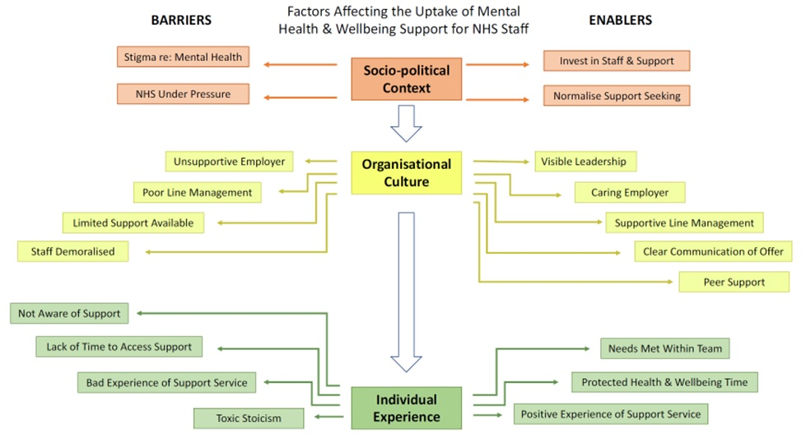
Staff support: Qualitative Study
Aim: To understand the barriers and enablers for HCWs using staff support services.
Interviewed 48 clinical and non-clinical staff.
Data collected April-August 2021.
Reflexive thematic analysis used.
Paper published in Journal of Health Psychology: https://journals.sagepub.com/doi/full/10.1177/13591053221140255

Slide 18
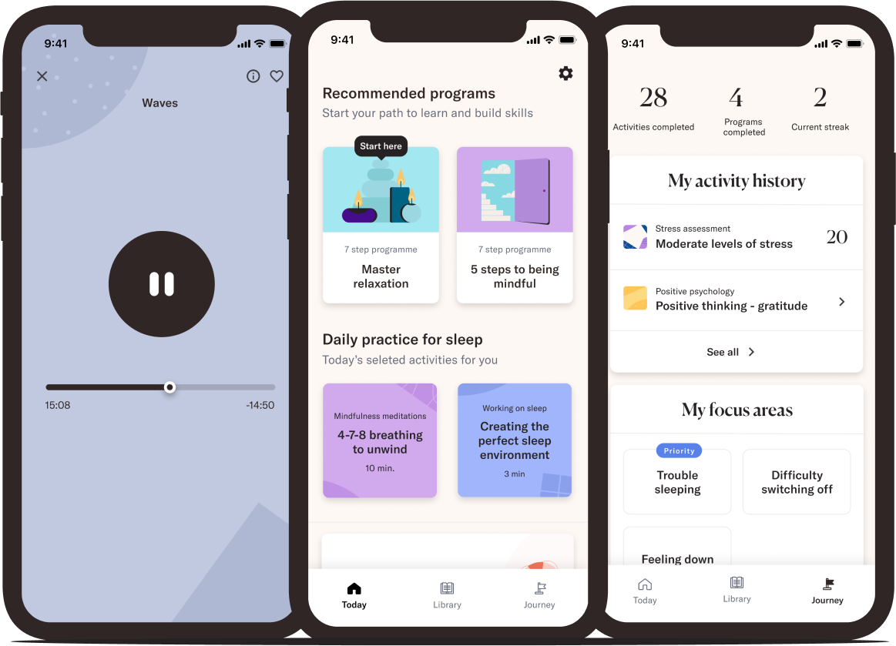
Randomised Controlled Trial: smartphone wellbeing app
RCT to investigate the effectiveness of the Koa Health ‘Foundations’ wellbeing app to improve mental health and wellbeing among HCWs.
Participants randomised to either intervention group (n=502) which received access to use the app for the eight week trial period or to a waitlist control group (n=500).
Measures collected at baseline, 4 and 8 weeks – primary outcome was General Health Questionnaire (GHQ-12).

Slide 19
RCT results
The application was associated with a significant reduction in GHQ score (i.e. better general mental health) compared with the control group: aMD=-1·39; 95%CI (-2·05, -0·74); p<0·0001
Strong association between app and reduction in insomnia symptoms: OR=0·36; 95%CI (0·21, 0·60); p<0·0001
Very few apps have been rigorously evaluated – if at all – and this has been shown to help.
Should be part of organization’s tiered staff support offer rather than standalone - small effect size & varied uptake/effectiveness across age, gender, ethnicity and occupational roles.
Paper pusblished in BJPsych: https://doi.org/10.1192/bjp.2022.103

Slide 20
Overview of results to date
About ½ of staff report symptoms of common mental disorders.
NOT the same as ½ of staff having a mental health diagnosis.
Diagnosable disorders around 8% (PTSD) to 13-14% (depression/anxiety).
Still concerning, but not quite the ‘tsunami’ predicted in the media.
However, concerning prevalence and incidence of suicidal ideation and self-harm behaviours.
Typically younger, female staff who are most affected, and those who’ve experienced moral injury, with male staff more likely to report alcohol misuse.
Practical support (free parking, relaxation spaces, breaks) most helpful, along with peer support from colleagues and supportive managers.
Honest, clear communication from Trust senior management and government is key.
Indications that smartphone wellbeing app can help, but small effect sizes.

Slide 21
What’s next? Current and future work
Received funding from the COLT Foundation for an analysis of data exploring psychosocial factors contributing to ‘Long COVID’ – analysis being completed this year.
Received funding from the Rosetrees Trust for a longitudinal trajectory analysis of mental health outcomes over time – baseline, 6 months, 12 months, 32 months.
Received funding from the Blahnik Foundation to develop and test an intervention to address moral injury in HCWs.
Mixed methods paper on support services, including detailed quantitative analysis of use/preferences, and interviews with HCWs and occupational health staff.
Occupational factors associated with intention to leave/sickness absence.
ESRC-funded PhD student working on quant and qual analyses of lower-paid HCWs.
Analysis of post-traumatic growth data.

Slide 22
Thanks for listening! Any questions?

