Slide 1
Neurodiversity and occupational health.
What you need to know, how you can help, and what employers are asking.

Slide 2
What is
anyway?
Neurodiversity

Slide 3
Neurodiversity definition:
“The natural diversity
of ALL human brains”

Slide 4
Being Neurodivergent means:
“Having a brain that works
Differently from the medical
model of normal”

Slide 5
Genetically
Inherited
conditions
Specific
Learning
differences
Mental
Health
conditions
Acquired
Neurodivergence
Sensory
Processing
Difficulties

Slide 6
It’s often quoted that 20% of the population are neurodivergent.
But how accurate is this figure?
Remembering co-existing conditions
the figure is closer to 5.85%

Slide 7
That’s still 5.85% of 69.21 million
And includes many people with 2 or more conditions

Slide 8
There are
people in employment in the UK.
33.09 million
Which means this conversation could affect:
1,935,767 people!

Slide 9
The most common conditions you may receive referrals for?
ADHD
Autism
Tourettes
OCD
Dsylexia
Dsypraxia/DCD
Dsycalculia

Slide 10
Are you seeing more referrals?
Average wait times for assessment:
Dyslexia, Dyspraxia: 2 – 4 weeks
OCD, Tourettes: 4 – 6 weeks
Autism: 300 days
ADHD: 12 – 15 years

Slide 11
What does this mean
For you?

Slide 12
What do
Most managers
Tell me?

Slide 13
They:
Are terrified of “getting IT wrong”:
Are afraid they don’t KNOW enough
Are aware they haven’t been TRAINED
See lots of CONFLICTING information
Are CONFUSED by reasonable adjustments

Slide 14
What do
Most
neurodivergent
People tell me?

Slide 15
They:
Are SCARED to speak out
Feel their Job is AT RISK if they ask for help
KNOW managers haven’t been trained
Feel they won’t be BELIEVED
Think that reasonable adjustments AREN’T reasonable

Slide 16
What do
Managers want
From you?

Slide 17
They want:
Answers
To speak to someone who knows MORE
To feel like you have got EASY solutions
The process to be QUICK and easy
To know how much your suggestions will COST

Slide 18
What do
Employees want
From you?

Slide 19
They want:
To speak to someone who knows
AS MUCH as them
To feel like you have been TRAINED
To feel you will VALIDATE their needs
To be treated like a person not a CONDITION

Slide 20
That is:
A lot on your shoulders
Difficult to achieve – but not impossible
About managing expectations

Slide 21
The truth:
You don’t need to be ND experts
Do need in-depth ND training
from ND professionals
A lot of what can help is simple, but
rarely does the first suggestion work

Slide 22
Words and terms
Neurominority
Neurotribe/s
Neurospicy/spiky
Neuroqueer
ND
AuDHD
Neuroinclusive

Slide 23
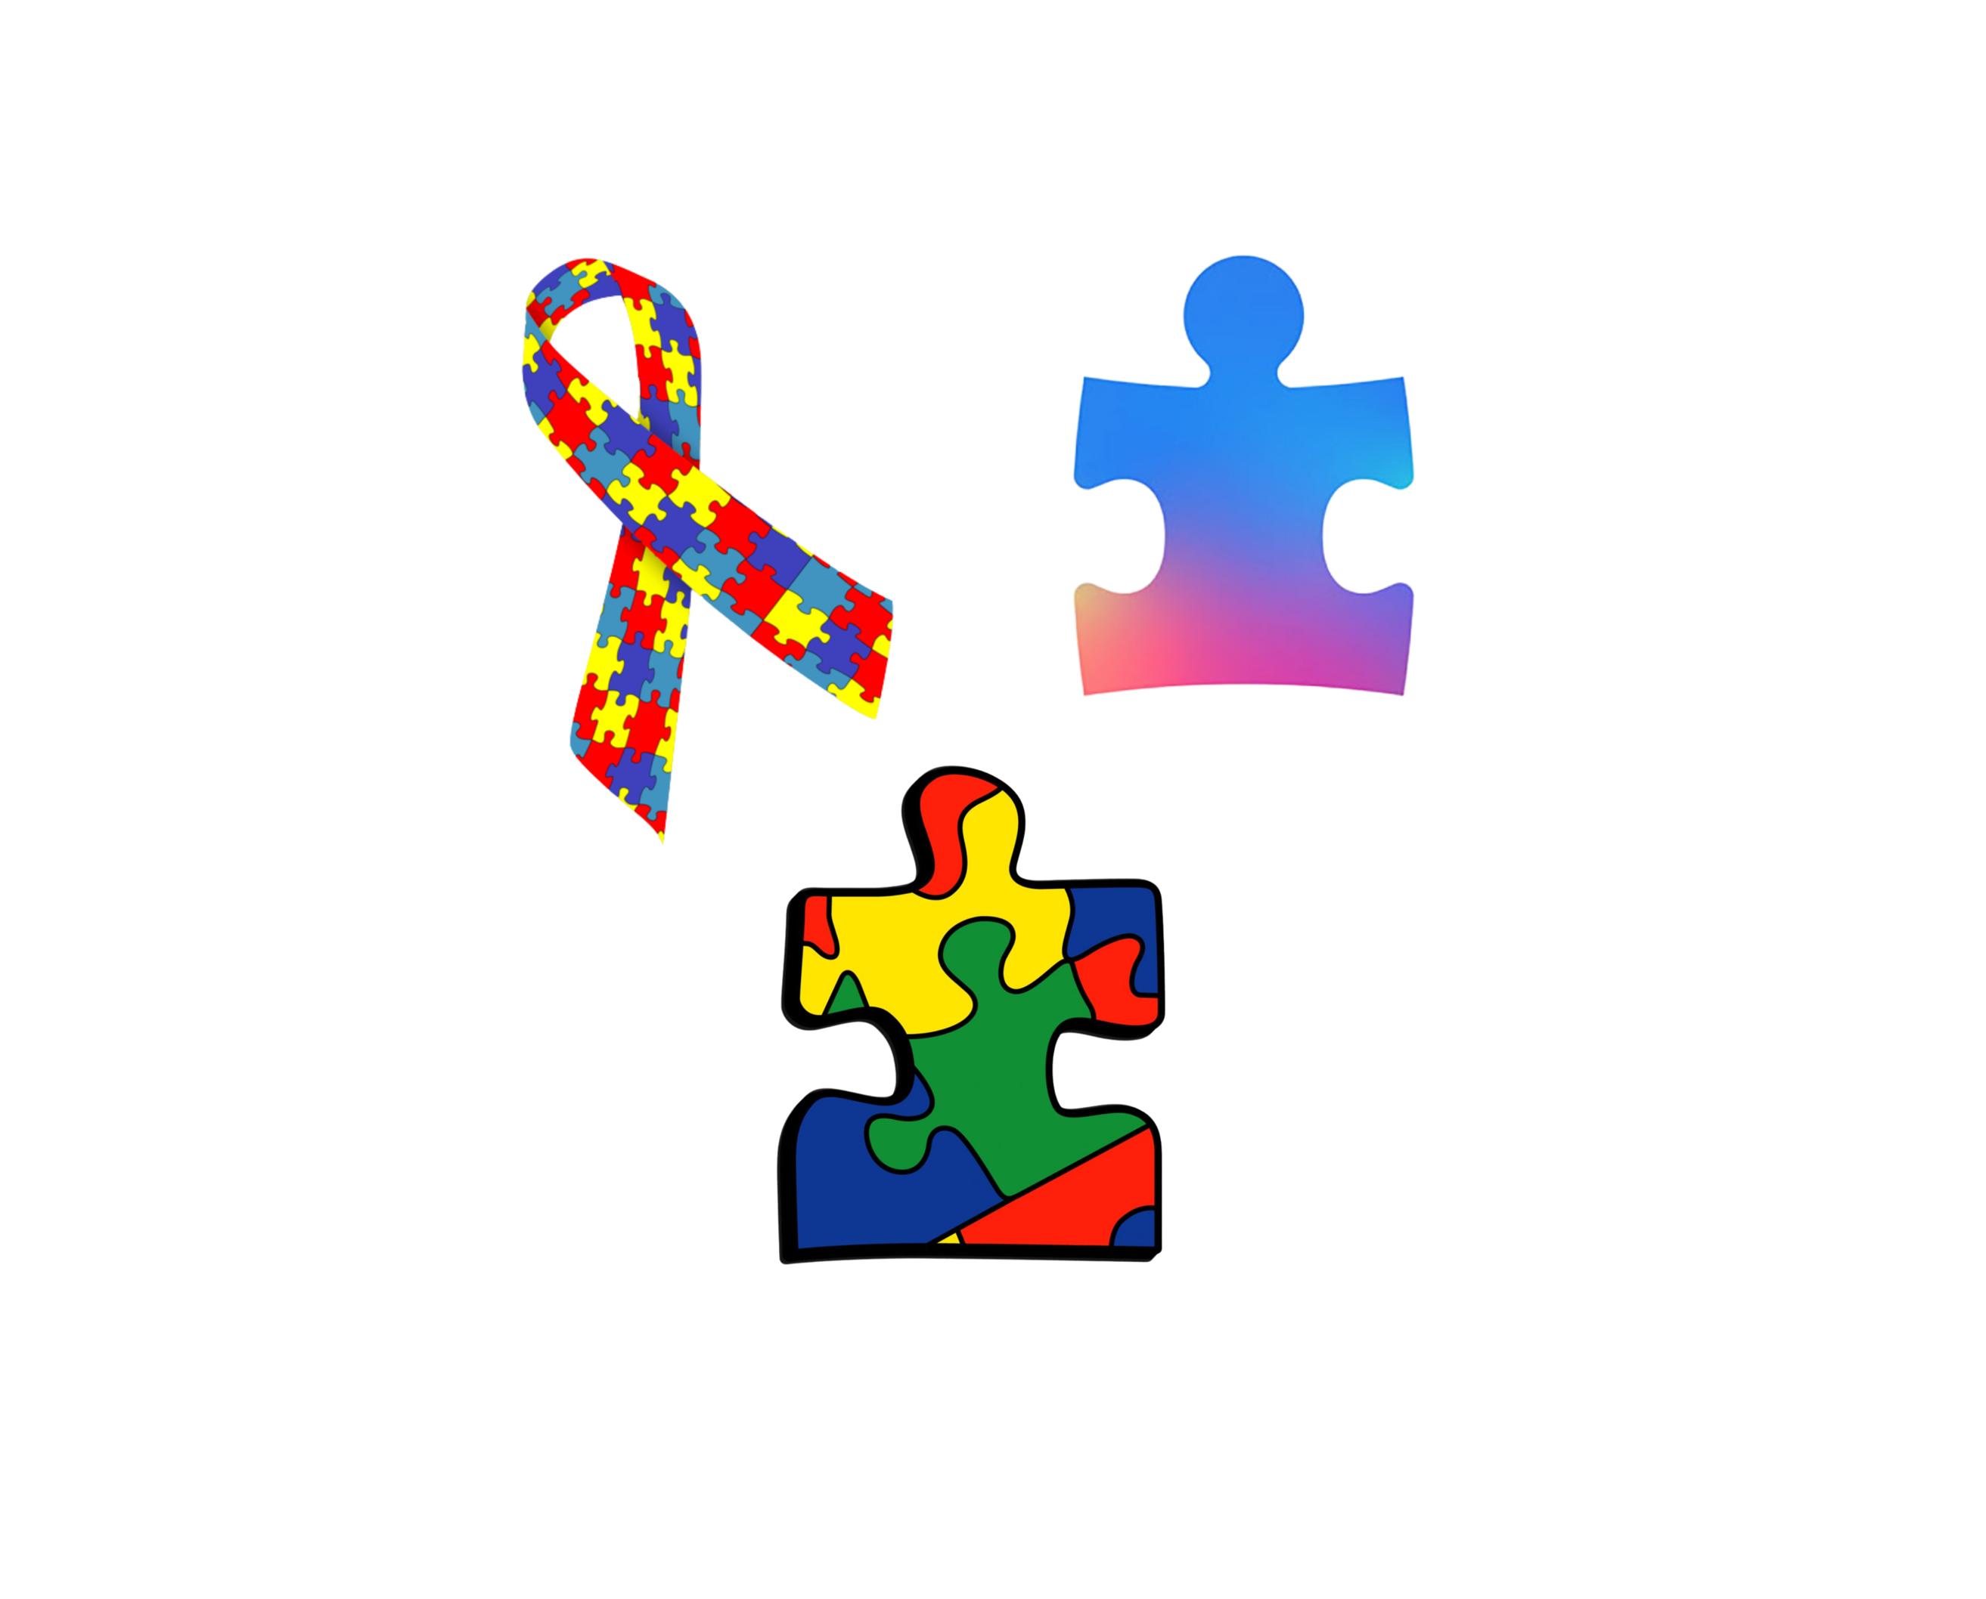
Imagery
Good
Bad

Slide 24
Imagery
The first National Autistic Society logo designed by a parent and board member in 1963

Slide 25
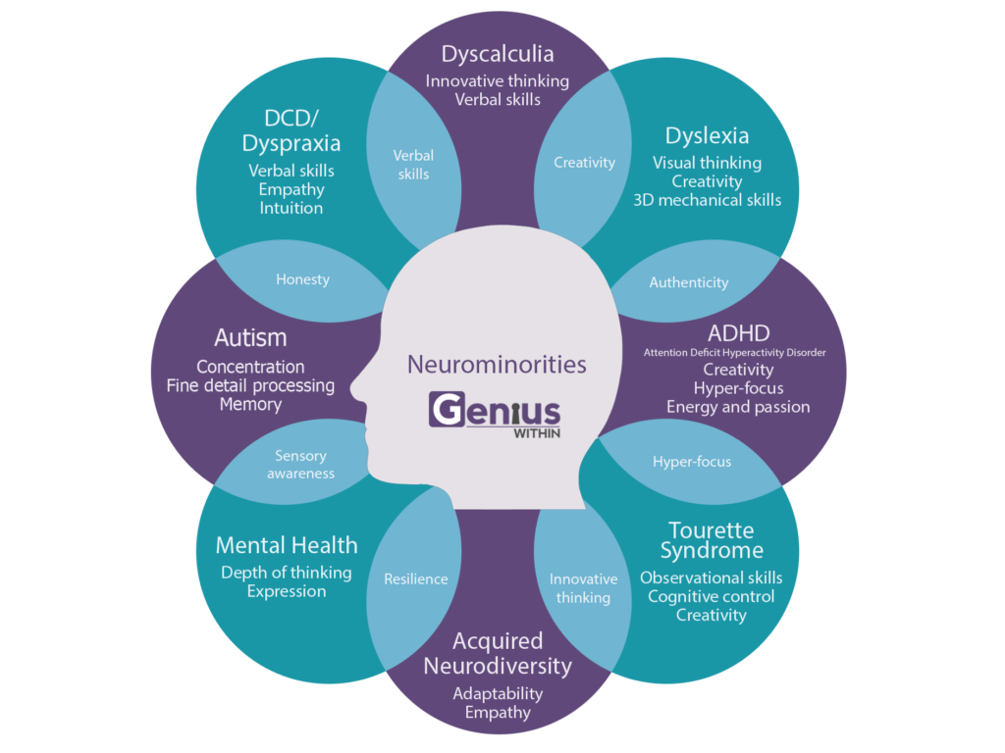
Do you see problems or potential here?
ThinkNeurodiversity.com 2023
Original image copyright Genius Within

Slide 26
Conditions are categorised differently but include everything you can see.
What’s important to remember is the amount of overlap between conditions.

Slide 27
Genetically heritable Conditions
Autism
ADHD
OCD
Tourette’s

Slide 28
Genetic Neurological Conditions
Autism
Including ASC / ASD/ Asperger’s

Slide 29
Lifelong developmental disability which affects how people communicate and interact with the world
Social and communication challenges
Repetitive and restrictive behaviour
Stimming behaviours that can include physical and vocal presentations.
Over or under sensitivity to light, sounds, taste, touch or smells
High focused on special interests
Extreme anxiety
Meltdowns and shutdowns present in all ages

Slide 30
The Autism Spectrum
Deals only with difficulties caused by an Autistic condition.
Includes all severities from non-verbal, physically impaired to “high functioning” (formerly diagnosed as Asperger’s)
May not be diagnosed till adulthood
Often presents differently in different people, there is no “general” presentation. Only shared traits, challenges and strengths.

Slide 31
Autism: A different lens
1. Social communication challenges
2. Sensory challenges
3. Direct / blunt communication
4. Stimming behaviours

Slide 32
Autism: A different lens
1. Desire to be understood and to understand
2. Pattern thinkers & detail oriented
3. Clear communicators
4. Creativity and ingenuity

Slide 33
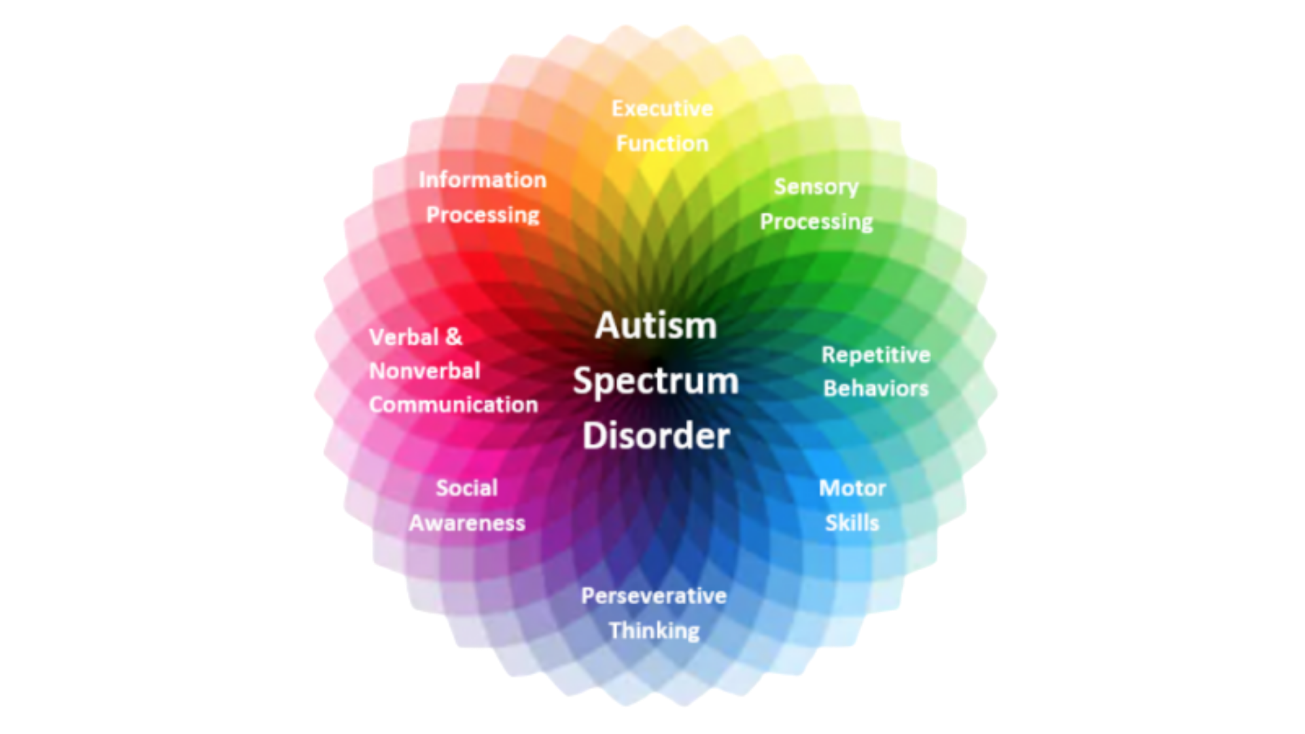
The Autism Spectrum

Slide 34
Genetic Neurological Conditions
ADHD
Sometimes called ADD

Slide 35
Includes:
Inattention (not being able to keep focus)
Hyperactivity (excess movement that is not fitting to the setting or hyperactive mind)
Impulsivity (hasty acts that occur in the moment without thought)
Diagnosed as one of three types:
Inattentive type
Hyperactive/impulsive type
Combined type.

Slide 36
Inattentive sub type
Doesn’t pay close attention to details or makes careless mistakes in school or job tasks.
Has problems staying focused on tasks or activities, such as during lectures, conversations or long reading.
Does not seem to listen when spoken to (i.e., seems to be elsewhere).
Does not follow through on instructions and doesn’t complete schoolwork, chores or job duties (may start tasks but quickly loses focus).
Has problems organizing tasks and work (for instance, does not manage time well; has messy, disorganized work; often will miss deadlines).
Avoids or dislikes tasks that require sustained mental effort, such as preparing reports and completing forms.
Often loses things needed for tasks or daily life, such as school papers, books, keys, wallet, cell phone and eyeglasses.
Is easily distracted.
Forgets daily tasks, such as doing chores and running errands. Older teens and adults may forget to return phone calls, pay bills and keep appointments.

Slide 37
Hyperactive / Impulsive sub type
Fidgets with or taps hands or feet, or squirms in seat.
Not able to stay seated or remain totally still (needs to move often).
Always “on the go,” as if driven by a motor. Brain never at rest.
Talks too much, overshares information.
Blurts out an answer before a question has been finished (for instance may finish people’s sentences, can’t wait to speak in conversations).
Has difficulty with patience, may be easily frustrated by people slow to act.
Interrupts or intrudes on others (for instance, cuts into conversations, or starts using other people’s things without permission). May take over what others are doing.

Slide 38
Combined sub type
A combination of any mixture of difficulties presented by the 2 main types.
More often diagnosed/presented more obviously by Men, but Women as affected as well.
Typically easier to see in others but much harder to live with as the challenges change on a day to day basis.

Slide 39
A word about Women
Often later diagnosed than males.
Women may tend to be very creative, outgoing, chatty, funny and outwardly social.
They often feel they have to “mask” to fit in and learn to do so from an early age.
They often are misdiagnosed at earlier ages with things such as Depression, Anxiety, Borderline Personality Disorder or other Personality Disorders.
Common traits can be frequent untidiness, lateness, difficulty making and keeping friendships, extreme emotional dysregulation.
The monthly Menstrual cycle and Menopause are both shown to make ADHD symptoms harder to manage in women.

Slide 40
A word about drugs
Not everyone with ADHD will need or choose to take medication.
The aim of stimulant medication is to regulate the release of Dopamine in the brain which is one of the key factors that makes ADHD challenging.
Other medications regulate Norepinephrine which can also be helpful.
People can also get great relief from, meditation, mindfulness, exercise, proper sleep, cold water therapy etc.
Adults late diagnosed can also benefit from specific ADHD coaching.

Slide 41
ADHD - Harnessing hyperfocus
1. Inattentive, impulsive, hyperactive
2. Sometime hard to ‘keep up with’
3. Can make careless mistakes, seem easily bored
4. Can be oversensitive, quick to flash

Slide 42
ADHD - Harnessing hyperfocus
1. Creativity in many ways and forms
2. Unmatched passion and energy
3. Can be great motivators and managers
4. Inspiring thinkers and doers

Slide 43
Genetic Neurological Conditions
Tourette’s
syndrome

Slide 44
Tourette’s Syndrome
A disorder that involves repetitive movements or unwanted sounds (tics) that can't be easily controlled. For instance, you might repeatedly blink your eyes, shrug your shoulders or blurt out unusual sounds or offensive words.
Tics — sudden, brief, intermittent movements or sounds — are the hallmark sign of Tourette syndrome. They can range from mild to severe. Severe symptoms might significantly interfere with communication, daily functioning and quality of life.
Tics are classified as:
Simple tics. These sudden, brief and repetitive tics involve a limited number of muscle groups.
Complex tics. These distinct, coordinated patterns of movements involve several muscle groups.
Tics can also involve movement (motor tics) or sounds (vocal tics). Motor tics usually begin before vocal tics do. But the spectrum of tics that people experience is diverse.
Coprolalia – Swearing only affects 1 – 10 people with Tourette. Yet is what most people associate with the condition.

Slide 45
Tourettes - The power ofAuthenticity
1. Can be uncomfortable for others
2. Seen as risky in public roles
3. Can be seen as unpredictable
4. Often judged by the label

Slide 46
Tourettes - The power ofAuthenticity
1. Very genuine and authentic people
2. Resilient and adaptable
3. Great communicators
4. Incredibly creative

Slide 47
Genetic Neurological Conditions
Obsessive Compulsive
Disorder

Slide 48
Obsessive Compulsive Disorder
A disorder in which people have recurring, unwanted thoughts, ideas or sensations (obsessions) that make them feel driven to do something repetitively (compulsions). The repetitive behaviors, such as hand washing, checking on things or cleaning, can significantly interfere with a person’s daily activities and social interactions.
For people with OCD, thoughts are persistent, and behaviors are rigid.
Not performing the behaviors commonly causes great distress.
Many people with OCD know or suspect their obsessions are not realistic; others may think they could be true (known as limited insight). Even if they know their obsessions are not realistic, people with OCD have difficulty disengaging from the obsessive thoughts or stopping the compulsive actions.

Slide 49
OCD - Mastery of Detail
1. Debilitating compulsions and obsessions
2. Seen as hard to manage
3. Can be seen as argumentative
4. Difficulty expressing challenges

Slide 50
OCD - Mastery of Detail
1. Attention to detail that is excellent
2. Brilliant organisers
3. Exceptional quality controllers
4. Strategic risk planners

Slide 51
Specific Learning Difficulties
Dyslexia
Difficulty reading, identifying speech sounds and learning how they relate to letters and words (decoding)
Dyspraxia
Neurological condition, which affects muscle co-ordination and perception, includes vision, hearing and proprioception
Dyscalculia
A condition that affects the ability to acquire arithmetical skills including fluent calculations
DysGraphia
Deficiency in the ability to write, primarily in terms of handwriting, but also in terms of coherence
ThinkNeurodiversity.com 2023
51

Slide 52
Dyslexia – Dyscalculia – Dysgraphia - DCD
1. Struggles in education
2. Communication challenges
3. Feelings of not fitting in
4. Can be seen as careless

Slide 53
Dyslexia – Dyscalculia – Dysgraphia - DCD
1. Big picture thinking
2. Innovative problem solving
3. Made for creative roles
4. Entrepreneurial mindsets

Slide 54
Sensory processing difficulties
Auditory Processing Disorder
A condition that impacts the brain’s ability to filter and interpret sounds
Sensory Processing Disorder
A condition that impacts the brain’s ability to process and be at ease with other senses, touch, taste, smell etc
ThinkNeurodiversity.com 2023
54

Slide 55
Mental Health Conditions
Stress
Anxiety
Depression
Stress is the feeling of being overwhelmed or unable to cope with mental or emotional pressure.
Anxiety is a feeling of unease, worry or fear which, when persistent and impacting on daily life may be a sign of an anxiety disorder.
Depression is a common mental health problem that causes people to experience low mood, loss of interest or pleasure, feelings of guilt or low self-worth, disturbed sleep or appetite, low energy, and poor concentration.
ThinkNeurodiversity.com 2023
55

Slide 56
Acquired Neurodiversity
Chronic Fatigue
Syndrome/ME
Multiple
Sclerosis
A serious, long-term illness that affects many body systems. It can progress a varying speeds and severity often advancing without warning.
An unpredictable disease of the central nervous system that disrupts the flow of information within the brain, and between the brain and body.
Brain Injury
Pre Natal illness
or trauma
Any head trauma, illness or injury that changes a persons capacity to think/process/perform
Any illness or trauma in the womb that causes Neurological impairment
Long term Covid-19
Symptoms of long COVID include breathlessness, headaches, cough, fatigue and cognitive impairment or ‘brain fog’.
ThinkNeurodiversity.com 2023
56

Slide 57
Acquired Neurodiversity
Personality
disorders
Dementia
Dementia is not a specific disease but is rather a general term for the impaired ability to remember, think, or make decisions that interferes with doing everyday activities.
Caused by illness or injury
(Also, those present from birth)
Addiction
Parkinson's
Whilst often a symptom of other conditions, long term addiction does rewire people’s brains in drastic ways
Parkinson's disease is a condition in which parts of the brain become progressively damaged over many years.
ThinkNeurodiversity.com 2023
57

Slide 58
Acquired Neurodiversity
Perimenopause and Menopause
ThinkNeurodiversity.com 2023
58

Slide 59
Acquired Neurodiversity
Perimenopause and Menopause
Recent research has shown how Perimenopausal symptoms can mask both ADHD and autism for years.
Our understanding of the brain changes and executive function challenges faced during and perimenopause and after menopause present very similarly to ADHD for lots of women.
It is important to understand how the monthly cycle affects executive function and therefore the ability to carry out expected tasks, manage emotions and to “keep the mask on”
ThinkNeurodiversity.com 2023
59

Slide 60
Now you can see the potential behind the labels.
ThinkNeurodiversity.com 2023
Original image copyright Genius Within

Slide 61
Session 4
Neurodiversity
in the workplace.

Slide 62
3
The Neurodiversity in the workplace bit…

Slide 63
Recruitment, interviews and training.

Slide 64
It starts with the website!
Include accessibility functions on your website as standard. *see Userway in Reasonable adjustments and resources
Encourage existing employees to share their experiences as disabled/neurodivergent applicants/trainees and employees.
Ensure all the company policies are available on the recruitment site, Equality and Diversity, Reasonable adjustments etc.
Back those up with real examples of where reasonable adjustments have been put in place and how they helped.
Give examples of the types of adjustments people can ask for at every stage.
Give directions to physical interviews in different formats, including video.
This is your chance to show the applicants that this is more than a tick box exercise.

Slide 65
Job adverts and descriptions
Use Inclusive Language:
Avoid jargon and acronyms that may not be understood by everyone. Use clear and straightforward language to describe the role and responsibilities.
Highlight Commitment to Diversity:
Clearly state your commitment to diversity and inclusion. Mention that you welcome applications from individuals with disabilities and neurodivergent conditions.
Detail Essential vs. Non-Essential Tasks:
Clearly distinguish between essential and non-essential tasks. This helps candidates understand the core responsibilities and consider if adjustments may be needed.
Emphasize Flexible Working Arrangements:
Highlight any flexible working options, such as remote work, flexible hours, or part-time positions.
Use Accessibility Statements:
Include a statement that encourages applicants to request reasonable adjustments during the recruitment process.
Describe the Work Environment:
Provide details about the physical and social environment, including any sensory considerations like noise levels or open-plan offices.
Focus on Skills and Competencies:
Emphasize the skills and competencies required for the role rather than the traditional qualifications. This can help attract a more diverse pool of candidates. Welcome applicants who may not match all core skills.
Provide Clear Application Instructions:
Make the application process straightforward and provide clear instructions. Offer multiple ways to apply, such as video applications or written submissions.
List Contact Information for Queries:
Include contact details for a person who can assist with any questions about the job or the application process, emphasizing accessibility.
Promote Employee Resource Groups:
Mention any employee resource groups or support networks available within the organization for individuals with disabilities or neurodivergent conditions.

Slide 66
Interviews
Offer Adjustments Upfront:
Proactively offer reasonable adjustments for the interview process, such as extra time for tests, accessible locations, or alternative formats for questions.
Provide Detailed Information:
Send detailed information about the interview format, including who will be present, the structure of the interview, and the types of questions that will be asked.
Share interview questions in advance:
Share to all candidates as well. If it’s not possible to share the actual questions/activities, share examples of the types of questions instead.
Allow for Different Communication Styles:
Be flexible with communication styles, allowing candidates to choose how they prefer to communicate (e.g., written, verbal, or using assistive technology).
Use Structured Interviews:
Use a structured interview format with standard questions to ensure fairness and consistency.
Be Mindful of Sensory Needs:
For in-person interviews, choose a quiet, well-lit room. For online interviews, ensure there are no distracting backgrounds or noises.
Provide Breaks if Needed:
Offer breaks during the interview process, especially for longer interviews, to help reduce anxiety and fatigue.
Use Clear and Direct Questions:
Ask clear, direct questions and avoid hypothetical or abstract questions that may be difficult to interpret. “Tell me…” questions can be rephrased as “Do you have examples of when…” to reduce anxiety.
Be Patient and Allow Processing Time:
Allow candidates extra time to process questions and formulate their responses without rushing them.
Clarify the Next Steps:
Clearly explain the next steps in the recruitment process and provide a timeline for when candidates can expect to hear back.
Gather Feedback on the Process:
After the interview, gather feedback from candidates on the accessibility and inclusivity of the process to continuously improve.

Slide 67
Onboarding/ First day/week
Provide a Welcome Pack:
Include information about the company, team, role, and any available support resources. Make sure this is available in accessible formats.
Ensure necessary kit and equipment is ready.
Phones, laptops, ID passes etc should all be ready on the first day at the same time.
Assign a Buddy or Mentor:
Pair new employees with a buddy or mentor who can provide guidance and support during the onboarding process.
Offer Flexible Training Options:
Provide training materials in various formats (e.g., written, video, interactive) and allow flexibility in the pace and order of training.
Create a Sensory-Friendly Workspace:
Ensure the new employee's workspace meets their sensory needs, such as quiet areas, appropriate lighting, and ergonomic furniture.
Schedule Regular Check-Ins:
Plan regular check-ins to discuss how the onboarding process is going and if any additional adjustments are needed.
Provide Clear Documentation:
Ensure all job-related information, policies, and procedures are clearly documented and easily accessible.
Include Neurodiversity Training:
Incorporate neurodiversity awareness training for the team to foster an inclusive environment.
Use Assistive Technology:
Offer and set up any necessary assistive technology that the new employee may need.
Tailor the Induction Plan:
Customize the induction plan to meet the individual needs of the employee, ensuring they are not overwhelmed with too much information at once.
Encourage Open Communication:
Foster a culture of open communication where the new employee feels comfortable discussing any challenges or requesting additional support.

Slide 68
Inductions
Personalize the Induction Programme:
Tailor the induction to the individual’s role and needs, ensuring it is relevant and engaging.
Provide a Clear Schedule:
Give a clear, detailed schedule of the induction activities, including who they will meet and what topics will be covered.
Use Multiple Learning Formats:
Incorporate various learning formats such as presentations, hands-on activities, and e-learning to cater to different learning styles.
Introduce Key Contacts:
Arrange meetings with key contacts and team members early on to help the new employee build their internal network.
Set Realistic Expectations:
Clearly outline the expectations for the first few weeks and months, allowing the employee to settle in at a manageable pace.
Offer Sensory Breaks:
Include breaks in the induction schedule to prevent sensory overload and allow time for reflection.
Facilitate Social Integration:
Organize informal social events or team-building activities to help the new employee integrate into the team.
Provide Continuous Support:
Ensure ongoing support beyond the initial induction period, with regular check-ins and opportunities for feedback.
Focus on Company Culture:
Include sessions on company values, culture, and diversity initiatives to help the new employee feel part of the organization.
Gather Feedback:
Collect feedback on the induction process to identify areas for improvement and ensure future inductions are more effective.

Slide 69
How to support neurodivergent colleagues.

Slide 70
Create Psychological safety
Definition
Psychological safety in the workplace is the belief that one can express ideas, questions, concerns, or mistakes without fear of negative consequences such as embarrassment, rejection, or punishment. This environment encourages open communication, innovation, and collaboration, fostering trust and mutual respect among team members.

Slide 71
Neurodivergent colleagues are often fearful of asking for help.
Why psychological safety is important?
They often already feel anxious, overwhelmed and judged by others.
Putting psychological safety first helps people feel calmer and more confident.

Slide 72
What can you do?
Encourage open discussion about neurodivergent conditions and foster dialogue about both the positives and challenges for people.
Create safe spaces for feedback and conversations.
Be the change. Lead by example.
Include the whole team in learning and conversations.

Slide 73
The most common causes of neurodivergent people struggling are:
Conditions – environmental factors that cause sensory issues.
Clarity – Overwhelm and burnout caused by not understanding or being able to process information in the same way as others. Or as expected?
Confidence – Feeling worried, anxious or unable to speak up about struggling.
Calmness – Often the result of masking. Presenting in ways that seek to hide our struggles leading to burnout and anxiety.
Control – The result of all of the above and the consequences lead to feeling out of control, inadequate or judged.

Slide 74
Why feeling out of control is so common
Neurodivergent people often feel out of control at work due to rigid structures, unpredictable demands, and a lack of understanding or support. Many workplaces are designed with neurotypical norms in mind, which can overwhelm those who process information differently. The constant need to adapt to an environment that doesn't cater to their strengths, coupled with sensory overload and social pressures, can lead to feelings of chaos and helplessness. Additionally, insufficient accommodations and the expectation to conform to conventional methods of working and communicating can make it challenging for neurodivergent individuals to manage their workload and maintain their mental well-being.

Slide 75
Reasonable adjustments help.
Definition
Reasonable adjustments are changes or modifications made to a workplace or job role to accommodate the needs of employees with disabilities, ensuring they have equal opportunities to perform their job effectively and without disadvantage. These adjustments can include modifications to the work environment, flexible working arrangements, or provision of specialised equipment.

Slide 76
Understand the legal aspects.
Know the company policies and procedures and communicate these clearly.
We have to do the basics first.
Remember this is about removing disadvantage not creating advantage.

Slide 77
Section 6 of the Equality Act 2010
Section 6 defines disability as a physical or mental impairment that has a substantial and long-term adverse effect on a person's ability to carry out normal day-to-day activities. This means any condition that significantly impacts daily life for at least 12 months or is expected to do so.
Section 15 of the Equality Act 2010
Section 15 prohibits treating a disabled person unfavourably because of something connected to their disability unless such treatment can be justified as a proportionate means of achieving a legitimate aim. This includes making reasonable adjustments to avoid disadvantages and ensure equal opportunities for disabled individuals.

Slide 78
Reasonable adjustments
What can you do when asked?
Consider - each request individually.
Context – ask for their reasons/are they disadvantaged ?
Check – Have they done any research?
Confirm – Timescales, processes and who may be involved.
Cost – What are the operational and financial costs or implications?
Communicate – If necessary, communicate the adjustment is to reduce disadvantage not create advantage. This has to be handled sensitively.
ThinkNeurodiversity.com 2023
78

Slide 79
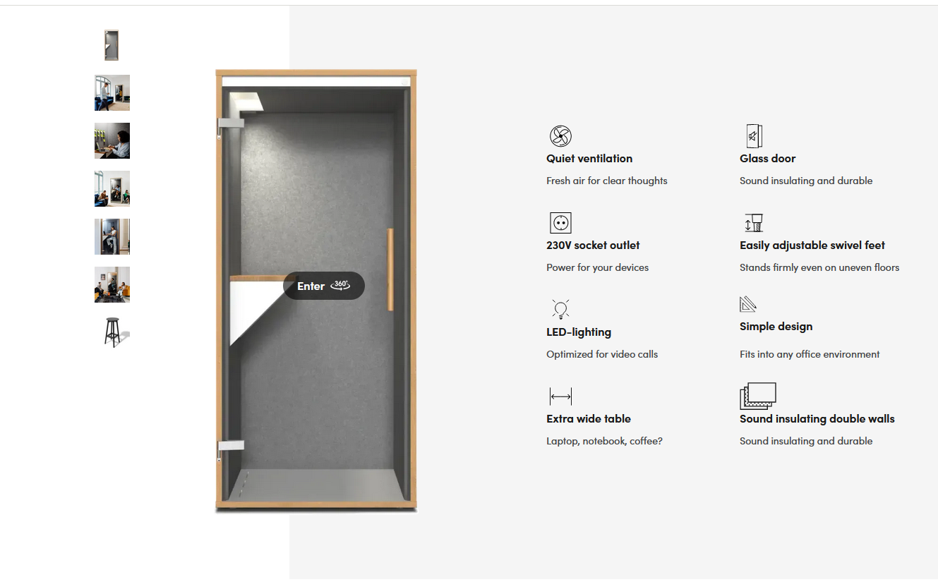
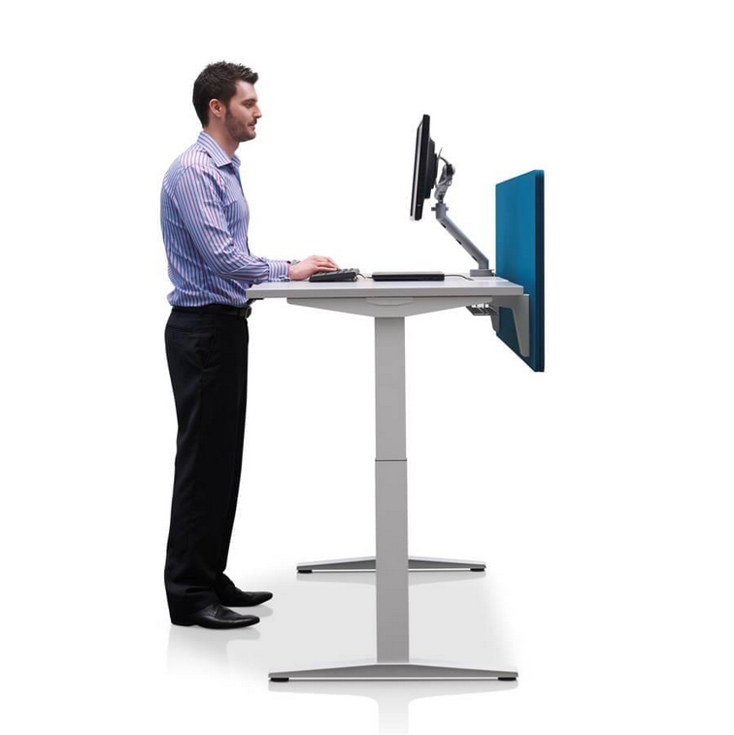
Reasonable adjustments some examples
ThinkNeurodiversity.com 2023
79

Slide 80
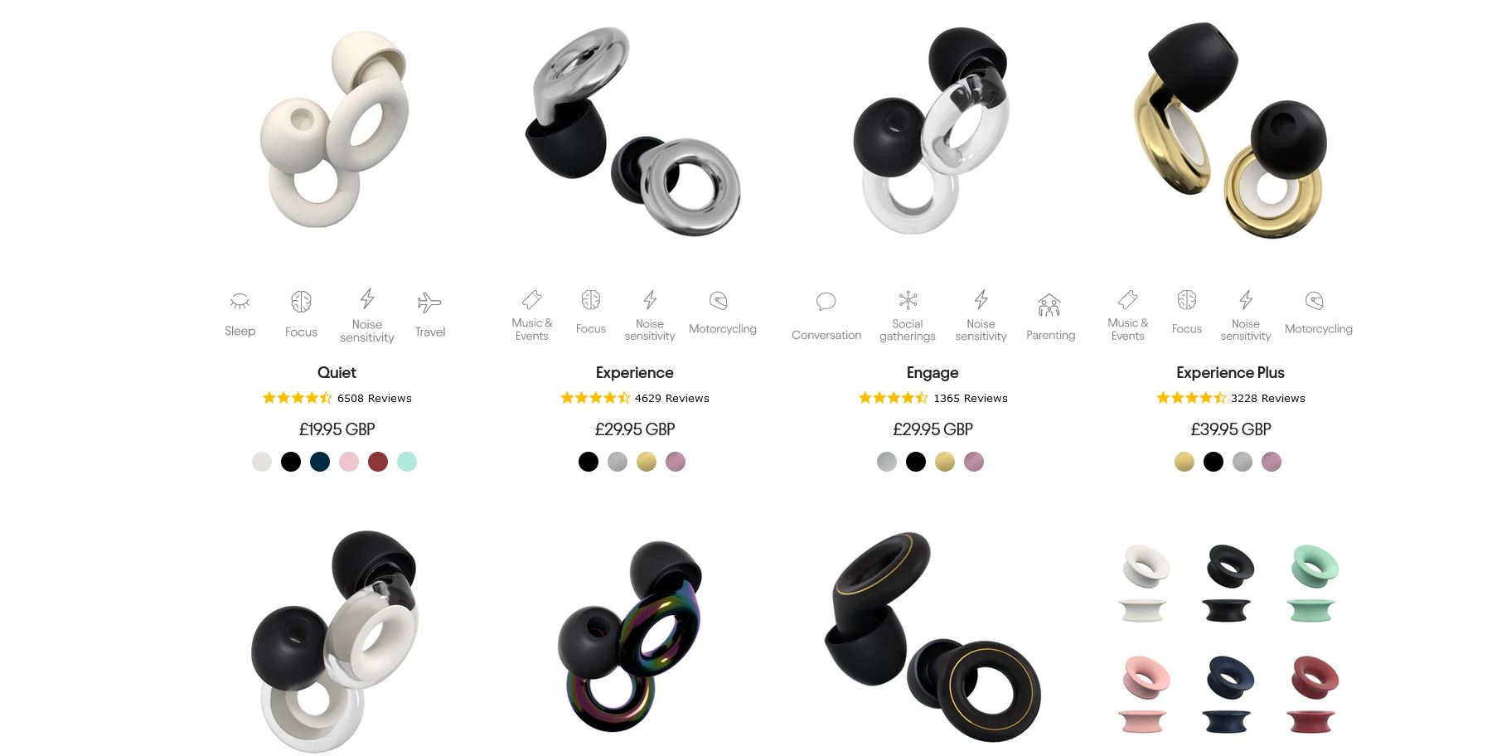
ThinkNeurodiversity.com 2023
80

Slide 81
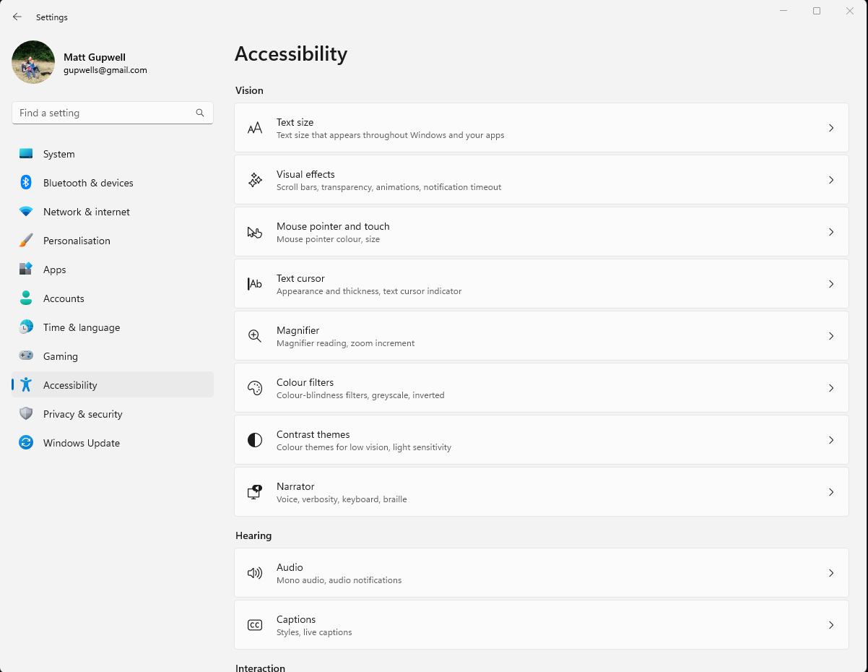
ThinkNeurodiversity.com 2023
81

Slide 82
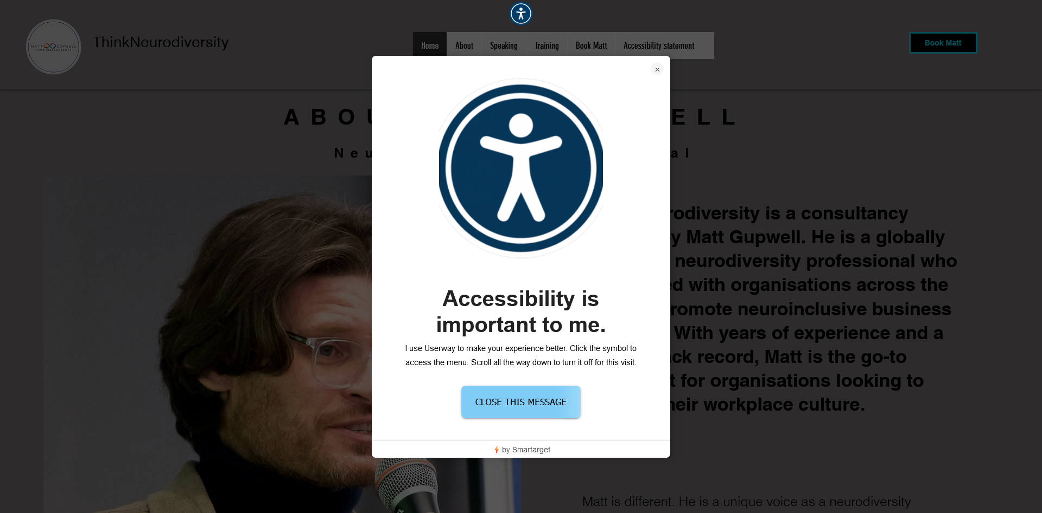
ThinkNeurodiversity.com 2023
82

Slide 83
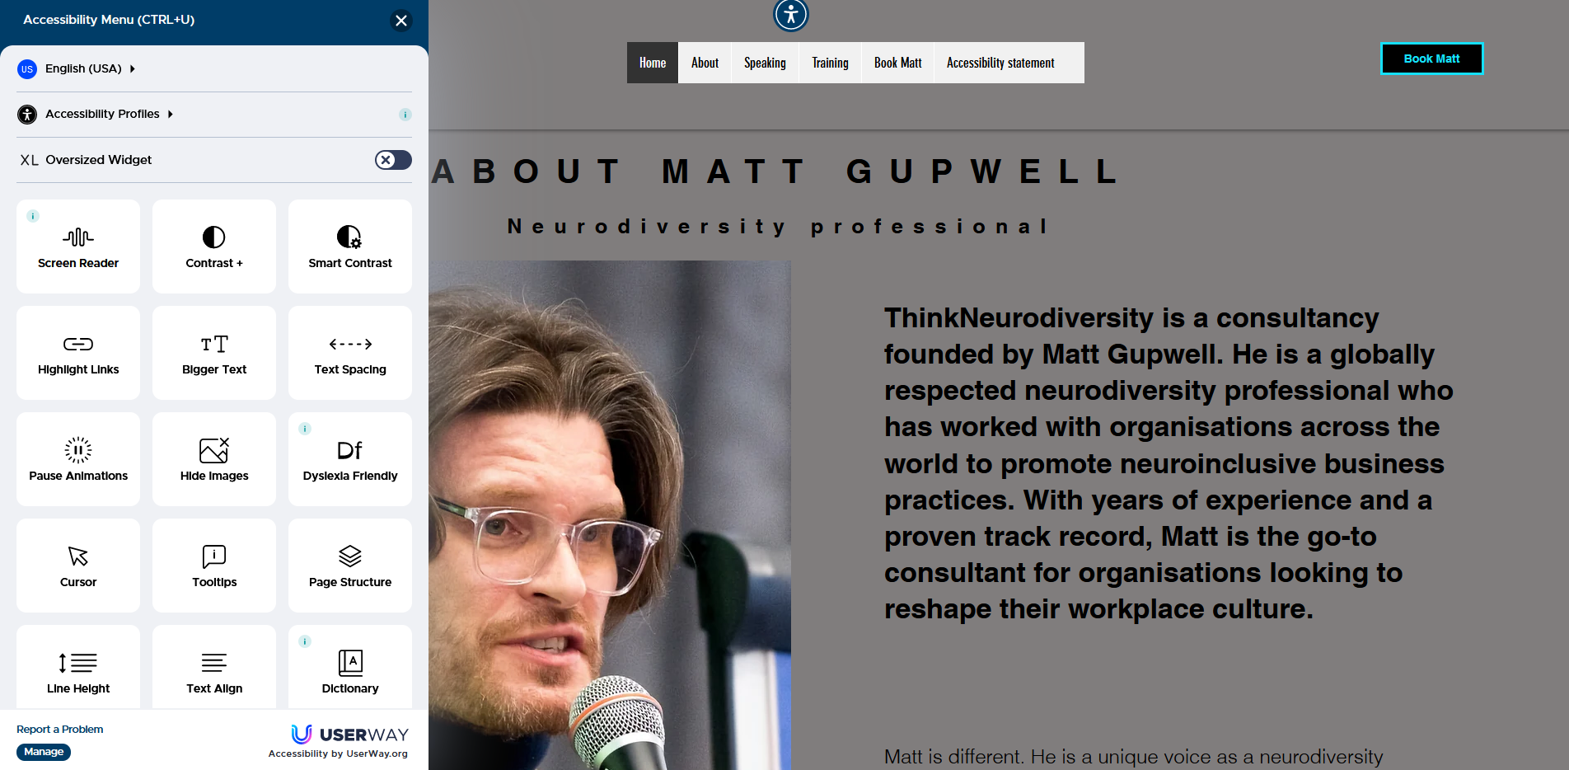
ThinkNeurodiversity.com 2023
83

Slide 84
ThinkNeurodiversity.com 2023
84

Slide 85
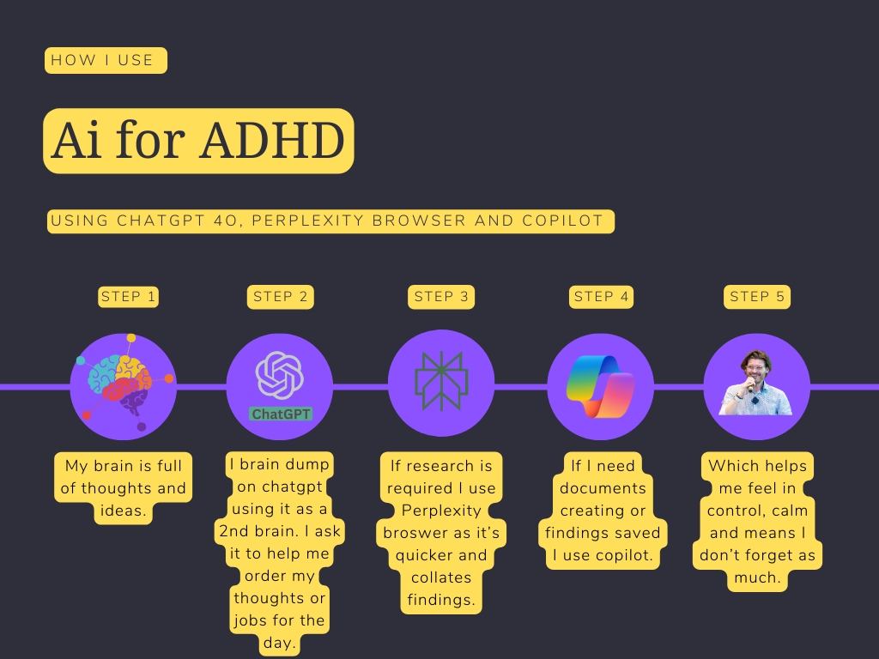
ThinkNeurodiversity.com 2023
85

Slide 86
ThinkNeurodiversity.com 2023
86

Slide 87
ThinkNeurodiversity.com 2023
87

Slide 88
Does diagnosis matter.
Or for that matter disclosure?

Slide 89
Definition
Under the Equality Act 2010, UK law does not require an employee to have a formal diagnosis to request support or reasonable adjustments at work. Employers are obligated to make reasonable adjustments if they know, or could reasonably be expected to know, that an employee has a disability or condition that affects their ability to perform their job. The focus is on the impact of the impairment rather than the formal diagnosis itself.

Slide 90
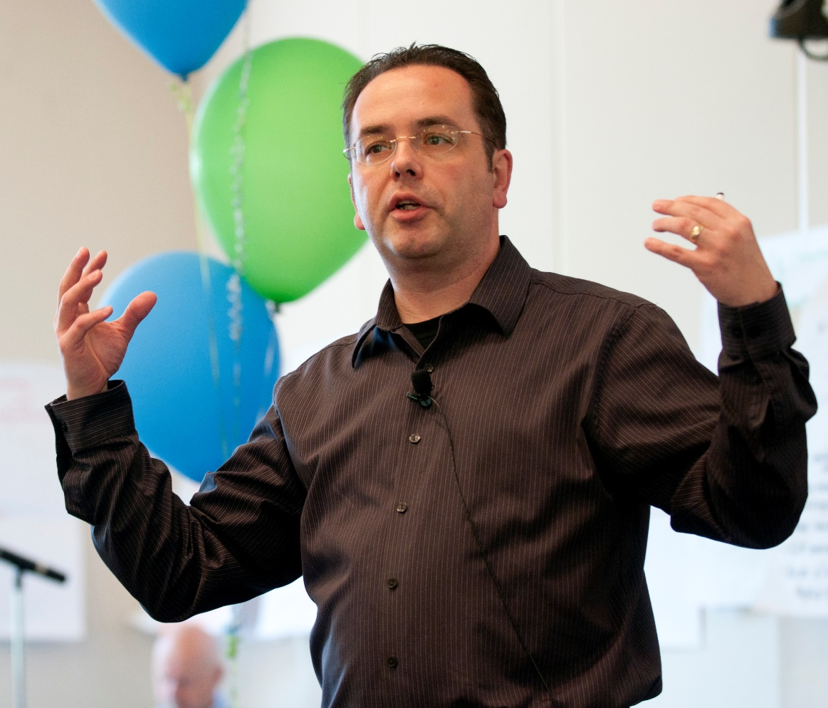
If the person is open about their conditions the questions are different.
There are two sides to this conversation.
How does your X affect you?
When does it affect you?
What help do you think you need?
That could be reasonable adjustments or pointing to workplace assessments.

Slide 91
If they don’t know or haven’t mentioned it the questions should only:
There are two sides to this conversation.
Focus on removing perceived disadvantage, not labelling the why.
It may take longer, or they may need more help identifying what would help.

Slide 92
What can you do?
Focus on the person first. To find a solution to their problems.
Remember, diagnosed or not – asking for help takes courage and they may already be anxious about the response.
Know that the person may already be aware of how they are perceived or may believe they are perceived.

Slide 93
What to do when performance is an issue?

Slide 94
Reasons not excuses.
A neurodivergent condition is not an excuse and should never be perceived as one.
Performance problems can often be the result of issues with Communication, Clarity, calmness and feeling out of control.
Remember they may fear asking for help and be ashamed that it’s got to this point!
But one can be neurodivergent and;
-in the wrong role
-not able to cope
-or not easy to work with or manage.

Slide 95
Address causes first. Find out how the person is.
Don’t guess at needs or conditions but manage the person not the problem.
The first meeting is crucial.
Reassure them that the aim is to help. Whatever that takes.

Slide 96
My tips having been sacked 30 times!
Investigate causes before anything else.
Don’t seek to get all the answers in 1 meeting.
Allow time for the person to process what is happening. A break in the meeting or scheduling another meeting
At all stages show them the aim is to help.
Remember that neurodivergent emotions, therefore responses can be BIG!

Slide 97
Resources
Think Neurodiversity 2023

Slide 98
Online assessments
Remember the tests on the next page are not clinical assessments and should not be taken as such.
However, they offer a good indication of whether someone is affected by those conditions.
If you or someone else are concerned or feel that life is impacted negatively, always speak to a GP first. It is recommended that if the tests indicate you may have a condition that your show the GP a copy of your results, as this can help expedite referrals.
Think Neurodiversity 2023

Slide 99
Useful links
Genius Within finder. A multi condition assessment and display of strengths and challenges.
http://geniusfinder.pro/
ADHD test specific to women and girls.
https://www.additudemag.com/self-test-adhd-symptoms-women-girls/
ADHD test general (adults only).
https://www.additudemag.com/adhd-symptoms-test-adults/
The Autism spectrum (eq) test.
https://www.additudemag.com/adhd-symptoms-test-adults/
Think Neurodiversity 2023

Slide 100
Useful links
Dyslexia test
https://www.additudemag.com/dyslexia-symptoms-test-adults/
OCD test
https://www.additudemag.com/screener-obsessive-compulsive-disorder-symptoms-test-adults/
Tourette Syndrome – tic disorder test.
https://www.additudemag.com/self-test-for-tic-disorder-in-adults/
Think Neurodiversity 2023

Slide 101
Resources for people waiting assessment or diagnosis
National charities / groups
https://www.autism.org.uk/
https://www.adhdfoundation.org.uk
https://adhduk.co.uk/
Think Neurodiversity 2023

Slide 102
Resources for people waiting assessment or diagnosis
National charities / groups
https://www.bdadyslexia.org.uk/
https://www.madebydyslexia.org/
https://www.tourettes-action.org.uk/
https://www.ocduk.org/
https://www.headway.org.uk/
Think Neurodiversity 2023

Slide 103
Resources for people waiting assessment or diagnosis
National charities / groups
https://www.mssociety.org.uk/
https://www.longcovid.org/

Slide 104
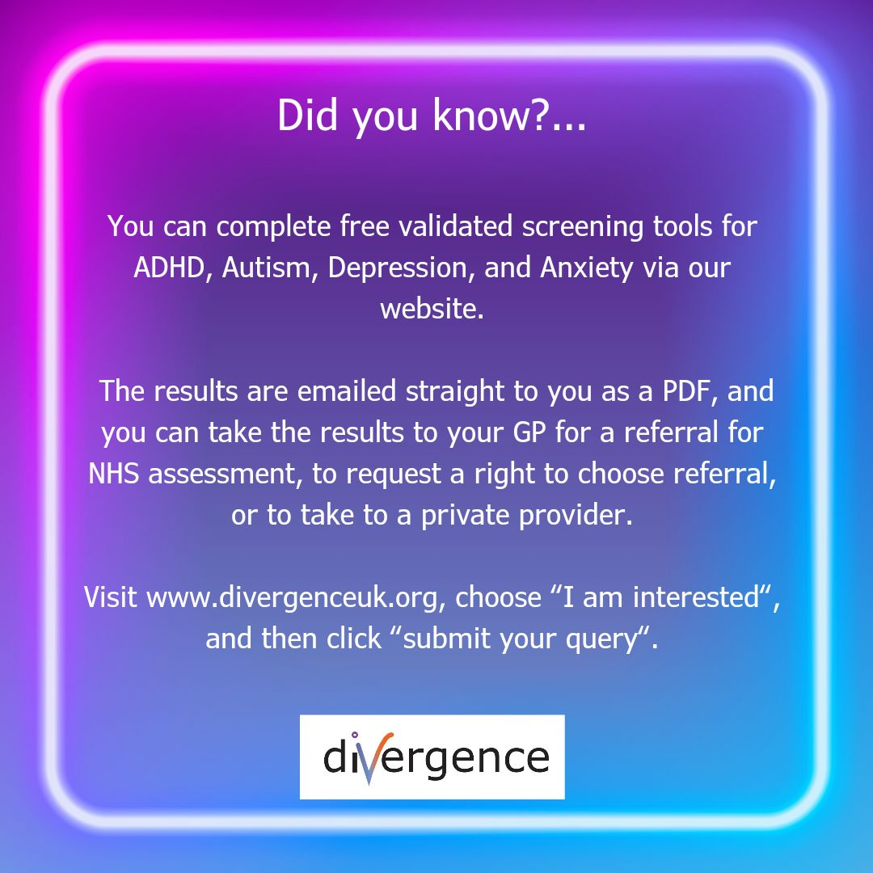
The clinical practise I work with
https://www.divergenceuk.org/

Slide 105
Resources from Matt
@TALKADHD PODCAST:
https://www.youtube.com/@TALKADHD
TALKADHD Whatsapp community:
https://chat.whatsapp.com/JR8R8jTl5zY0jr8MzXjIE7 -

Slide 106
Resources from Matt
Userway accessibility software:
https://www.uwtracks.com/6R5NDGT/55M6S/
Fathom meeting recording software:
https://fathom.partnerlinks.io/oi8son9o112q

Slide 107
Contact Matt for consultancy, training or speaking.
My website
Email me
Linkedin

Slide 108
Thank you
Matt Gupwell
enquire@thinkneurodiversity.com
www.thinkneurodiversity.com
Linkedin: @mattgupwell
ThinkNeurodiversity.com 2023
108

