Slide 1

Developing and delivering occupational health and wellbeing programmes for the diverse NHS workforce: what should we be considering?
Professor Manish Pareek
Chair in Infectious Diseases
University of Leicester
@drmanpareek
mp426@leicester.ac.uk

Slide 2































Laura Gray
Lucy Teece
Carl Melbourne
Anna Guyatt
Kamlesh Khunti
Martin Tobin
Sue Carr
Mayuri Gogoi
Fatimah Wobi
Chris Martin
Janet Hood
Vishant Modhwadia
Claire Garwood
Holly Reilly
Rachael Dowling
Yasmin Godhania
Dan Pan
Andrea Cooper
Pranab Haldar
Laura Nellums
Amani Al Oraibi
Osama Hassan
Irtiza Qureshi
David Ford
Chris Orton
Sharon Heys
Kath Woolf
Chris McManus
Ibrahim Abubakar
Ted Dove
Ruby Reed-Berendt
Amit Gupta
Shirley Sze
Jatinder Minhas
Joshua Nazareth
David Jenkins
Prashanth Patel
Amit Gupta
Members of the UK-REACH PEP and STAG group
Our Partners

Slide 3






Areas to cover today…
NHS workforce
Migration
Health of staff
Data
Occupational Health assessments
Looking forward/Summary

Slide 4
NHS workforce

Slide 5
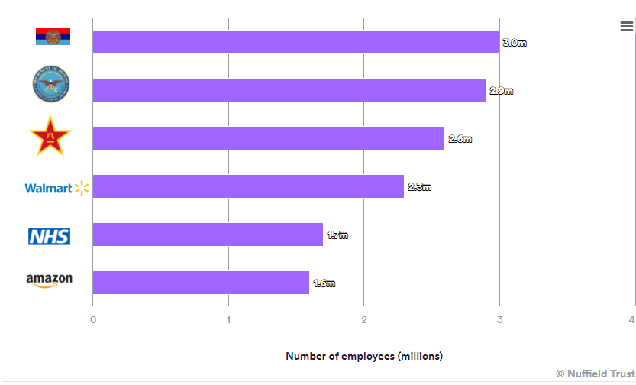
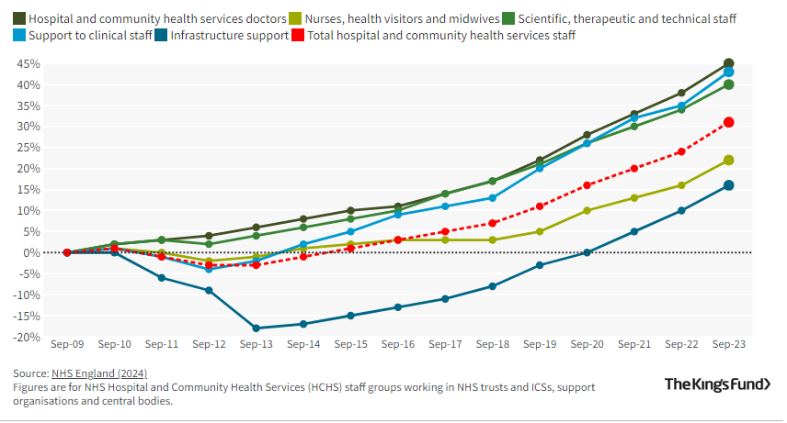

Slide 7
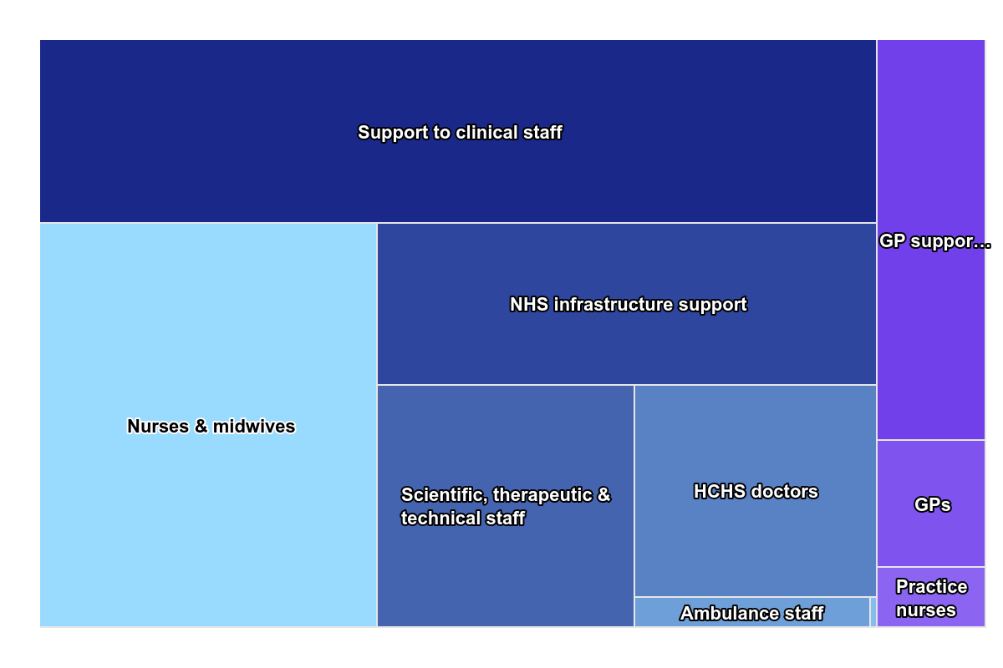
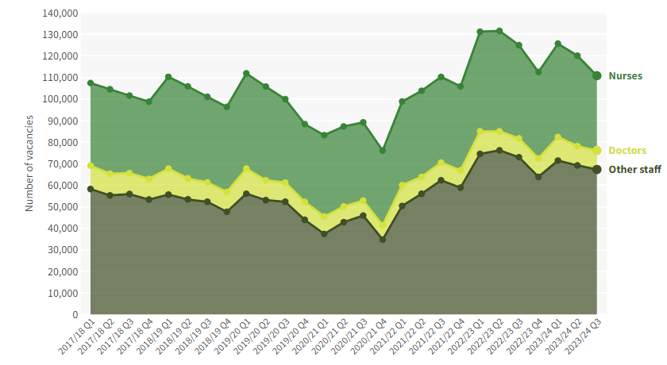
Numbers and vacancies

Slide 8
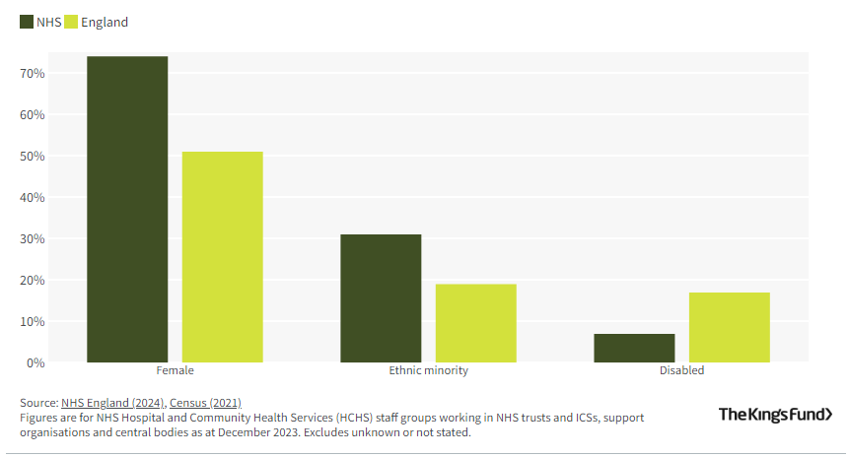
NHS workforce diversity

Slide 9
Migration

Slide 10
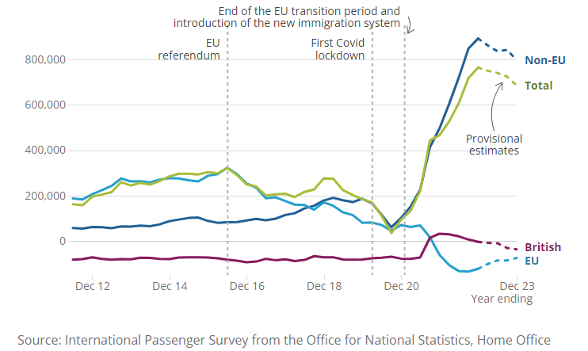
Migration to the UK
Source: ONS 2024

Slide 11
Migration to the UK
Source: ONS 2018

Slide 12
Migration to the UK
Source: ONS 2018

Slide 13
Migration to the UK
Source: ONS 2018

Slide 14
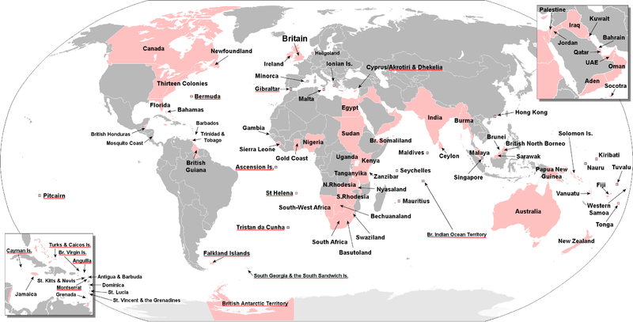
Migration to UK influenced by its past

Slide 15
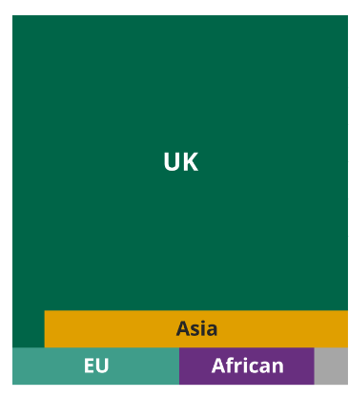
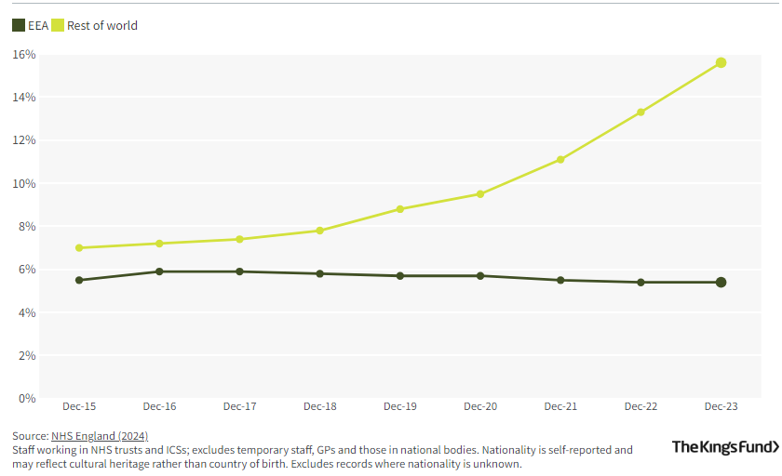
20% of staff international and rising

Slide 16
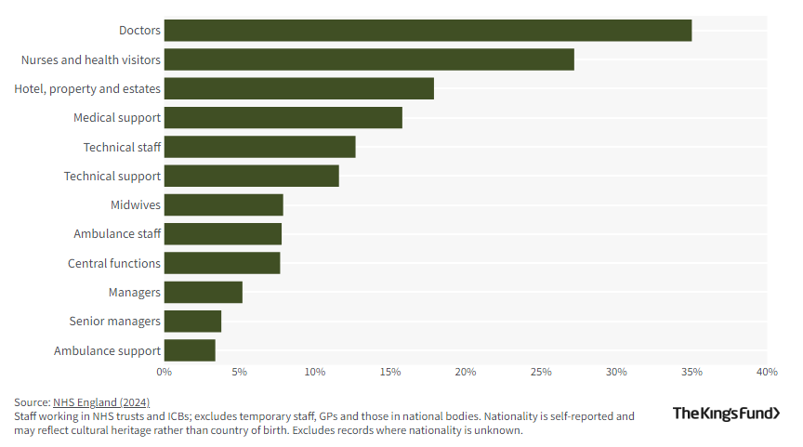
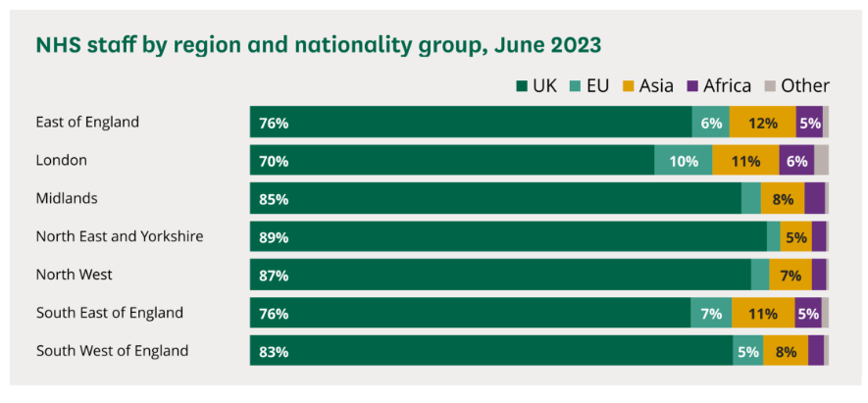
Proportion of international staff varies by region and job role

Slide 17
NHS staff health

Slide 18
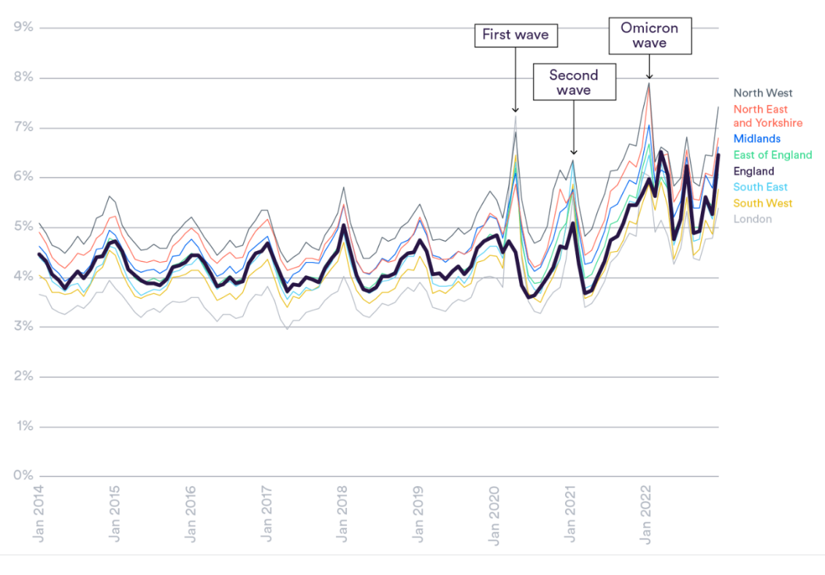
NHS sickness data: changes over time

Slide 19
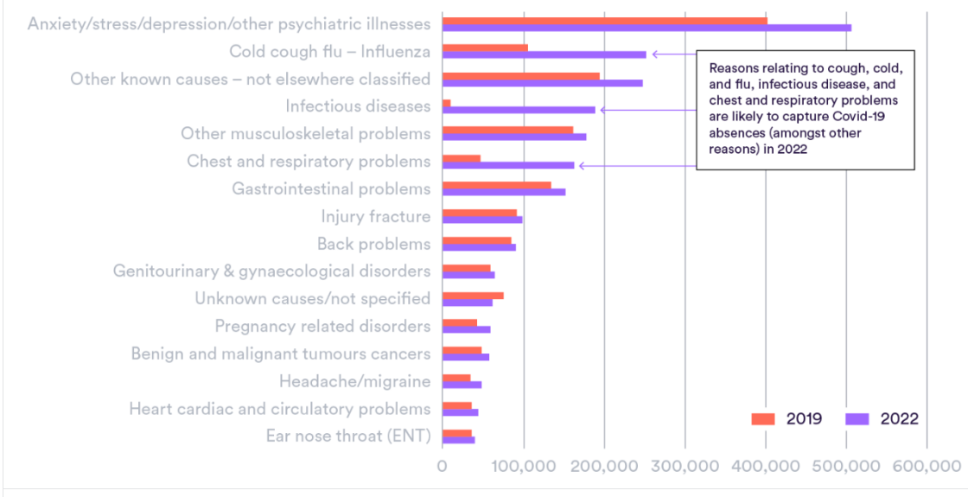
Reasons for sickness in the NHS workforce

Slide 20
Reasons for sickness in the NHS workforce

Slide 21


Slide 22
Mainly focused on mental health
Burnout specific focus
Less on physical health

Slide 23
Mainly focused on mental health
Burnout specific focus
Less on physical health
More holistic and broader understanding of staff health and well-being
Importance of physical health (including bidirectional nature with mental health)
Consider diversity of the workforce (one size does not fit all)
Integrating interventions into work

Slide 24
Mainly focused on mental health
Burnout specific focus
Less on physical health
More holistic and broader understanding of staff health and well-being
Importance of physical health (including bidirectional nature with mental health)
Consider diversity of the workforce (one size does not fit all)
Integrating interventions into work
Need high-quality objective data

Slide 26
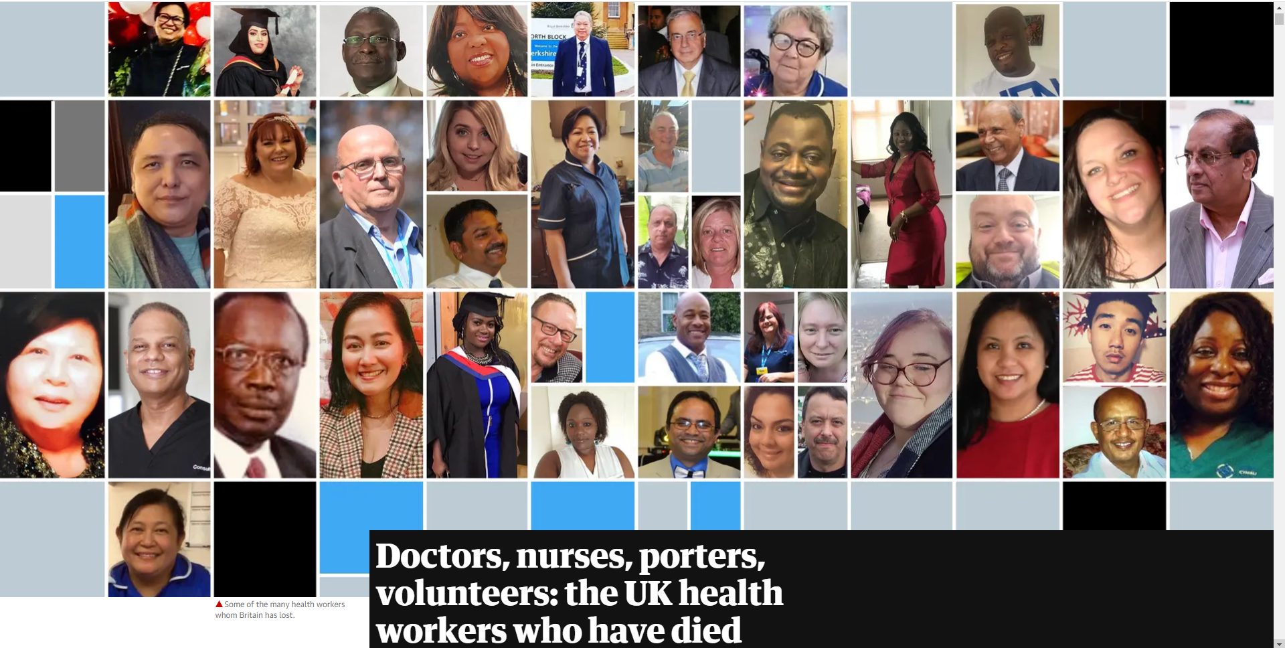
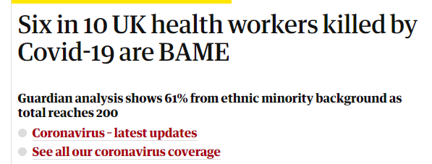

Healthcare workers and COVID-19: early concern

Slide 27
United Kingdom Research study into Ethnicity and COVID-19 outcomes in Healthcare workers

Slide 28

UK-REACH: Urgent Public Health Study
If, how, and why, ethnicity affects COVID-19 clinical outcomes in HCWs
Impact of COVID-19 on the physical and mental health of Black, Asian and ethnic minority HCWs

Slide 29

UK-wide and multiple partners

Slide 30
WP1
Expedited linkage and analysis of HCW datasets
WP2
Longitudinal cohort study looking at changes in health outcomes, social circumstances and professional roles of HCWs
WP3
Ethical and legal implications of linking professionals' registration data to healthcare data
WP4
WP5
Qualitative research focused on understanding risk perceptions, support and coping mechanisms relevant to COVID-19
Key recommendations through sustained joint working with a multi-professional, national stakeholder group
WP6
Immune response to COVID-19 infection/vaccination and differences by ethnicity in HCWs (National Core Studies funded)

Slide 31









WP2: Longitudinal cohort study
    Demographics
    Job role and work
    Living arrangements
    Health
    Access to PPE
    Vaccine attitudes
    Email invites
    Online consent
    Questionnaire

Slide 32
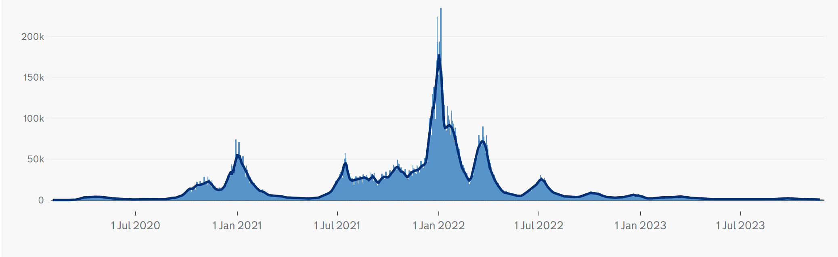
Five waves of data collection to date
Wave 1
Dec 20-Mar 21
Wave 2
Apr 21-July 21
Wave 3
Oct 21-Dec 21
Wave 4
Jun 22-Oct 22
Wave 5
Nov 23-Jan 24
Cases in England
(daily)

Slide 33
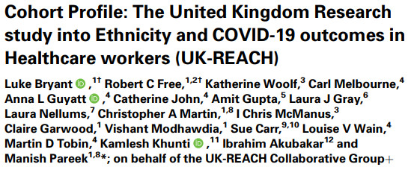
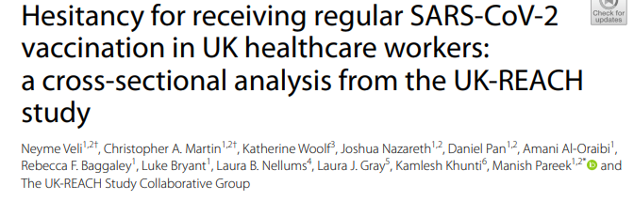
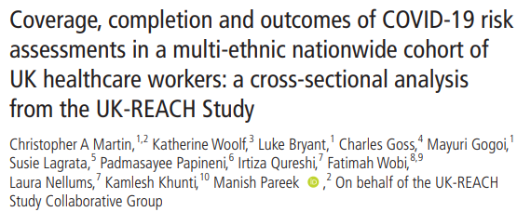
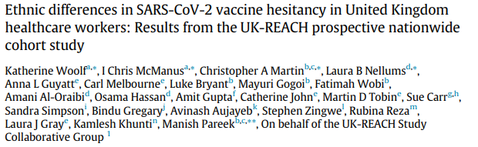
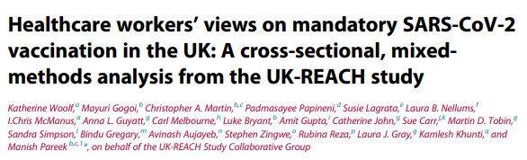
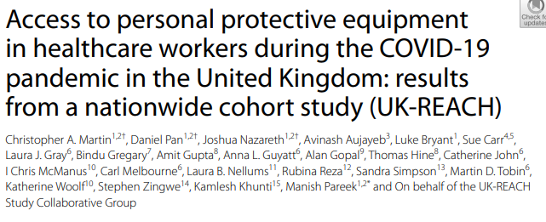
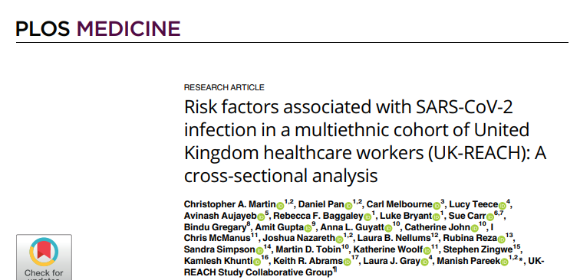
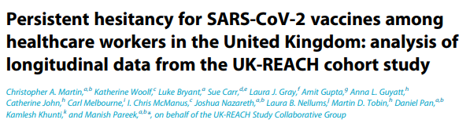

Slide 34
Cohort overview
Vaccines/Vaccine Hesitancy
Risk Assessments
Risk Assessments
Vaccines/Vaccine Hesitancy
Vaccines/Vaccine Hesitancy
Access to PPE
COVID infection risk
Vaccines/Vaccine Hesitancy

Slide 35

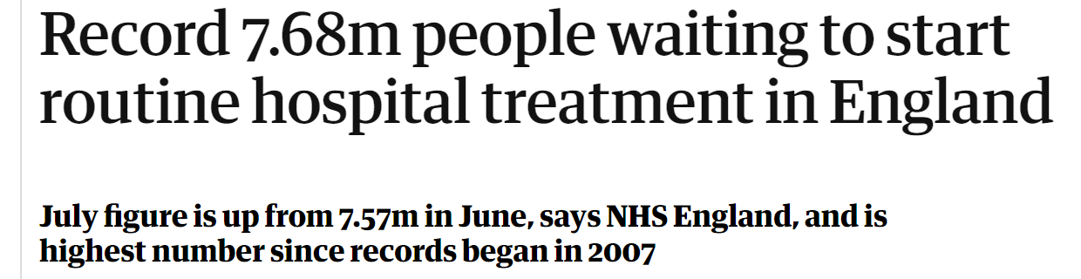

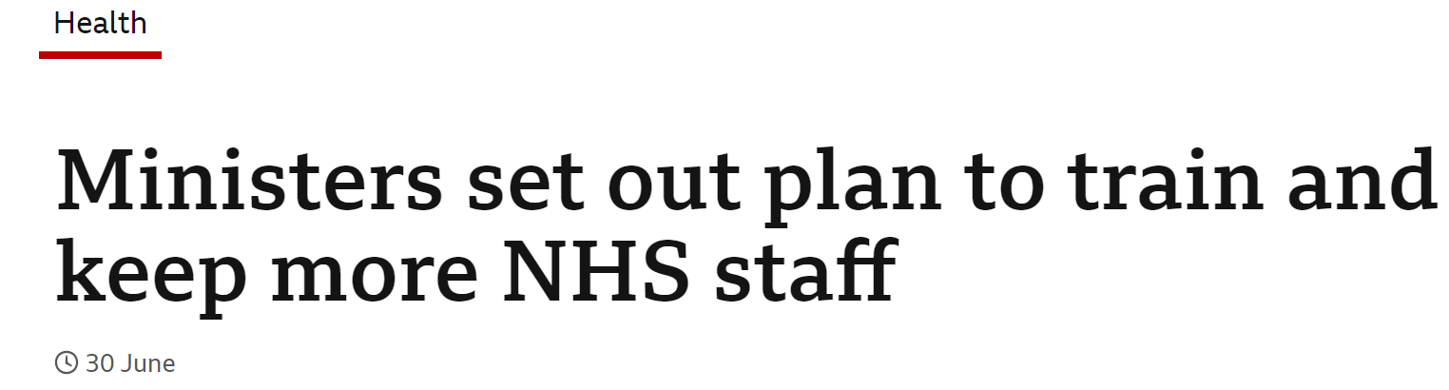
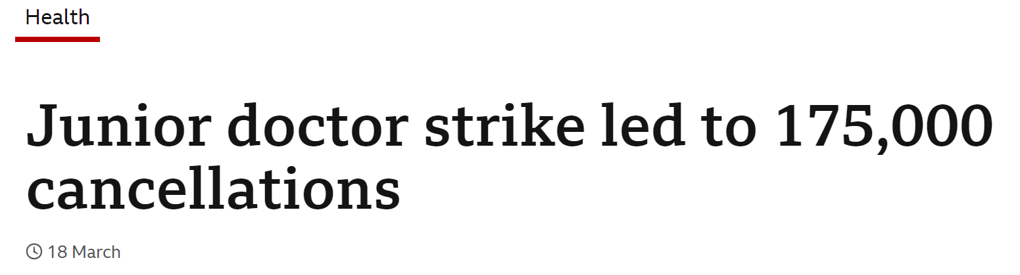
Research in a rapidly changing environment

Slide 36
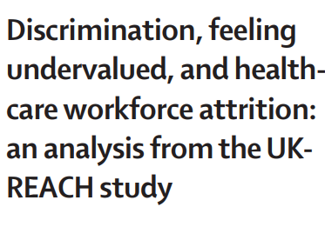



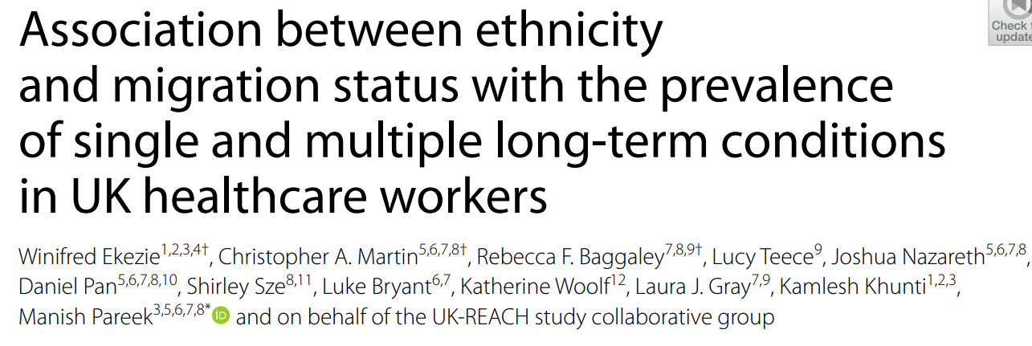
Cohort overview
Vaccines/Vaccine Hesitancy
Risk Assessments
Risk Assessments
Vaccines/Vaccine Hesitancy
Vaccines/Vaccine Hesitancy
Access to PPE
COVID infection risk
Vaccines/Vaccine Hesitancy
Factors associated with Health Related Quality of Life in UK healthcare workers: a cross-sectional study

Slide 37
Cohort overview
Vaccines/Vaccine Hesitancy
Risk Assessments
Risk Assessments
Vaccines/Vaccine Hesitancy
Vaccines/Vaccine Hesitancy
Access to PPE
COVID infection risk
Vaccines/Vaccine Hesitancy
Discrimination
Workforce retention/
intentions to leave
Long-COVID
Quality of Life
Multiple long-term conditions/physical health
Mental health/Financial concerns
Factors associated with Health-Related Quality of Life in UK healthcare workers: a cross-sectional study

Slide 38
Cohort overview
Vaccines/Vaccine Hesitancy
Risk Assessments
Risk Assessments
Vaccines/Vaccine Hesitancy
Vaccines/Vaccine Hesitancy
Access to PPE
COVID infection risk
Vaccines/Vaccine Hesitancy
Discrimination
Workforce retention/
intentions to leave
Long-COVID
Quality of Life
Multiple long-term conditions/physical health
Mental health/Financial concerns
Factors associated with Health-Related Quality of Life in UK healthcare workers: a cross-sectional study

Slide 39
Cohort overview
Vaccines/Vaccine Hesitancy
Risk Assessments
Risk Assessments
Vaccines/Vaccine Hesitancy
Vaccines/Vaccine Hesitancy
Access to PPE
COVID infection risk
Vaccines/Vaccine Hesitancy
Discrimination
Workforce retention/
intentions to leave
Long-COVID
Quality of Life
Multiple long-term conditions/physical health
Mental health/Financial concerns
Factors associated with Health-Related Quality of Life in UK healthcare workers: a cross-sectional study

Slide 40


Slide 41
Multiple long-term conditions
Healthcare workers’ (HCW) well-being has a direct effect on patient care
Little known about the prevalence and patterns of long-term medical conditions in HCWs, especially those from ethnic minorities/migrants
Analysis using questionnaire data from baseline (December 2020-March 2021)
Outcomes
  Presence/absence of particular comorbidities
  MLTCs (≥2 long-term conditions vs < 2 long-term conditions)

Slide 42
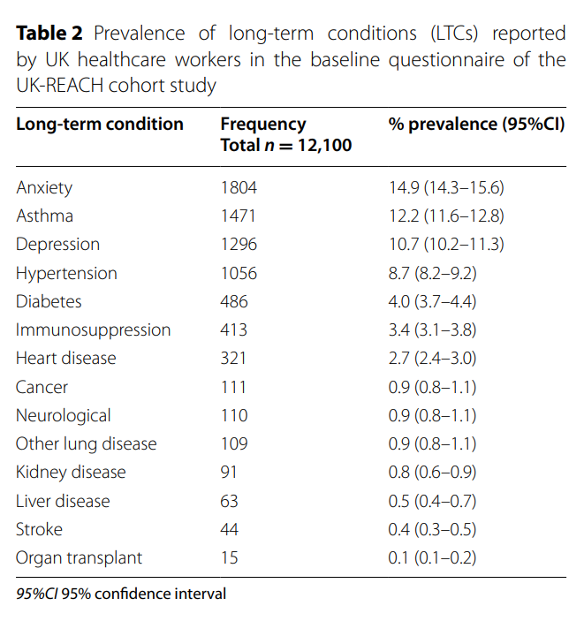

Slide 48
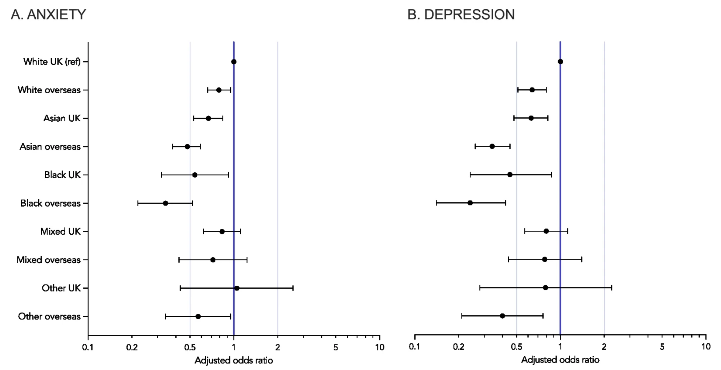

Slide 49
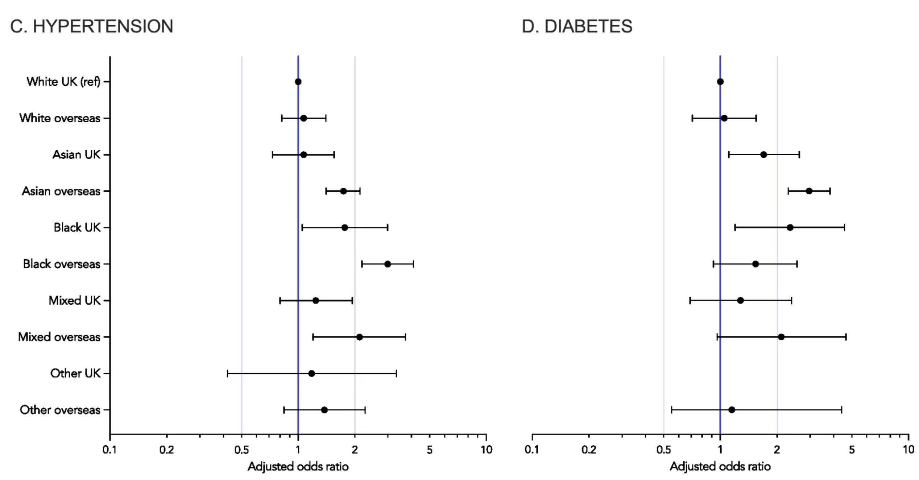

Slide 50
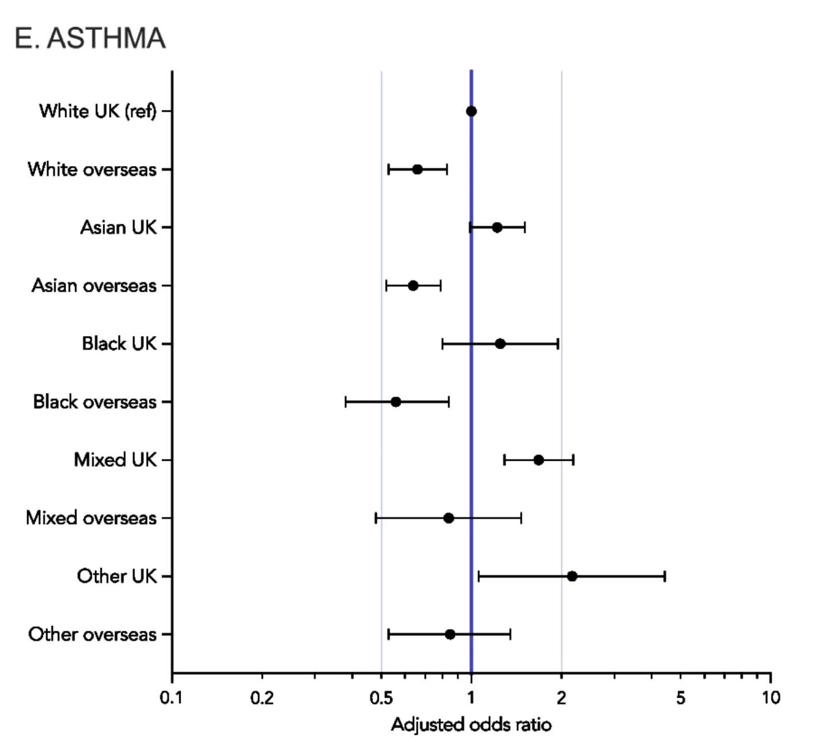

Slide 51
Prevalence of multiple long-term conditions 15%

Slide 52
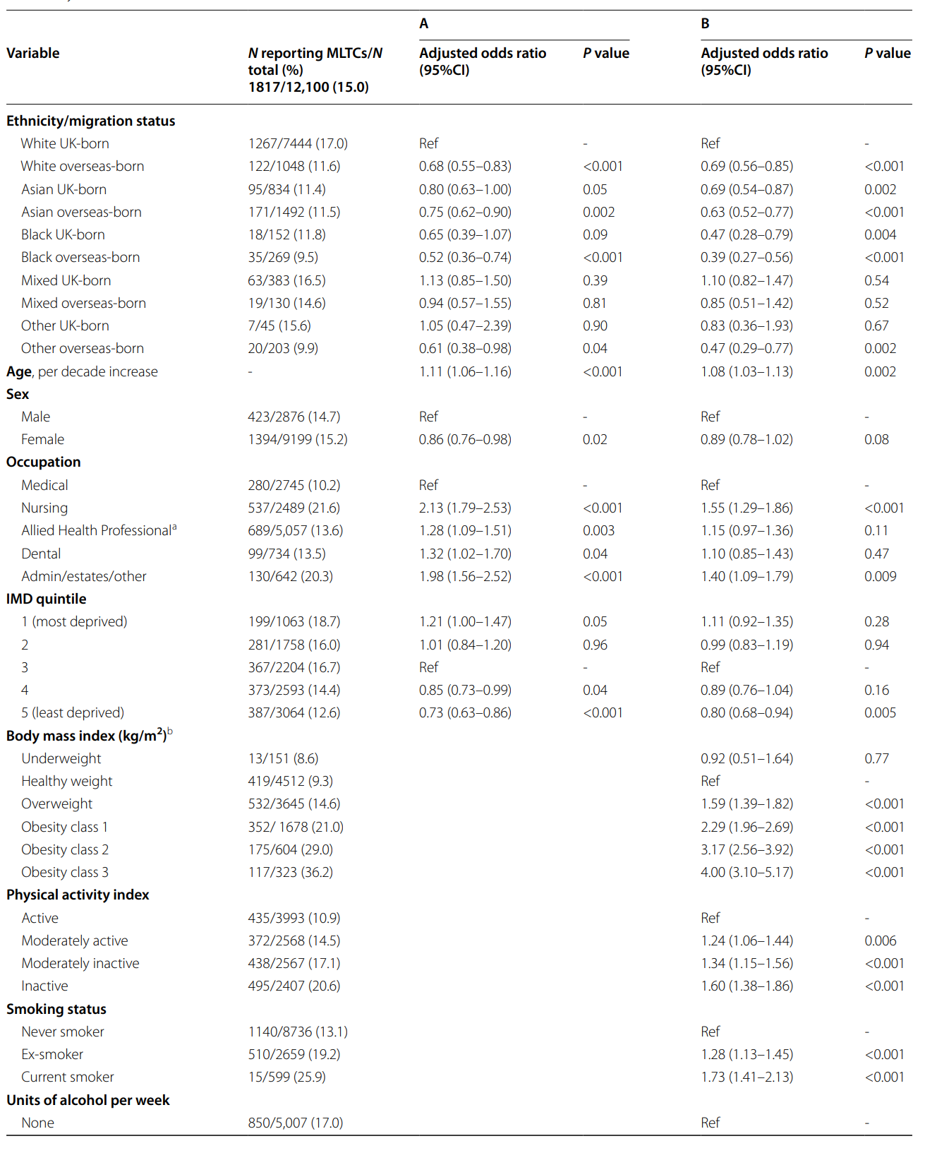

Slide 56
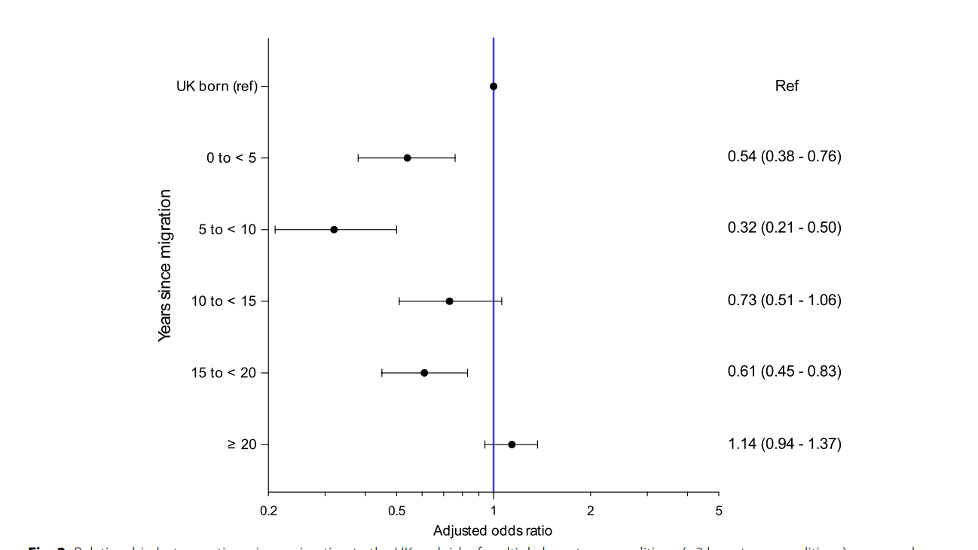

Slide 57
Conclusions
Among UK HCWs, the prevalence of common LTCs and odds of reporting MLTCs varied by ethnicity and migrant status.
The lower odds of MLTCs in migrant HCWs reverted to the odds of MLTCs in UK-born HCWs over time.
Further research on this population should include longitudinal studies with linkage to healthcare records.
Interventions should be co-developed with HCWs from different ethnic and migrant groups focussed upon patterns of conditions prevalent in specific HCW subgroups to reduce the overall burden of LTCs/MLTCs.

Slide 58
Cohort overview
Vaccines/Vaccine Hesitancy
Risk Assessments
Risk Assessments
Vaccines/Vaccine Hesitancy
Vaccines/Vaccine Hesitancy
Access to PPE
COVID infection risk
Vaccines/Vaccine Hesitancy
Discrimination
Workforce retention/
intentions to leave
Long-COVID
Quality of Life
Multiple long-term conditions/physical health
Mental health/Financial concerns
Factors associated with Health-Related Quality of Life in UK healthcare workers: a cross-sectional study

Slide 59
Cohort overview
Vaccines/Vaccine Hesitancy
Risk Assessments
Risk Assessments
Vaccines/Vaccine Hesitancy
Vaccines/Vaccine Hesitancy
Access to PPE
COVID infection risk
Vaccines/Vaccine Hesitancy
Discrimination
Workforce retention/
intentions to leave
Long-COVID
Quality of Life
Multiple long-term conditions/physical health
Mental health/Financial concerns
Factors associated with Health-Related Quality of Life in UK healthcare workers: a cross-sectional study

Slide 60
Factors associated with Health Related Quality of Life in UK healthcare workers:
a cross-sectional study
Christopher A Martin, Rebecca F Baggaley, Lucy Teece, Daniel Pan, Joshua Nazareth, Luke Bryant, Carol Rivas, Professor of Health and Social Care, Katherine Woolf, Manish Pareek, On behalf of the UK-REACH Study collaborative group

Slide 61
>12,000 HCWs in baseline questionnaire
Quality of Life measured using EQ-5D-5L instrument
Explored differences by sociodemographic group using descriptive statistics and, after dichotomising each EQ-5D-5L dimension (pain/discomfort, anxiety/depression, usual activities, self-care, mobility) into a binary outcome (reporting any problems compared to no problems), by logistic regression.
We also explored differences in the EQ-5D-5L visual analogue scale (“How good is your health today on a scale from 0 – 100?”) by sociodemographic group using linear regression.

Slide 62
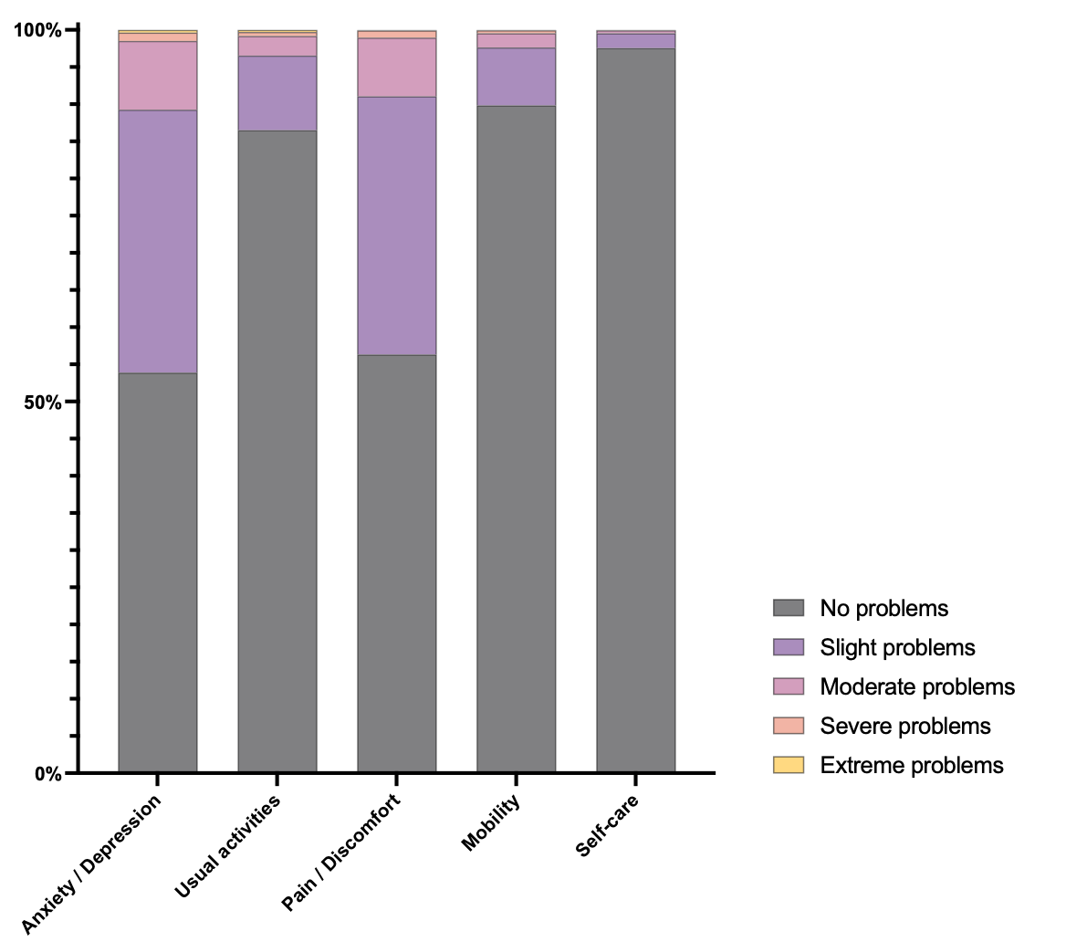
Proportion of healthcare workers reporting problems across EQ5D domains

Slide 63
Grey = adjusted for Age, sex, ethnicity/migration, IMD quintile, occupation
Turquoise = additionally adjusted for health factors (alcohol, smoking, long term conditions, BMI)

Slide 64
Grey = adjusted for Age, sex, ethnicity/migration, IMD quintile, occupation
Turquoise = additionally adjusted for health factors (alcohol, smoking, long term conditions, BMI)

Slide 65
Grey = adjusted for Age, sex, ethnicity/migration, IMD quintile, occupation
Turquoise = additionally adjusted for health factors (alcohol, smoking, long term conditions, BMI)

Slide 66
Grey = adjusted for Age, sex, ethnicity/migration, IMD quintile, occupation
Turquoise = additionally adjusted for health factors (alcohol, smoking, long term conditions, BMI)

Slide 67
Grey = adjusted for Age, sex, ethnicity/migration, IMD quintile, occupation
Turquoise = additionally adjusted for health factors (alcohol, smoking, long term conditions, BMI)

Slide 68
Grey = adjusted for Age, sex, ethnicity/migration, IMD quintile, occupation
Turquoise = additionally adjusted for health factors (alcohol, smoking, long term conditions, BMI)

Slide 69
Grey = adjusted for Age, sex, ethnicity/migration, IMD quintile, occupation
Turquoise = additionally adjusted for health factors (alcohol, smoking, long term conditions, BMI)

Slide 70
Grey = adjusted for Age, sex, ethnicity/migration, IMD quintile, occupation
Turquoise = additionally adjusted for health factors (alcohol, smoking, long term conditions, BMI)

Slide 71
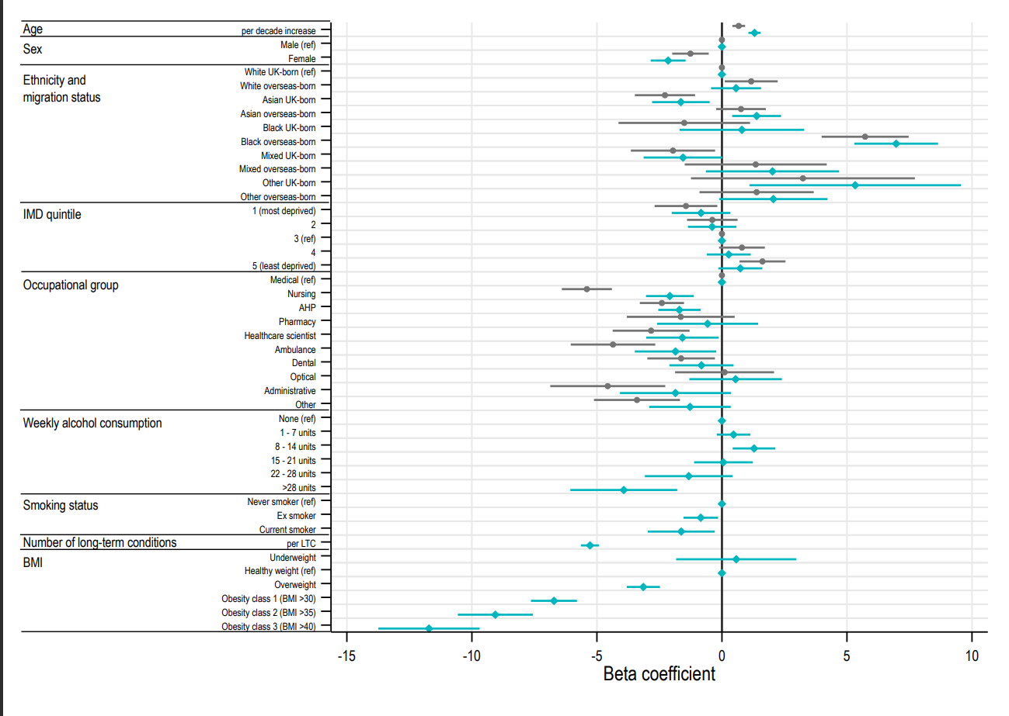
Multivariable linear regression models showing the association of sociodemographic, occupational and health factors with EQ-5D visual analogue scores (VAS) where 100 represents ‘The best health you can imagine’ and 0 represents ‘The worst health you can imagine’.

Slide 72
Worse quality of life
Better quality of life
Multivariable linear regression models showing the association of sociodemographic, occupational and health factors with EQ-5D visual analogue scores (VAS) where 100 represents ‘The best health you can imagine’ and 0 represents ‘The worst health you can imagine’.

Slide 73
Conclusions
Relatively high HRQoL in HCWs compared to general population BUT increased reporting of problems with anxiety/depression and pain/discomfort
Older age, lower odds of anxiety /depression and higher odds of pain/discomfort and mobility problems
Women more likely to report problems over all domains than men
Black groups (esp. overseas born) and Asian overseas born have lower odds of depression than White UK
Increasing deprivation in residential area associated with higher odds of reporting problems
Large differences by occupation with medics less likely to report problems than almost all professions (large effects seen when examining nurses – significantly higher odds across domains)
Similar effects seen when analysing EQ5D domains and EQ5D VAS scores

Slide 74
Occupational Health Assessments

Slide 75
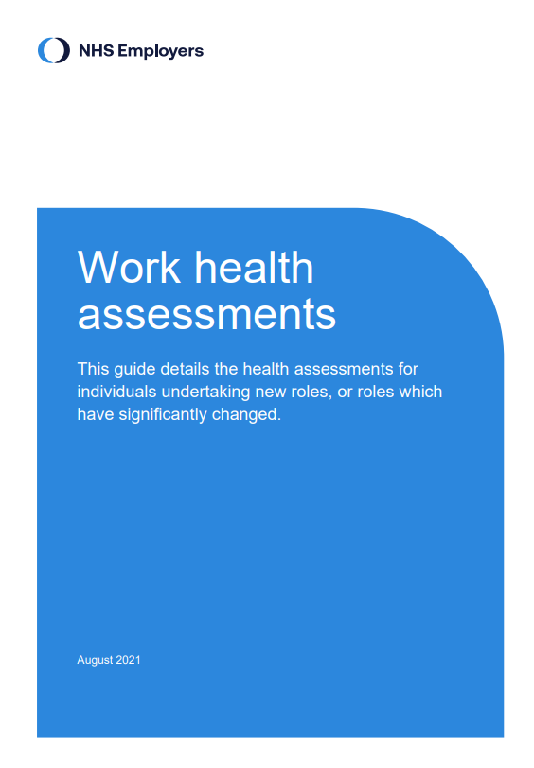
Delivery of services at point of need
Protocol led for new entrants to NHS
Vaccination status, BBV testing
Dealing with issues as they arise for staff

Slide 76
Oin workforce
Join
NHS Career
Leave

Slide 77
Oin workforce
Join
NHS Career
Leave
New joiner assessments

Slide 78
Seasonal flu vaccine
Oin workforce
Join
NHS Career
Leave
New joiner assessments

Slide 79
Seasonal flu vaccine
Oin workforce
Join
NHS Career
Leave
New joiner assessments
Exercise
Diet
Mental Health
NHS Health Checks
Screening programmes
Wider vaccinations

Slide 80
Seasonal flu vaccine
Oin workforce
Join
NHS Career
Leave
New joiner assessments
Exercise
Diet
Mental Health
NHS Health Checks
Screening programmes
Wider vaccinations
Holistic programmes of health across the life-course
Integrate with other NHS initiatives
Target specific programmes to certain groups

Slide 81
Looking forward

Slide 82

Ongoing analyses
Promotion of ethnic minority staff
Redeployment experiences
Longitudinal changes in mental health

Slide 83




Slide 84
Predictors of breakthrough infection/
transmission and correlates of protection

Slide 85
Predictors of breakthrough infection/
transmission and correlates of protection
Prevalence and patterns of long-COVID
Longitudinal changes
Support and interventions

Slide 86
Predictors of breakthrough infection/
transmission and correlates of protection
Prevalence and patterns of long-COVID
Longitudinal changes
Support and interventions
Retention policies
Groups at higher risk of attrition
Drivers of attrition and how they vary by group

Slide 87
Summary
NHS staff increasing numbers and more diverse
Health of staff poorly understood
  Mental health focus vs other aspects
Need to consider broader aspects of health assessment
Life course approach – underpinned by data
UK-REACH continues to provides key insights
National asset to examine a range of areas relating to staff well-being

Slide 88
Any questions?
mp426@le.ac.uk

