Slide 1
Perspectives from HSE
Dr Steve Forman
Principal Medical Adviser
Consultant Occupational Physician
Health and Safety Executive

Slide 2
Session overview
Strategic overview
Health surveillance
Summary and questions

Slide 3
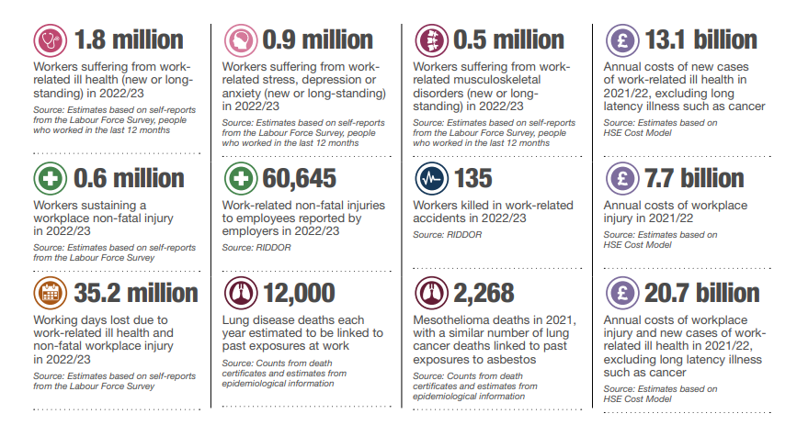

Slide 4
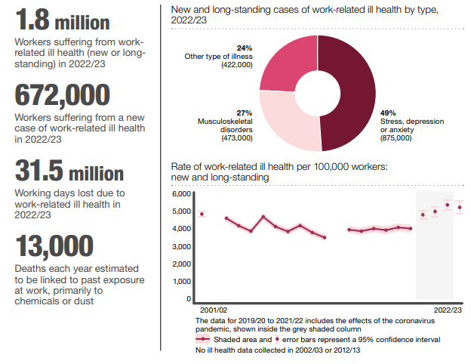

Slide 5
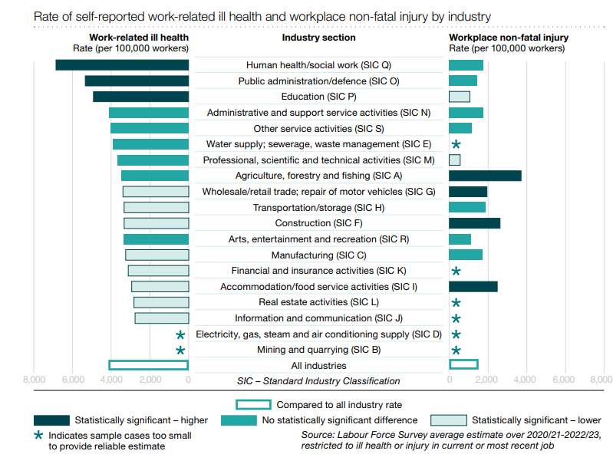

Slide 6
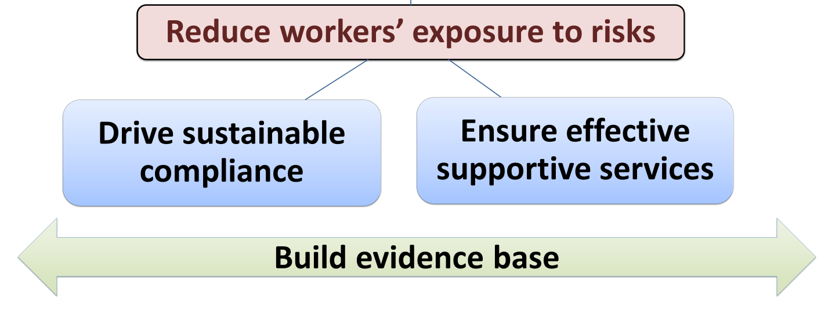

Slide 7
Health surveillance and its importance
Scheme of repeated health checks used to identify work-related ill health
Health surveillance required when workers remain exposed to health risks, even after controls put in place
Why?
Early identification of work-ill health to manage risk for individual and also other workers
Control measures may not always be reliable, despite appropriate checking, training and maintenance
Also, provides opportunity to discuss health issues, reinforce importance of controls and training

Slide 8

Controls and health surveillance
Risks created by hazards should be adequately controlled
Health surveillance is the check for disease
Complimentary systems

Slide 9
Regulations requiring health surveillance

Slide 10
Regulations requiring an Appointed Doctor
Only doctors appointed by HSE can undertake this work

Slide 11
Who does it?
Occupational health professionals with appropriate competencies
Need to understand workplace and risks, therefore should visit
Clinical responsibility and decision making cannot be delegated to non-clinical staff e.g. Occupational Health Technicians
May have responsible person, but they still require training, support and access to occupational health professional

Slide 12
Where health surveillance goes wrong
Health surveillance not performed by employer
Inadequate health surveillance by OH provider
  Testing performed incorrectly
  Failure to recognise abnormal results
  Serial results not considered
  Inadequate understanding of workplace
Occupational health provider not communicating results to employer (may be not at all or inadequate information)
Employer not acting on results

Slide 13
Where health surveillance goes wrong
Inadequate health surveillance by OH provider
  Testing performed incorrectly
  Failure to recognise abnormal results
  Serial results not considered
  Inadequate understanding of workplace
Occupational health provider not communicating results to employer (may be not at all or inadequate information)

Slide 14
Undertaking health surveillance
Baseline assessment needs OH input
Any tests performed should be done so competently and be of adequate quality
Test result requires interpretation of clinical data, by competent occupational health professional (i.e. OH nurse, OH physician)
Need comparison with previous results taking relevant history into account
Is performed serially, not a ‘one-off’

Slide 15
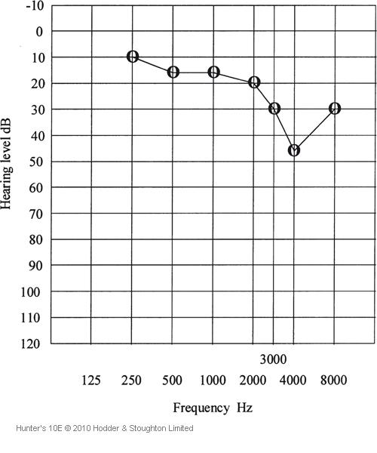
Undertaking health surveillance
Over-reliance on computer interpretation by testing device (includes not recognising biologically implausible data)
Need route of escalation to occupational health physician (not GP)
Should have returned to face-to-face (non-remote) assessments (e.g. Tier 4)

Slide 16
Output to employer
Fitness to work with the relevant hazard(s)
When further health surveillance required
The employer needs sufficient information to meet legal duties
They must act on results to protect workers with work-related disease

Slide 17
COSHH Guidance

Slide 18
Duties on employer – when health surveillance identifies disease
Ensure that a suitably qualified person informs the employee
Review the risk assessment
Review controls, taking account of occupational health advice
Consider assigning the employee to alternative work where there is no risk from further noise exposure, taking account of occupational health advice
Ensure continued health surveillance and review health of other similarly exposed employees

Slide 19
Health records
Duty for retention is on employer (e.g. for 40 years in COSHH)
Where no retention period – keep record at least as long as employee employed
Should include fitness for work, any restrictions and timescale for next review
Should not include confidential medical information

Slide 20
Medical records
Compiled by occupational health professional
Contains confidential medical information e.g. notes, test results
Retention periods are not defined in Health and Safety legislation
Need to consider what happens if you stop working (for whatever reason)

Slide 21
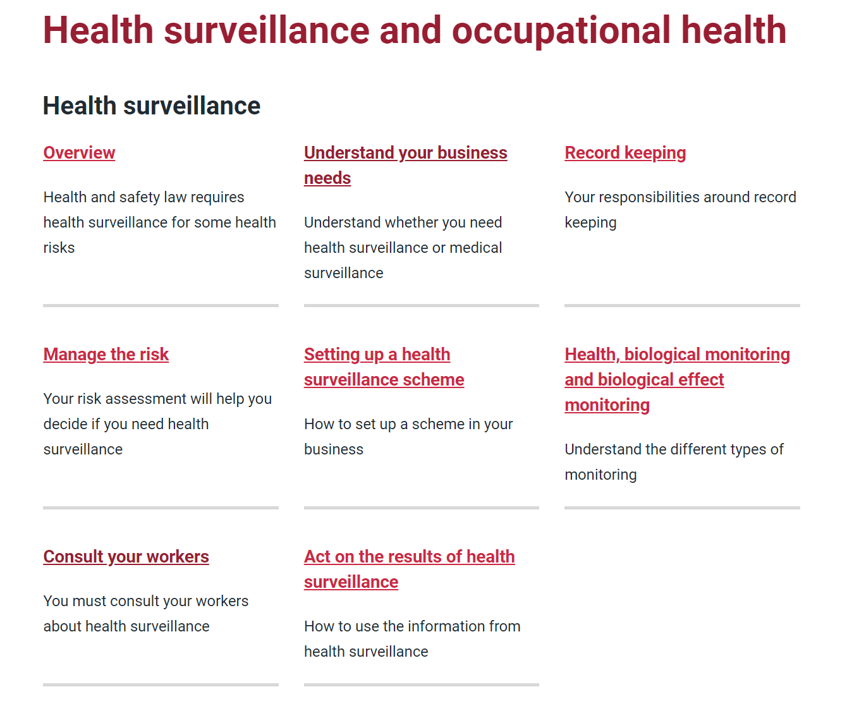
www.hse.gov.uk/health-surveillance/

Slide 22
Summary
Health surveillance allows early identification of work-related ill health so employers can manage risk (both at individual and group levels)
Compliments system of control
Occupational health professionals are needed to provide competent health surveillance of adequate quality
Health surveillance is an important process that needs to be performed correctly

Slide 23


