Slide 1
NHS Health at Work Network ‘Celebrate, Share, Inspire’
Hilary Winch
Network Chair

Slide 2
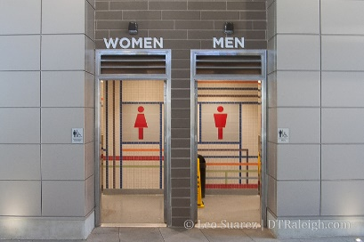
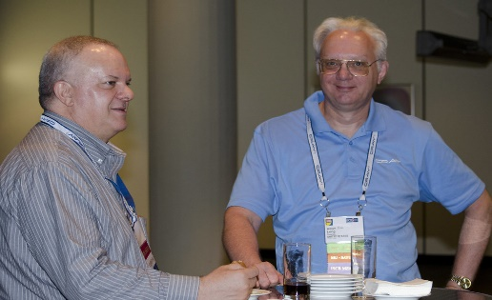
Welcome
Notes:
Any fire alarm
Facilities / breaks
Endeavour to keep to time
Time for question – but use the microphone
Take advantage of networking in break times
Visit our supporters - flow into thanking supporters

Slide 3
Thank you to our supporters

Slide 4
A year on…….. Highlights of work undertaken
Measles
Pertussis
Good practice guide
Health surveillance documents commenced
Consultation response
Working better
Fit note
G2 user group discussions
HSE – Entonox guidance
National School – apprenticeship discussions
NHS employers – exploring pressures of peak demand
NMC – OH verification
SEQOHS – new standards review
NHSE Growing OHWB – continues to make strides / local outputs
Network developed ‘NHS OHPRAS’
Notes:
Range of activities that been involved in – happy to give specific details at later stage on an individual basis.
Most importantly – Last year our conference was entitled Growing OHWB – into action. The momentum of this programme continues to make strides – which was the reason for developing our recognition and achievement awards known as our very own NHS OHPRAS. The submissions of practice were excellent and all could have been worthy winners. But it was great to celebrate these last evening and going forward will share aspects of their practice to inspire us all

Slide 5
Congratulations to our NHS OHPRAS Winners!

Slide 6
Congratulations to our NHS OHPRAS Winners!

